Slide 1

Electrochemical Nitrate Reduction to Ammonia on Facet-engineered Epitaxial Perovskite Oxide
Presenter: Jun Beom Hwang
Advisor: Prof. Sanghan Lee
Notes:
Good afternoon. My name is Jun Beom Hwang from GIST. First of all, it’s truly an honor to be here and to have the opportunity to present our work. The title of this talk is “Electrochemical Nitrate Reduction to Ammonia on Facet-engineered Epitaxial Perovskite Oxide”.

Slide 2

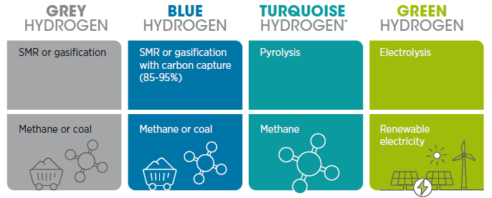
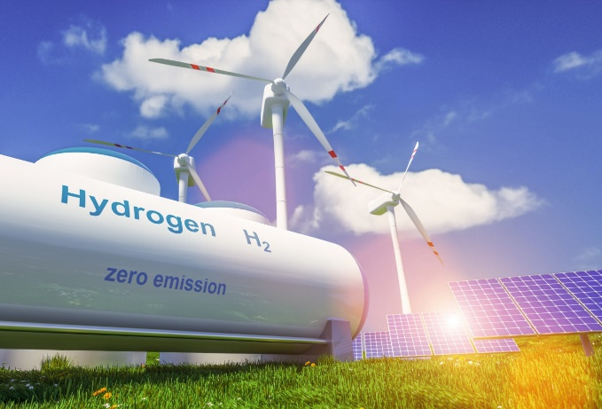
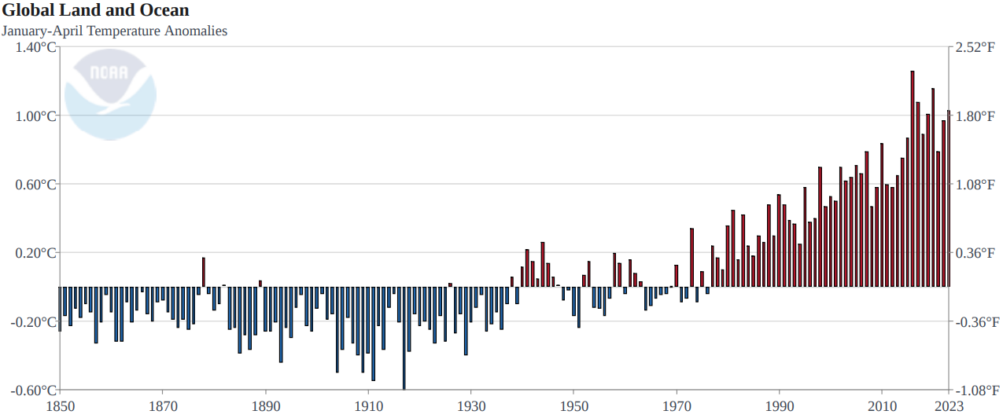
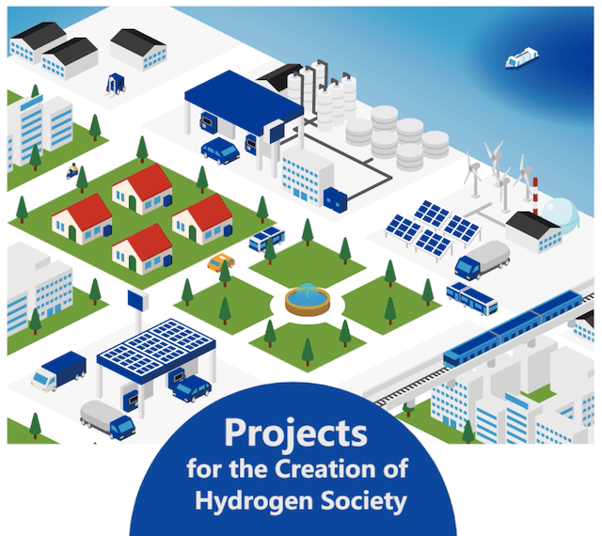
Introduction
Method
Results
Summary
World Climate Crisis & Carbon Neutral Society
Green hydrogen, International Renewable Energy Agency, 2020
Ref. What’s Next for Corporate Sustainability in a Post-COVID19 World
Ref. NOAA National Centers for Environmental Information, Monthly Global Climate Report for April 2023
Notes:
Recent 3years, we suffer from COVID 19 pandemic and lost many things. This is kind of wave to our society. However, we overcome this situation via wearing mask and invented vaccine. Sequentially, we encountered Recession phenomena in various field. But as you know already, there are more big wave is coming and almost done in out environment. This is Climate change.
As you can see this figure, the temperature of earth is rapidly increasing and it arouses global warming and climate change. In order to slow down this situation, Hydrogen was addressed for new generation energy source to operate our society. There are four kind of hydrogen. Ultimately, we must have to produce green hydrogen for our society without CO2 emission. Lost of countries establish their own tactics to go Carbon zero society and finally net zero society.
In order to address the rapid climate change, achieving carbon neutrality is of utmost importance. As many of you know, starting from the Kyoto Protocol and now the Paris Agreement, this importance is being taken seriously beyond the national level to the global level.
Among the many possible ways to achieve the goal of carbon neutrality, a hydrogen society is the prime candidate.
Our ultimate goal is to realize a hydrogen society by supporting the production, storage, and transportation of hydrogen.

Slide 3
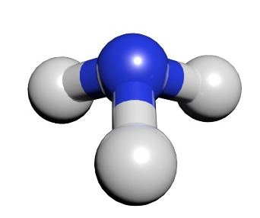
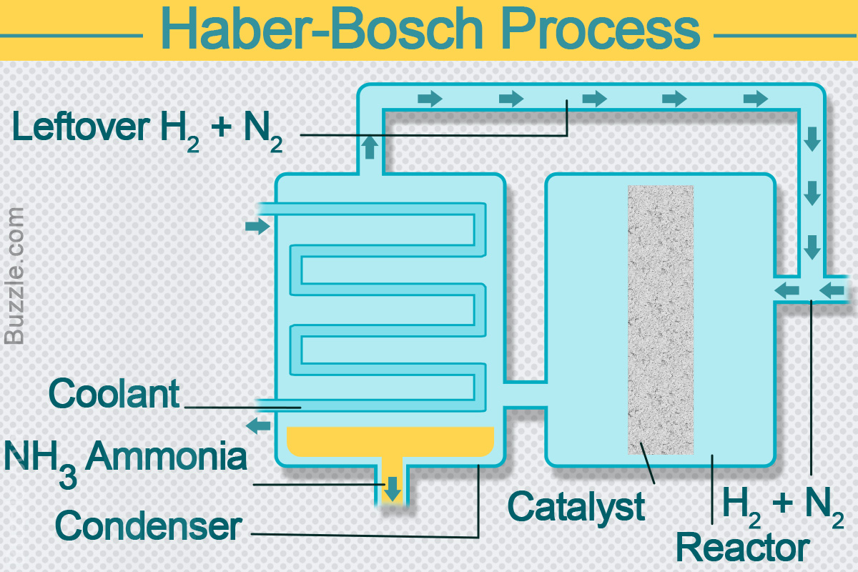
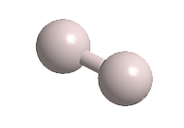
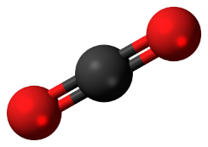
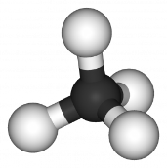
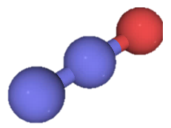
Introduction
Method
Results
Summary
Ammonia: Green hydrogen carrier
H₂
NH₃
Carbon-free energy carrier (hydrogen storage carrier)
→ High hydrogen content
& low liquefying temperature & pressure
Essential chemical of industry and agriculture
→ Production, transportation, and utilization infrastructure are extensively established.
Ref. sciencestruck.com/explanation-of-haber-bosch-process-for-ammonia-production
Significant energy consume (400-500 ℃ / 10–30 MPa)
Emitting significant amounts of greenhouse gases
CO₂
CH₄
N₂O
Notes:
In this respect, the development of hydrogen carriers is essential, and ammonia could be a potential alternative.
Ammonia shows high available hydrogen contents per molecule, and mild liquefying conditions.
Also, it can be useful in various industries and agriculture.
Nowadays, ammonia is mainly synthesized by the Harbor-Bosch method. However, a significant amount of energy is consumed during this process with the production of considerable greenhouse gases because of the use of high temperature and pressure.

Slide 4
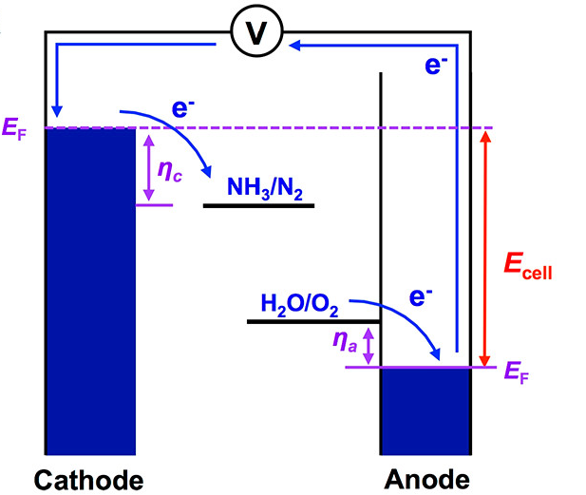
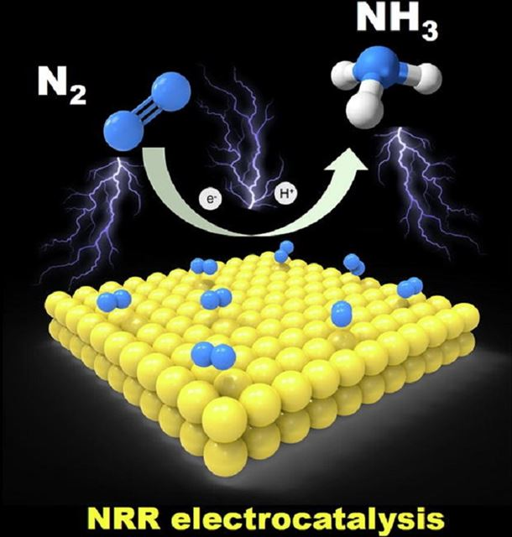
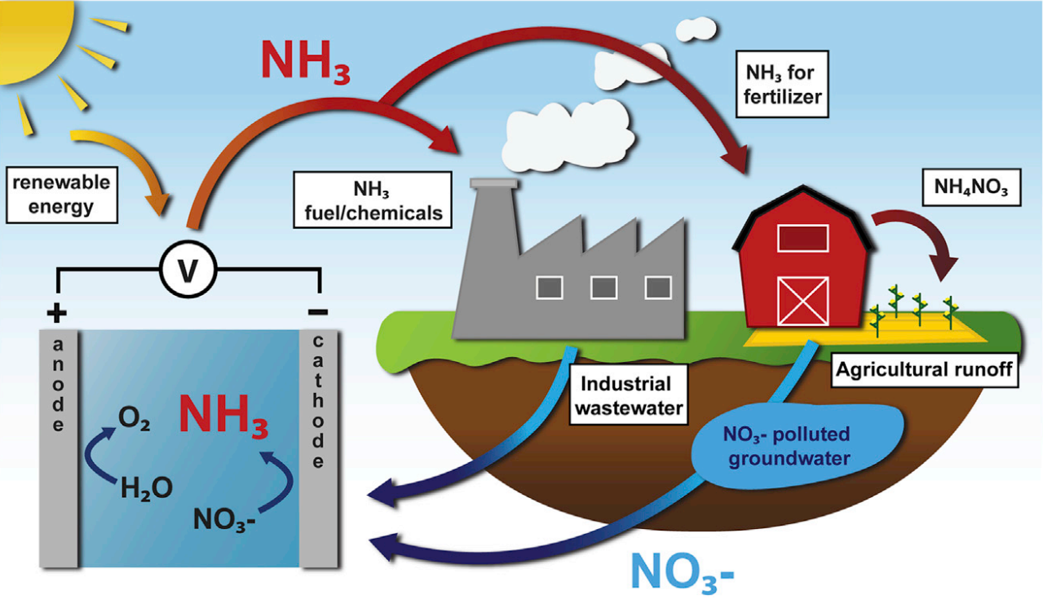
Introduction
Method
Results
Summary
Electrochemical reduction reaction for Ammonia production (N₂ vs. NO₃⁻)
Nitrogen (N₂) reduction – N₂RR
Nitrate (NO₃⁻) reduction – NO₃RR
vs.
ACS Energy Lett. 2020, 5, 6, 1834.
10.1016/j.mattod.2019.03.002
Ref. Joule 5, 290–294
Non-polarity of N₂ molecule: Low solubility
High fracture energy of N₂ (941 kJ mol⁻¹)
Slightly positive reduction potential vs. hydrogen reduction
Higher solubility of NO₃⁻ in aqueous electrolyte
Smaller dissociation energy of NO₃⁻ (204 kJ mol⁻¹)
NO₃⁻ polluted water to NH₃ (Upcycling)
Electrochemical Nitrate Reduction Reaction as a promising alternative to Nitrogen Reduction Reaction
Notes:
Recently, many reports were introduced the topic of electrochemical nitrogen reduction to ammonia. It is feasible way to produce green ammonia but it has severe limitations for high efficiency, such as --- --- ---.
Rather than nitrogen reduction, nowadays nitrate reduction has great advantages as compare to nitrogen reduction. --- --- --
So EC NO3RR is a promising alternative to N2RR
I mainly deal with this reaction.

Slide 5
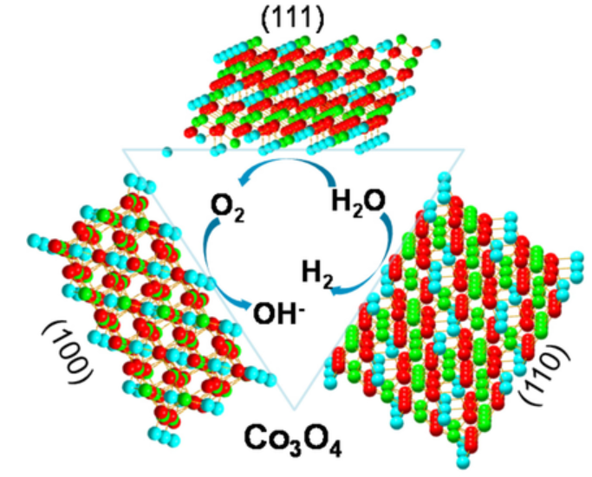
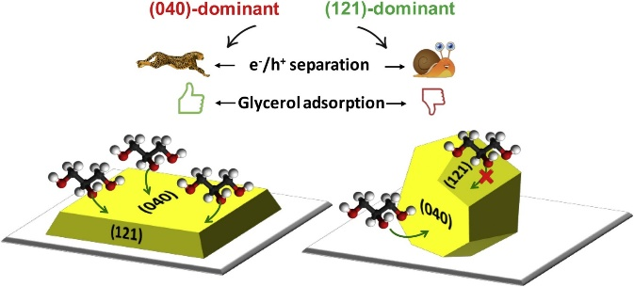
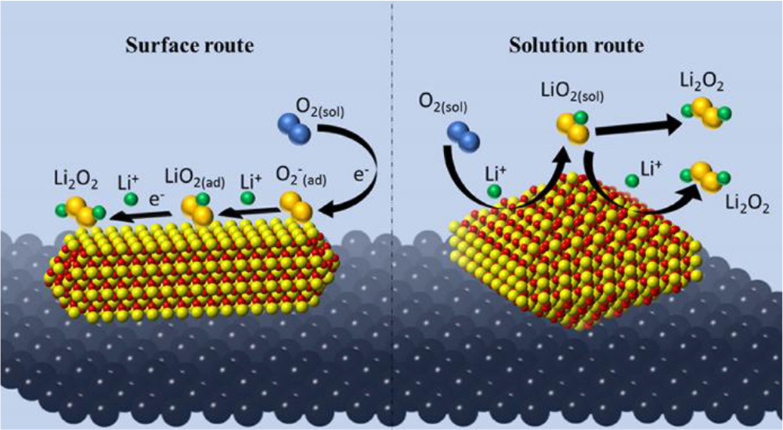
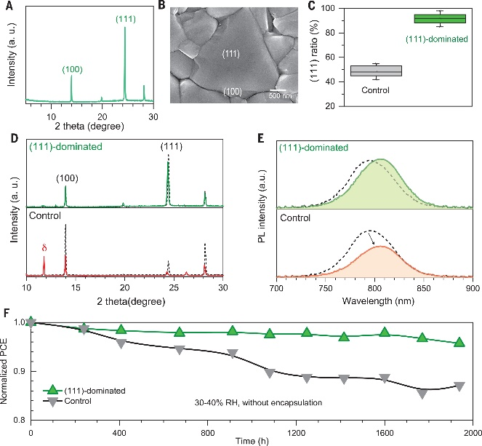
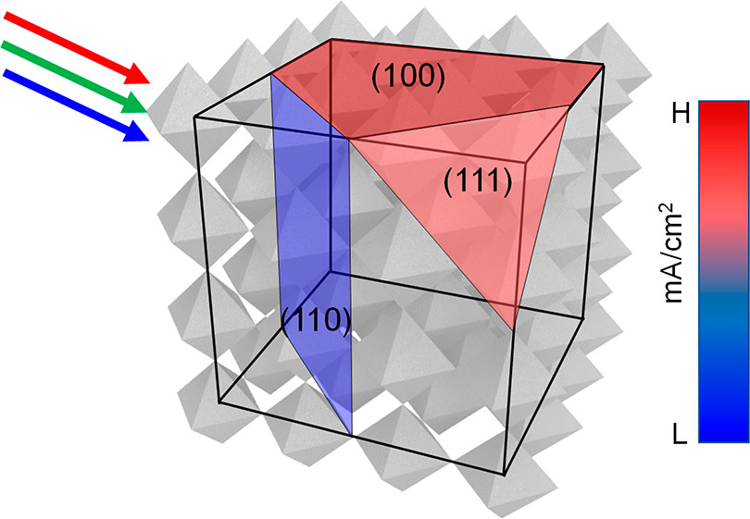
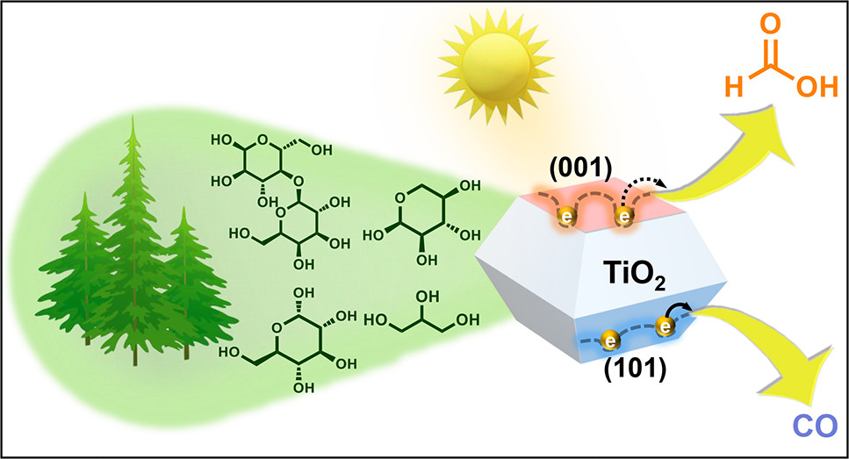
Introduction
Method
Results
Summary
Studies on facet-engineered catalysts
OER, HER, Biomass Oxidation
Battery, Solar-cell
ref. J. Am. Chem. Soc. 2019, 141, 2832-12838
ref. Appl. Catal. 2020, 278 119303
ref. ChemElectroChem 2018, 5, 1080-1086.
ref. J. Am. Chem. Soc. 2022, 144,21224-21231
ref. Science, 2023, 379, 173-178.
ref. Science, 2023, 379, 173-178.
However, no studies on facet-engineered NO₃RR. It caused by
  1. Poly crystalline nature of reported materias
  2. No suitable model system
Suitable catalyst + Facet control
“ Thin-film Epitaxy ”
Notes:
In order to operate NO3RR system, we need proper catalyst and also adequate techniques to modulate catalytic performance.
I focused on Facet-engineering to modulate electrochemical properties of catalysts. Previous researches have been reported for OER, HER, Biomass oxidation. As well as Battery and Solar cell. Each different facet has different function and it addresses the selectivity of materials. So, facet engineering can modulate catalytic performance as well as Redox system.
However, there are no research in NO3RR system. The fine way to study facet-dependent catalytic performance, we need thin-film epitaxy techniques.
Thin-film epitaxy can provide single crystalline nature materials for each different crystal orientation. It is one of the best way to study the relationship in between facet and NO3RR
So, I conducted this research in this aspect and examined this in this work.
Previous researches have been tried to control the microenvironments of catalyst surface, such as using hydrophobic catalysts and Li-based system to suppress HER.
Actually, they shows high faraday efficiency of ammonia productions. However, these methods have the practical problem of demanding new optimization of existing electrolysis and catalytic systems.

Slide 6
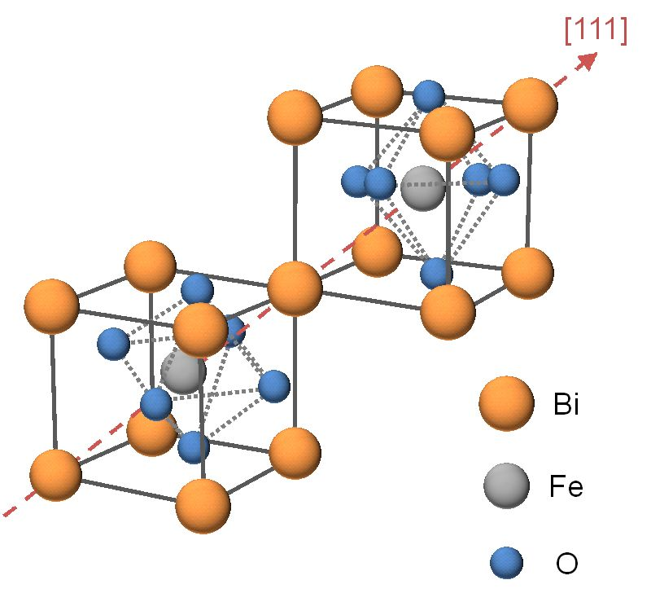
Introduction
Method
Results
Summary
Facet-engineered BiFeO₃ as a model system
Bismuth Ferrite (BiFeO₃)
Crystallographic Orientations
Polarization direction
Rhombohedral structure (R3m)
a = 3.96A , a=89.375° (pseudo-cubic)
Crystalline anisotropic properties
Intrinsically enriched non-stoichiometry oxygen (O_{v})
Adjustable (unique) structure & composition
NO₃RR electrochemical catalyst
Along different crystallographic orientations,
Crystal facet engineering
Different ferroelectric switching
Notes:
I chose BiFeO3 perovskite oxide materials which has --- --- ---
Also recently it reported as a good NO3RR catalyst.
I controlled the crystallographic orientation to study the unique characteristics dependent with orientations.

Slide 7
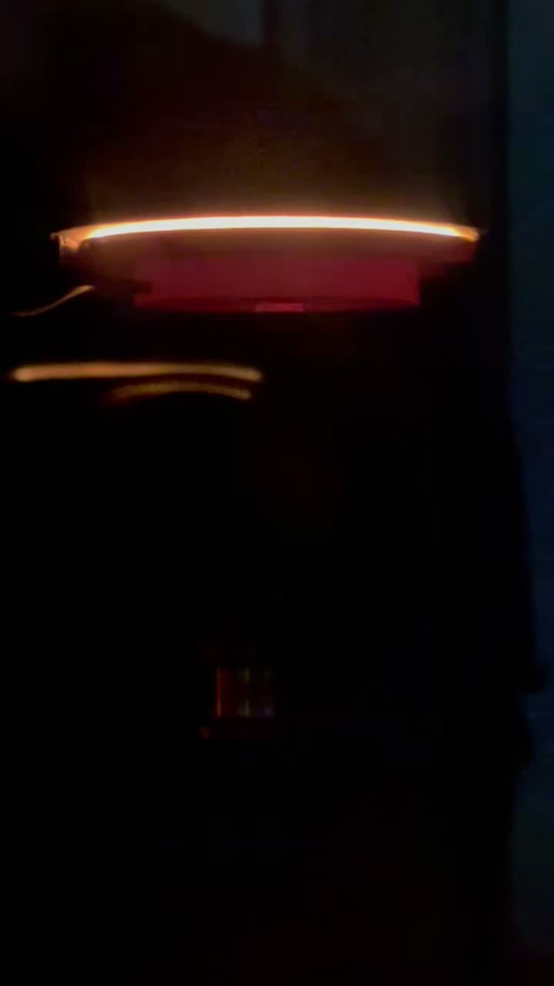
Introduction
Method
Results
Summary
Epitaxial BiFeO₃ thin-film via Pulsed-Laser Deposition (PLD)
Sample
Sample structure
BFO/SRO/STO (100)
BFO/SRO/STO (110)
BFO/SRO/STO (111)
Pulsed laser
BFO (40nm)
BFO (40nm)
BFO (40nm)
SRO (40nm)
SRO (40nm)
SRO (40nm)
SRO
STO (001)
STO (110)
STO (111)
BFO
target stage
1.4 %
3.96 Å
<Pulsed Laser Deposition system >
0.4 %
3.91 Å
c
High density, crystalline thin film growth: Adequate to grow epitaxial thin film
In-situ heterojunction formation using target rotation system
Easy to control thickness (pulsed dependent)
3.905 Å
a
BiFeO₃
SrRuO₃
SrTiO₃
Conducting & buffer layer
Notes:
In order to produce epitaxial thin-film, we chose PLD system. PLD system has own special characteristic such as - -- -. More importantly, it can fabricate thin-film to with maintaining stoichiometry of materials. That’s because we can obtain high-quality epitaxial thin film.
Right sections shows the sample structure for as-prepared samples. We used SrTiO3 material as a substrate to modulate orientation as 001 110 111. and SrRuO3 layer was adopted as a conducting layer for charge transport and buffer layer to minimize lattice mismatch with STO-BFO.

Slide 8
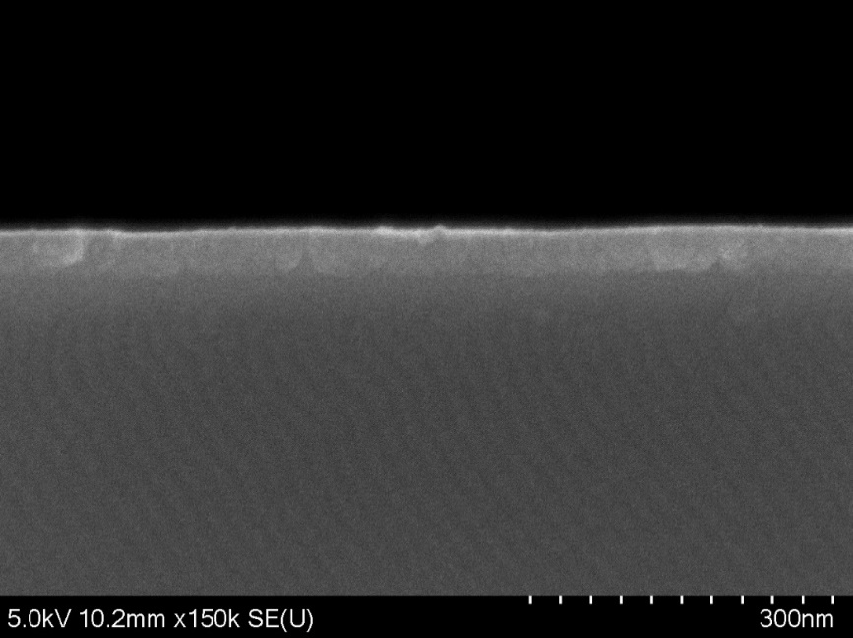
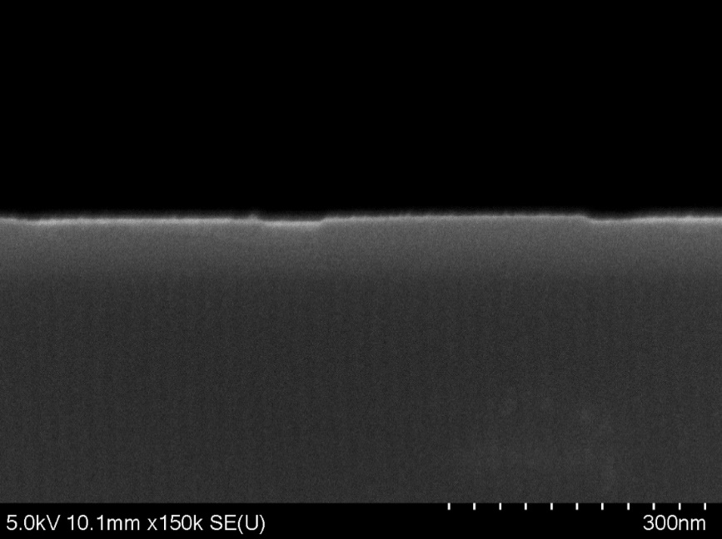
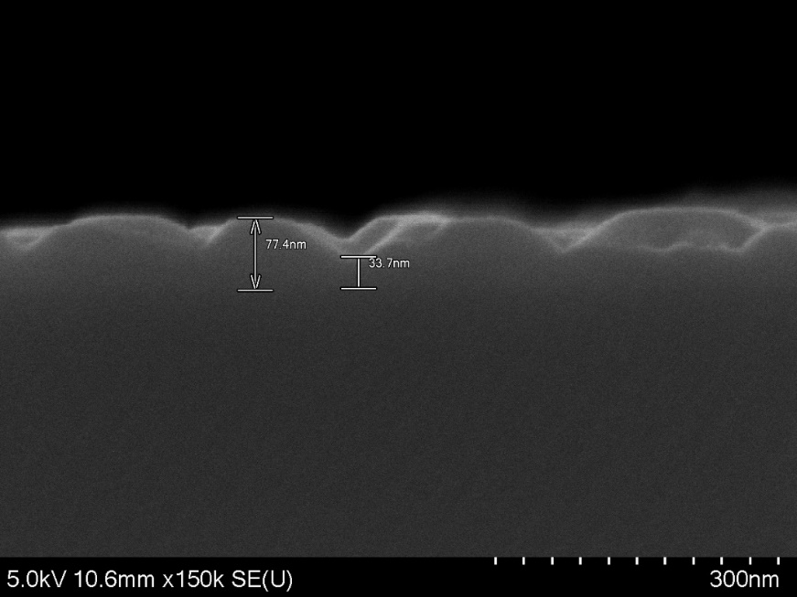
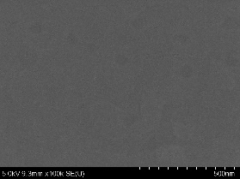
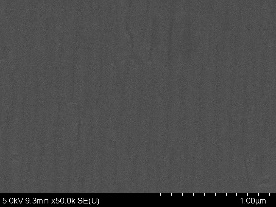
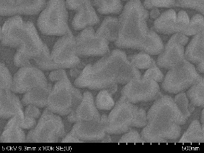
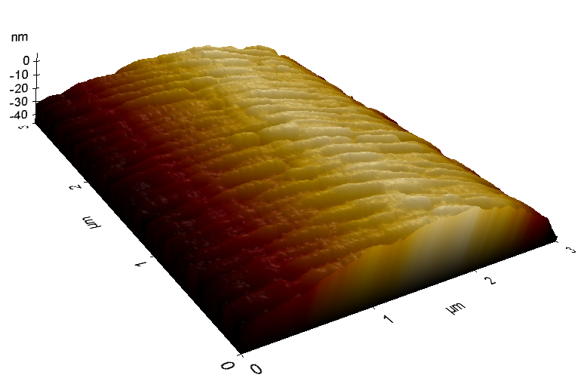
Introduction
Method
Results
Summary
SEM: morphology, thickness / AFM: surface topology
BFO(001)
82nm
BFO(110)
75nm
BFO(111)
77nm
SRO(001)
SRO(110)
SRO(111)
STO(001)
STO(110)
STO(111)
30 nm
30 nm
30 nm
Notes:
In order to check the morphology, thickness and topology of as-prepared samples, we conducted SEM and AFM analysis. We controlled the thickness of BFO and SRO to 40nm each. It is because to remove the thickness effect while NO3RR.
Interestingly, the surface of each samples has different feather. 001 has worm like smooth surface but 110 111 has directional and island like structures were founded. It is deduced that 001 has non-polar surface So it slighltly influenced to growth condition but 110 111 has polar-surface so it affect to growth condition and it arouses island formation.

Slide 9
Introduction
Method
Results
Summary
Out-of-plane θ-2θ XRD patterns
STO (002)
STO (110)
STO (111)
STO (220)
BFO (001)
STO (001)
SRO (002)
STO (003)
BFO (110)
SRO (110)
BFO (002)
SRO (220)
BFO (220)
BFO (111)
BFO (003)
BFO/SRO/STO (100)
BFO/SRO/STO (110)
BFO/SRO/STO (111)
BFO (40nm)
BFO (40nm)
BFO (40nm)
SRO (40nm)
SRO (40nm)
SRO (40nm)
STO (001)
STO (110)
STO (111)
BiFeO₃ thin films with different crystallographic orientations were grown epitaxially.
Notes:
First of all, in order to check it is well prepared or not, we checked XRD analysis. As you can see, 001 110 111 result shows single crystalline nature of XRD patterns and there are no formation of secondary phase of materials. It means as-prepare samples were grown epitaxially.

Slide 10
Introduction
Method
Results
Summary
Ammonia quantitation
Notes:
Using this materials, we evaluated NRR performance. prior to this, we draw calibration curves and it shows almost reached 100% accuracy. Using this curve, we calculated the production yield and faradaic efficiency.

Slide 11
Introduction
Method
Results
Summary
LSV curves & NRR performance
0.1M KOH + 0.1M KNO₃
Current density (mA/cm₂)
Ammonia yield (μg h⁻¹ cm⁻²)
Faradaic efficiency (%)
BFO/SRO/STO (100)
BFO/SRO/STO (110)
BFO/SRO/STO (111)
BFO/SRO/STO (100) with NO₃⁻
BFO/SRO/STO (110) with NO₃⁻
BFO/SRO/STO (111) with NO₃⁻
(001)
(110)
(111)
Applied potential (V vs. RHE)
Sample (at -0.6 V vs. RHE)
Notes:
In order to compare the EC performance for as-prepared samples, I conducted LSV analysis and it shows that 110 shows superior current density as well as on set potential for NRR.
Sequentially, we did 2hr NRR performance test at -0.6 V vs. RHE. As you can see, 110 exhibits highest yield and faradaic efficiency.
It means, 110 has high performance NRR selectivity and sensitivity.
More interestingly, 001 and 111 shows similar but 110 shows better performance. So, we want to know this situation and elucidate the performance dependency.

Slide 12
Introduction
Method
Results
Summary
LSV curves (before & after rxn.)
Current density (mA/cm₂)
Current density (mA/cm₂)
Before rxn. (100)
Before rxn. (100)
Before rxn. (110)
Before rxn. (110)
Before rxn (111)
Before rxn (111)
After rxn. (100)
After rxn. (100)
After rxn. (110)
After rxn. (110)
After rxn. (111)
After rxn. (111)
Applied potential (V vs. RHE)
Applied potential (V vs. RHE)
Notes:
Followed by previous slide, we evaluated LSV curves for before and after 2hr reaction. as you can see, after reaction, the performance were degraded for all samples. It can be deduced that the epitaxial structure of BFO were collapsed while reaction due to the reduction of Bi or Fe. Another possibility is some materials were deposited on catalyst surface and it influence to performance.
Interestingly, in lower potential region, the 111 shows increased current density as compare with 001 110. but in high potential region, it also shows degradation tendency. In this part, we will figure it out what happens in between them with XPS and FR-IR analysis.

Slide 13
Introduction
Method
Results
Summary
Out-of-plane θ-2θ XRD, Raman analysis (before & after rxn.)
Before rxn.
Before rxn.
Before rxn.
STO (002)
After rxn.
STO (110)
After rxn.
STO (111)
After rxn.
STO (001)
STO (220)
BFO (001)
STO (003)
SRO (110)
SRO (002)
BFO (110)
Log intensity (a.u.)
Log intensity (a.u.)
SRO (220)
Log intensity (a.u.)
BFO (002)
BFO (111)
BFO (220)
BFO (003)
BFO/SRO/STO (100)
BFO/SRO/STO (110)
BFO/SRO/STO (111)
★ STO
■ BFO
★ STO
■ BFO
★ STO
■ BFO
★
★
★
★
★
★
★
★
★
■
intensity (a.u.)
★
■
★
★
★
■
★
★
intensity (a.u.)
★
★
intensity (a.u.)
★
■
Raman shift (cm⁻²)
Raman shift (cm⁻²)
Raman shift (cm⁻²)
Notes:
As we expected, after 2hr reaction, we cannot define the crystallographic structures of BFO in all directions. Additionally, Raman spectra shows the removed tendency same with XRD results. It seems that BFO were damaged while NRR due to the reduction of Bi and Fe and it arouses structural collapse. Another possibility is some amorphous nature of materials were formed on catalyst surface and it interferes the detection of XRD and Raman.
However, the CA shows stable current density. It means that the crystallinity does not dramatically influence to NRR performance.
It is quite interesting that why it is happening and what happens in on surface.
In near future, I will discover this points

Slide 14
Introduction
Method
Results
Summary
Using a pulsed laser deposition method, we fabricated an domain-engineered-Epitaxial perovskite thin-film for NO₃⁻RR.
Through various analysis, we found morphology changes and material properties which controlled with crystal domain.
It showed an excellent ammonia yield of 221.54 μg h⁻¹ cm⁻²
and achieved almost 100% of faradaic efficiency.
Compared to other studies, this is a superior result.
Among the (001), (110), and (111), the (110) showed the highest efficiency. This is interesting because it shows better performance than (111), which is assumed to have a more active surface area.
Ammonia yield (μg h⁻¹ cm⁻²)
Faradaic efficiency (%)
(001)
(110)
(111)
Sample (at -0.6 V vs. RHE)

Slide 15



Thank you for your attention
Presenter: Jun Beom Hwang
pluto134340@gm.gist.ac.kr

Slide 17
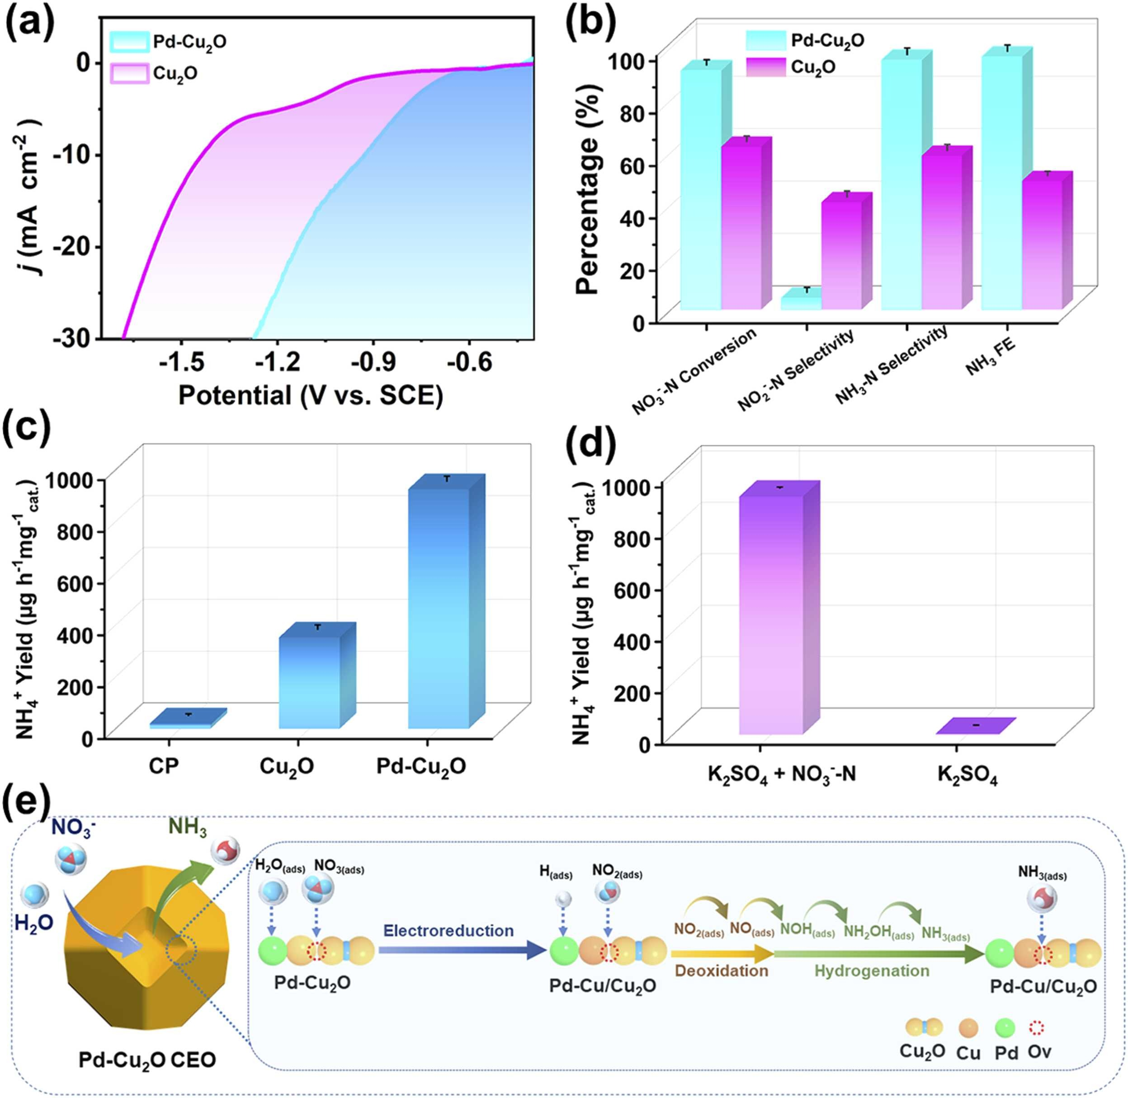
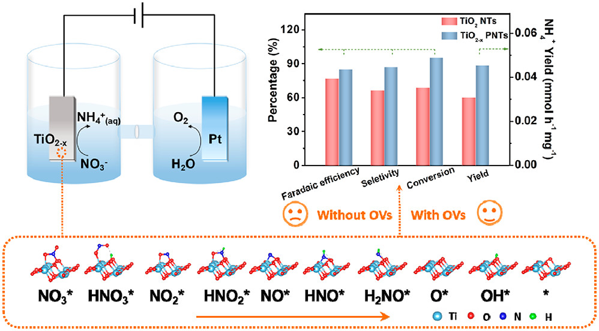
Oxygen vacancy engineering for high-performance NRR
Case-1
Case-2
Applied Catalysis B: Environmental 306 (2022) 121094
Applied Catalysis B: Environmental 306 (2022) 121094
Oxygen atoms of NO₃⁻
O_{v} sites
NRR intermediates
O_{v} sites
Adsorption of NO₃⁻
N-O bond
Formation of by-products
Thermodynamic barrier

Slide 18
Critical Parameters for Thin-Film Formation
Substrate Temperature (T_{S})
Melting temperature of deposition materials (T_{M})
Deposition rate
Surface mobility of atoms (and clusters)
Base pressure
Working pressure
Substrate surface energy (γ_{SV})
Interfacial energy (γ_{fs})
Contaminants
Film thickness
Crystal structure of the surface
Laser energy (energy density)

Slide 19
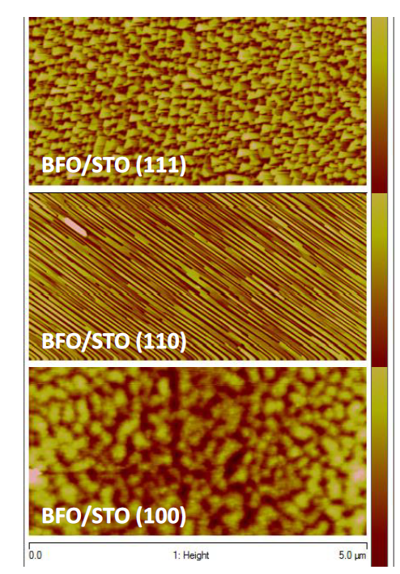
Epitaxial stabilization is also strongly associated with the surface energy and structural continuity resulted from BFO and the STO substrates.
Here, STO(100) has non-polar surface, while -(110), and –(111) have polar surface. It has been reported a distinct island nucleation kinetics in different surface polarities, wherein, the early stage island nucleation contributes to the final surface morphology of the film.

Slide 20


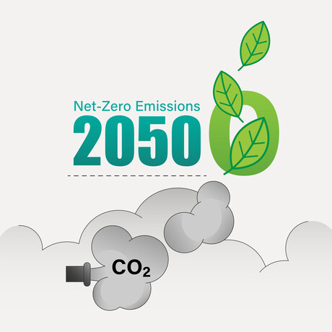

ref. Net zero, carbon neutral, carbon negative... what do they mean exactly?

Slide 21
Introduction
Method
Results
Future plan
LSV curves & NRR performance
0.1M KOH + 0.1M KNO₃
Current density (mA/cm₂)
Ammonia yield (μg h⁻¹ cm⁻²)
Faradaic efficiency (%)
BFO/SRO/STO (100)
BFO/SRO/STO (110)
BFO/SRO/STO (111)
BFO/SRO/STO (100) with NO₃⁻
BFO/SRO/STO (110) with NO₃⁻
BFO/SRO/STO (111) with NO₃⁻
(001)
(110)
(111)
Applied potential (V vs. RHE)
Sample (at -0.6 V vs. RHE)

