Slide 1
GCIM 2023 Microenvironmental Control Using Exchange Ionomers for Improving Photoelectrochemical N₂ to NH₃ Conversion Efficiency
Presenter: Yejoon Kim
Advisor : Prof. Sanghan Lee
Notes:
Good afternoon. My name is Yejoon Kim from GIST. First of all, it’s truly an honor to be here and to have the opportunity to present our work. The title of this talk is “Microenvironmental Control Using Exchange Ionomers for Improving Photoelectrochemical N2 to NH3 Conversion Efficiency”.

Slide 2
Introduction
Methods
Results
Summary
Notes:
My talk will follow this order, introduction, brief methodology, results, and finally summary.

Slide 3
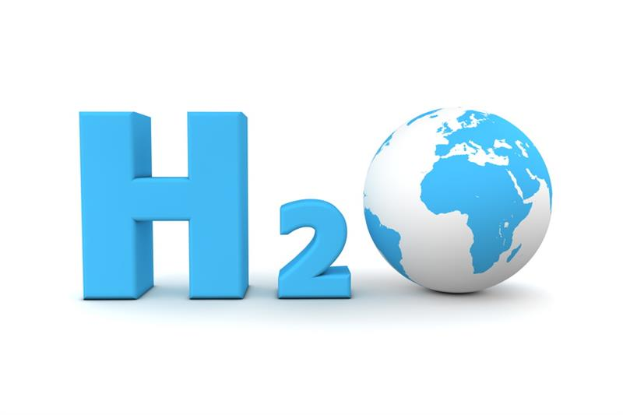
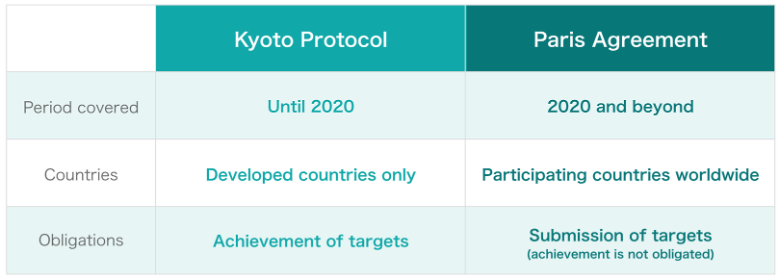
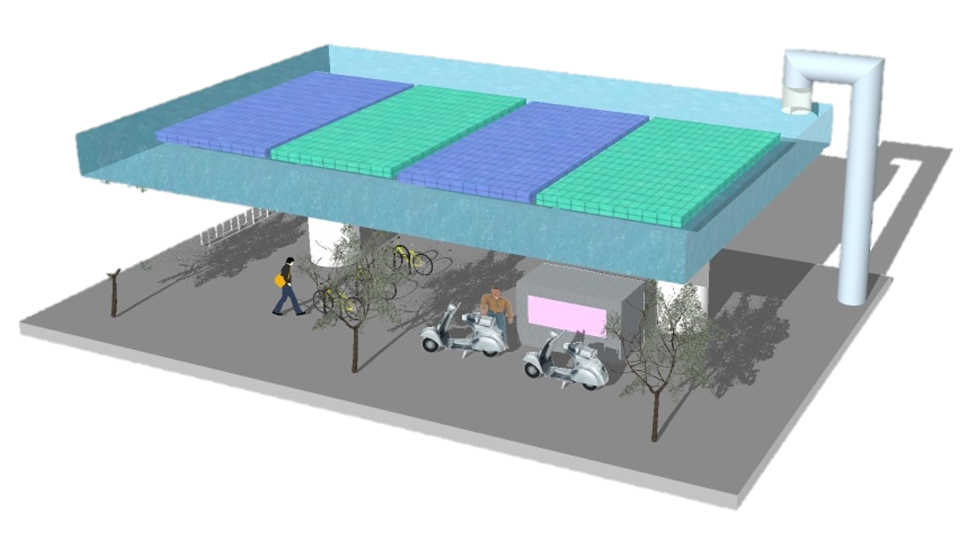
Introduction
Carbon neutrality
“ Ultimate goal ⇒ Hydrogen (H₂) society ”
ref. Hyundai Motor Group, Hydrogen Infrastructure, Vision for Hydrogen: Part 3.
ref. For Earth, For Life, About Carbon Neutrality, Our Common Goal with the World
Notes:
In order to address the rapid climate change, achieving carbon neutrality is of utmost importance. As many of you know, starting from the Kyoto Protocol and now the Paris Agreement, this importance is being taken seriously beyond the national level to the global level.
Among the many possible ways to achieve the goal of carbon neutrality, a hydrogen society is the prime candidate.
Our ultimate goal is to realize a hydrogen society by supporting the production, storage, and transportation of hydrogen.

Slide 4
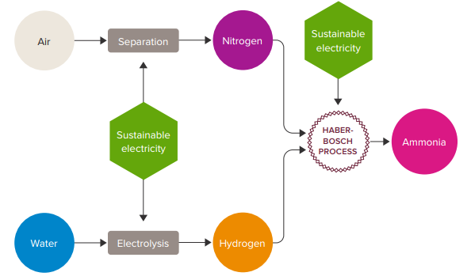
Introduction
Ammonia as a hydrogen carrier
ref. The Royal Society, The role of hydrogen and ammonia in meeting the net zero challenge.
H₂
NH₃
Carbon-free energy carrier (hydrogen storage carrier) → High hydrogen content
& low liquefying temperature & pressure
Essential chemical of industry and agriculture
Reactor
H₂
450 ºC
200 atm
NH₃
N₂
Significant energy consume!
Notes:
In this respect, the development of hydrogen carriers is essential, and ammonia could be a potential alternative.
Ammonia shows high available hydrogen contents per molecule, and mild liquefying conditions.
Also, it can be useful in various industries and agriculture.
Nowadays, ammonia is mainly synthesized by the Harbor-Bosch method. However, a significant amount of energy is consumed during this process with the production of considerable greenhouse gases because of the use of high temperature and pressure.

Slide 5
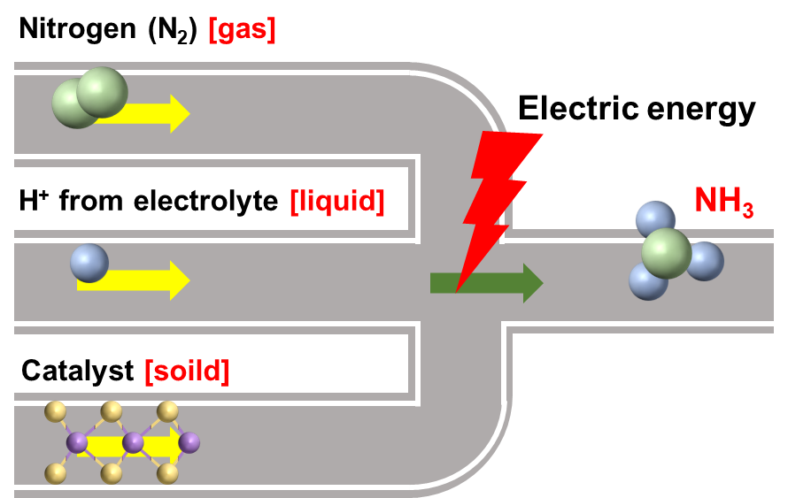
Introduction
Photoelectrochemical nitrogen reduction reaction
PEC NRR
(Solar energy)
Three-phase contact points
(TPCPs)
ref. ACS Energy Lett. 2020, 5, 6, 1834.
However, low production efficiency caused by
Non-polarity of N₂ molecule: Low solubility
Competitive HER at negative potential : Low selectivity (Less TPCPs)
Suitable catalyst + Microenvironmental control
“ Tailored catalytic layer ”
Notes:
Therefore, we thought photoelectrochemical nitrogen reduction reaction is of considerable interest because it can couple with the merits of the electrochemical system and photocatalytic system.
The synthesis process is nitrogen reduction inside an aqueous electrolyte, and there are no greenhouse gas generation. This system requires some energy consumption to run, but this can be overcome with photovoltaics. This means that ammonia can be produced eco-friendly by the photoelectrochemical systems.
However, it still shows low efficiency due to the characteristics of NRR. The nitrogen shows non-polarity molecular structure and it leads a low solubility in electrolyte. Also, the nitrogen reduction reaction has the slightly positive reduction potential versus competitive reaction such as HER, and it leads a low selectivity.
To overcome this limitation, we should understand the reaction coordinates of NRR and develop a tailored catalytic layer.
NRR is caused at the Three-phase contact points where gas nitrogen, liquid electrolyte, and solid catalysts intersect with electrical energy. In other words, to maximize NRR efficiency, we should control the these Three-phase contact points, and it should be a complex regulation controlling not only the catalyst but also the reaction microenvironment around the catalyst.

Slide 6
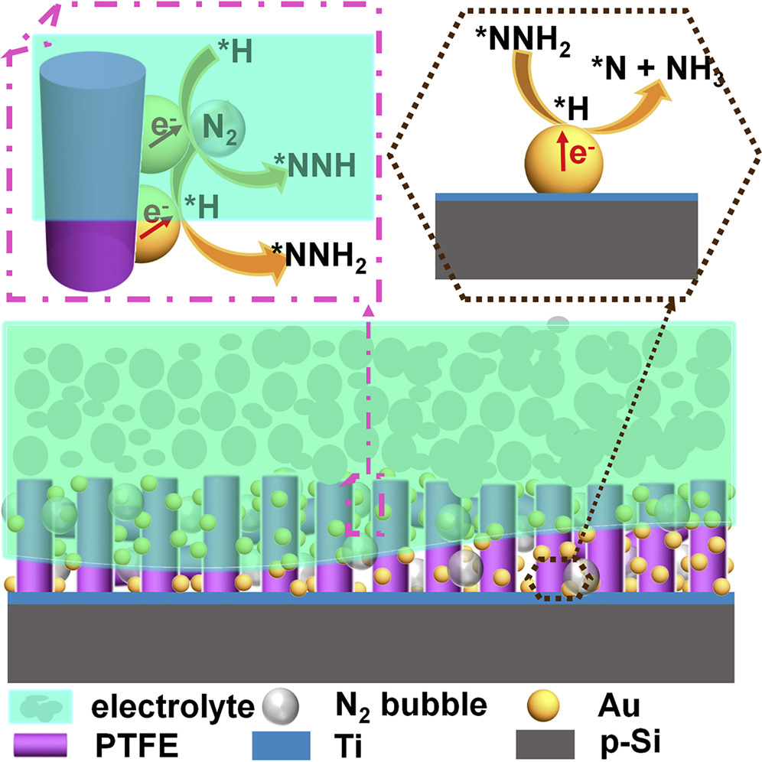
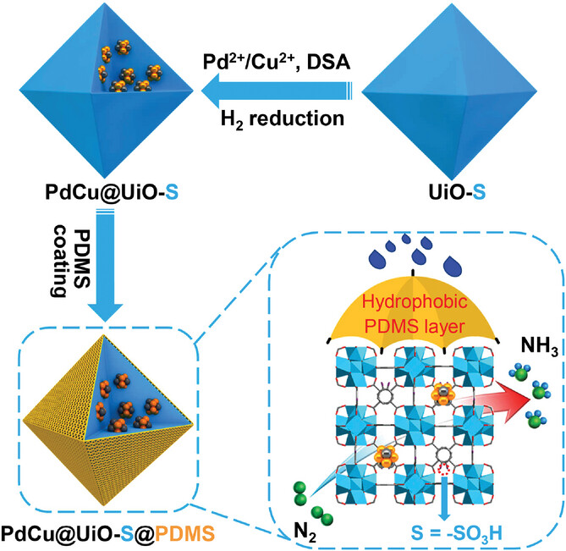
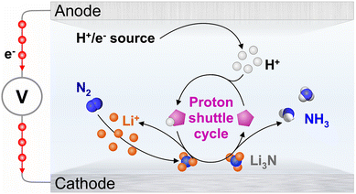
Introduction
Microenvironments control
Hydrophobic catalyst
Li-NRR
ref. Chem. 2019, 5, 3, 617-633.
ref. Adv. Mater. 2023, 35, 2210669.
ref. Energy Environ. Sci., 2023, 16, 1082-1090.
High demand for newly optimized catalysts and systems
Notes:
Previous researches have been tried to control the microenvironments of catalyst surface, such as using hydrophobic catalysts and Li-based system to suppress HER.
Actually, they shows high faraday efficiency of ammonia productions. However, these methods have the practical problem of demanding new optimization of existing electrolysis and catalytic systems.

Slide 7
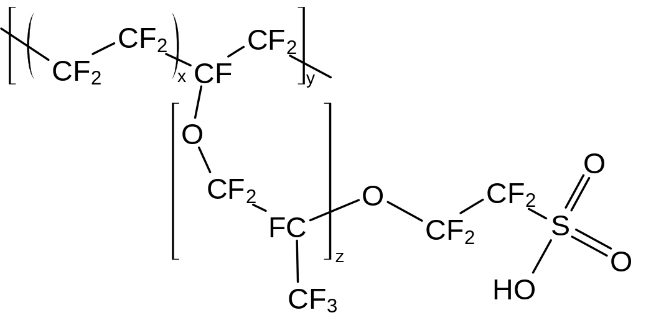
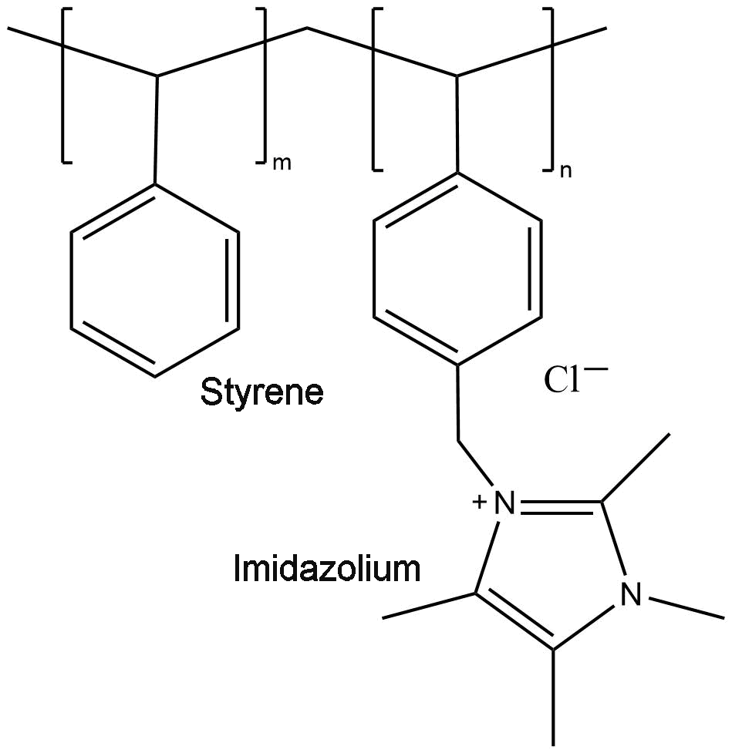
Introduction
Microenvironments control
Ionomer layers
Bulk electrolyte
Nafion
Cation (proton) exchangeable
C⁺
Ionomer
Sustainion
Anion (proton) exchangeable
Modified electrolyte
(pH, Chemical concentration)
Specific electrochemical reactions
A⁻
e⁻
“ Easy to handle or apply ”
Electrode surface
Notes:
So we developed a new PEC NRR system using nafion and sustainion ionomers. These ionomers exchange only specific ions due to fuctinoal groups. Nafion mainly exchange cations, and sustainions mainly exchange anions. Thus they can modify the pH or chemical concentration near by catalysts. It means that, they have some potential to microenvironment control.
Most importantly, it is easy to handle and apply to various materials. It can be easily coated using ionomer dispersion solutions.

Slide 8
Introduction
Microenvironments control
Ionomer layers
Tailored for NRR !!
No additional systems are required !
Catalysts
(w. the potential for NRR)
Notes:
This is a schematic of microenvironments control using ionomers.
First, we need a suitable catalyst, which has a potential for NRR.
After than, dropping and coating the ionomer dispersed solution on the surface of the catalysts.
During these simple processes, we expected to develop a tailored catalyst for NRR without an additional system.

Slide 9
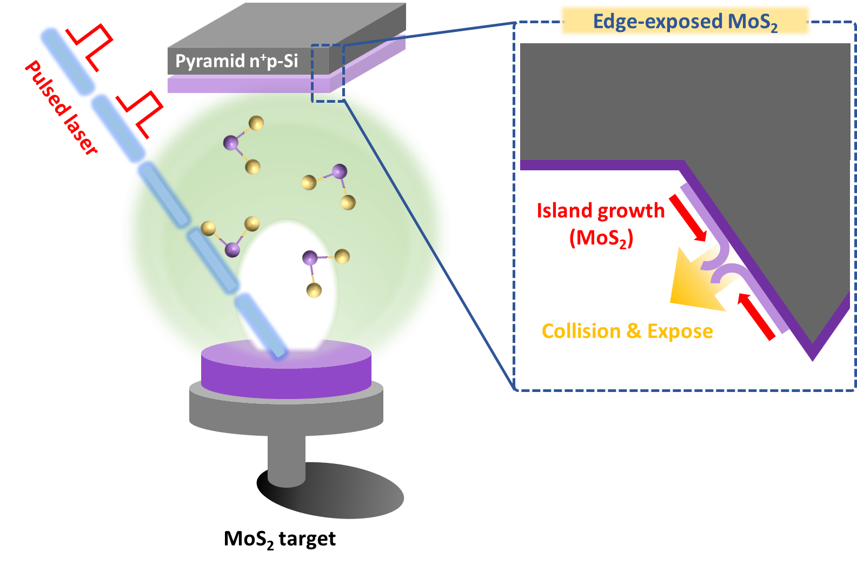
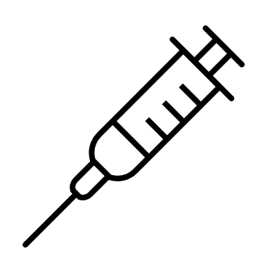
Methods
Pulsed laser deposition (PLD)
Ionomer drop casting
Ionomer
50 μL/cm²
Ionomer layer
MoS₂/Si
Notes:
Herein, we chose the MoS2 as a catalyst layer which has the NRR potential. Some previous computational simulation have reported that the edge-sites of MoS2 could act as an active sites of NRR.
Also MoS2 has been reported to be an excellent HER catalyst, so we expected to further clarify the effect of microenvironmental control.
Using the pulsed laser deposition method, we can fabricate edge-exposed form of MoS2 to centimeter scale.
Next, a specific volume of ionomer-dispersed solution was dropped on the MoS2 layer and dried for 2 hrs.

Slide 10
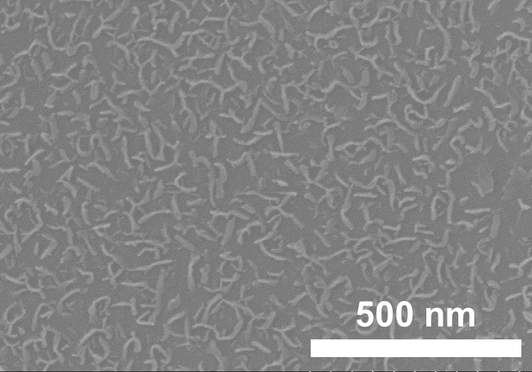
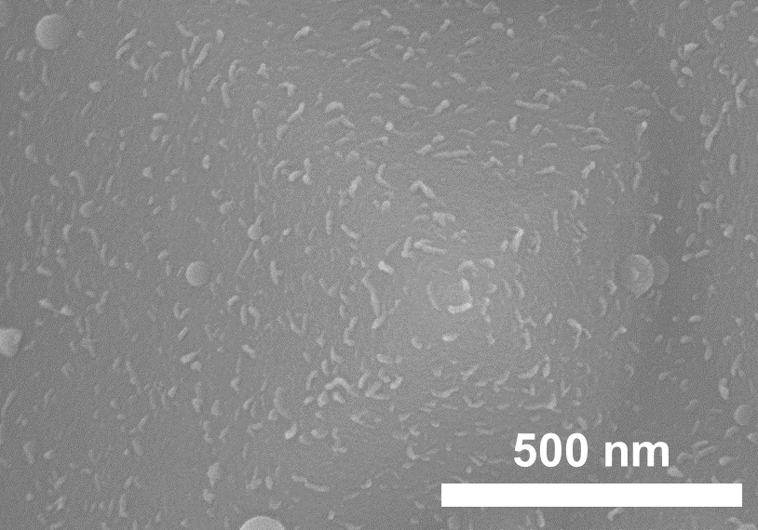
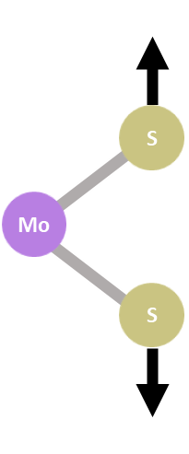
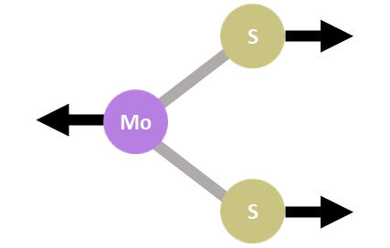
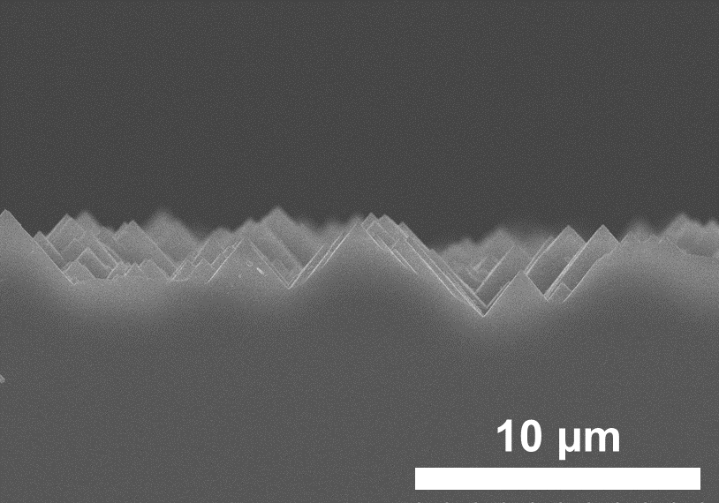
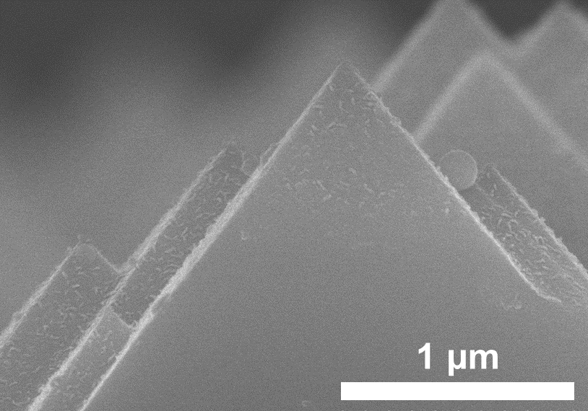
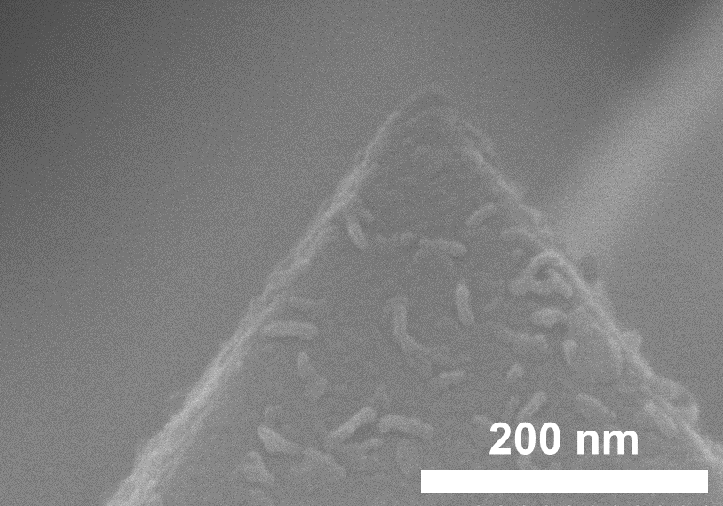
Results
Characterization
Raman spectroscopy
SEM (Scanning Electron Microscope) images
Edge exposed MoS₂ on planar Si
Edge exposed MoS₂ on pyramid Si
Pyramid Si
Notes:
This is a characterization of the edge-exposed MoS2 layer. The two distinct peaks in the Raman spectrum confirm the high-quality deposition of MoS2 on the silicon substrate.
In the SEM images, we can recognize a unique morphology of edge-exposed MoS2 and confirm a good coverage on the pyramidal structure of MoS2.
These pyramidal structures were used to maximize the photoelectrochemical performance of Si photocathodes.

Slide 11
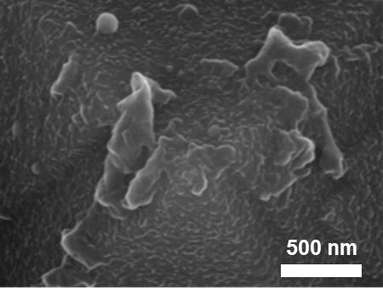
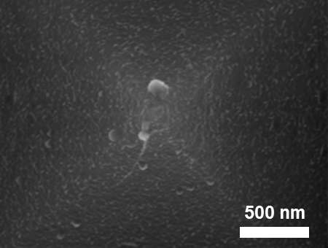
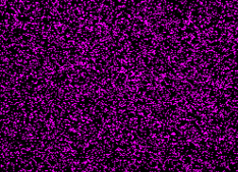
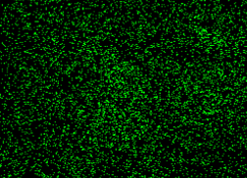
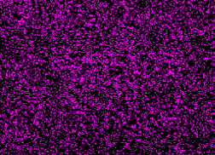
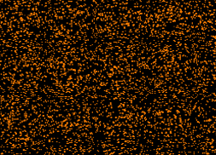
Results
Characterization
SEM & EDS images
UV-vis absorbance of ionomers
Nafion
Sustainion
Mo
F
Mo
Cl
Notes:
Next, Here is an SEM image of the ionomer as coated.You can see the results more clearly in the EDS image.
In the case of Nafion, you can see the fluorine in the molecule through the distribution, and in the case of Sustainion, you can see the chloride atoms through the distribution.
In Nafion's case, it's a bit of an anomaly, but if you check the EDS results, you'll see that it's evenly distributed.
Also, the fact that the morphology of the edge-exposed MoS2 is observed to be uniform, and the EDS spectra of the molybdenum atoms are uniform, suggests that there is no significant damage to the catalyst layer below when the ionomer is coated.
Furthermore, we measured the absorbance of the ionomers in visible light. It is important because, under the light conditions of PEC NRR, the visible light has the highest portion of solar light. If the ionomer layers affect on visible light absorption, the performance of overall system can degradaate dramatically.
However, the ionomer had a near-zero absorbance in the visible light region, suggesting that the ionomers are suitable for introduction into a PEC system.

Slide 12
Results
NRR performance
Edge-exposed MoS₂
Planar
Edge-exposed
Notes:
First, we investigated the effect of edge exposure. Compared with the planar type of MoS2, The edge-exposed MoS2 shows higher ammonia yield and faraday efficiency over whole potential region.
Also, we verified the -0.3 voltage shows the highest NRR activity.
However, they show still low yields and poor efficiencies. This is because HER reaction affect more strongly than NRR as I mentioned.

Slide 13
Results
NRR performance
Ionomer / MoS₂ / Si
Sustainion forms a higher water concentration than Nafion. → Higher current suppression in Nafion.
However, at catalyst surface junctions, sustainion forms more NRR favorable microenvironment.
Relatively high N₂ concentration Adequate proton supply
Notes:
So, we conduct the microenvironment control using two ionomers with various concentration.
In linear sweep voltammetry profiling, Nafion shows higher inhabitation of HER.
However, the sustainion shows higher ammonia yields and efficiencies over whole concentration region, and especially at 0.03 wt.% of sustainion exhibits the best performance.
These results mean that sustainion is forming a more NRR-favorable microenvironment on the catalyst surface.
In other words, a relatively high N2 concentration must be achieved for efficient NRR, while also ensuring an adequate proton supply.
However, the proton-limiting effect that nafion exhibits clearly has an impact on NRR efficiency, so we tried placing nafion on top of sustainion to form an ionomer bilayer.

Slide 14
Results
NRR performance
Ionomer bilayer / MoS₂ / Si
NH₃ yield & FE%
CA
Cycling test
~ 3 mA cm⁻²
0.05 M H₂SO₄
Showing high NH₃ yield (145.83 μg h⁻¹ cm⁻²) and high FE% (23.68 %) in 3 mA cm⁻² scale measurement
Notes:
This is what the effect looked like in these results. When the 0.04 wt% of nafion coated on the sustainion, it shows superior performance.
Showing 145.83 μg h-1 cm-2 of high ammonia yield and 23.68% of high FE.
Furthermore, in mA scale of current density, it maintained around 20% of faraday efficiency during 5 cycles. Each cycle was run for 2 hours under -0.3 potential versus RHE. We should remember that this experiment was conducted in an acidic electrolyte.

Slide 15
Results
NRR performance
EIS (Electrochemical impedance spectroscopy)
Ionomer bilayer | R_{ct} | W_{R}
0.01 wt.% Naf / Sus | 10.13 | 5.896
0.02 wt.% Naf / Sus | 10.3 | 9.783
0.03 wt.% Naf / Sus | 18.53 | 27.78
0.04 wt.% Naf / Sus | 10.14 | 30.68
Increase in Warburg impedance (W_{R}) → decrease in mass transfer (mainly protons)
But just small increase in charge transfer resistance (R_{ct})
Indirect evidence for the possibility that the direction of reaction on the catalyst surface may have changed.
Successful Microenvironment control for NRR
Notes:
To verify that the microenvironmental control was responsible for this great effect, we performed EIS measurements.
We can see that as the surface nafion concentration increases, the resistance due to mass transfer as known as Warburg resistance increases.
Up to 0.03 wt%, these effects lead to a significant increase in charge transfer resistance.
However, at 0.04 wt%, the effect of the Warburg impedance is significantly increased, while the change in charge transfer resistance is not significant.
This is indirect evidence that the microenvironment around the catalyst has changed, possibly altering the directionality of the reaction taking place on the catalyst surface.
Therefore, it shows that ionomer bilayer conducted successful microenvironmental control for NRR.

Slide 16
Summary
Using a pulsed laser deposition method, we fabricated an edge-exposed MoS₂ catalyst layer with potentials for NRR.
Using an ionomeric bilayer, we optimized the microenvironment of the MoS₂ catalyst for NRR by suppressing HER and enriching nitrogen-containing TPCPs.
It showed an excellent ammonia yield of 145.83 μg h⁻¹ cm⁻² and an efficiency of 23.7 %. Compared to other studies, this is a superior result.
EIS spectra show indirect evidence for the possibility that the kind of reaction on the catalyst surface may have changed.
Notes:
This is the summary of this talk.

Slide 17
Notes:
Thank you for your attention.

