Slide 1
Photoelectrochemical Glycerol Selective Oxidation of Oxygen Vacancy Modulated WO₃
Yoonsung Jung, Sanghan Lee∗
School of Materials Science and Engineering, Gwangju Institute of Science and Technology (GIST), Gwangju, 61005, Korea

Slide 2
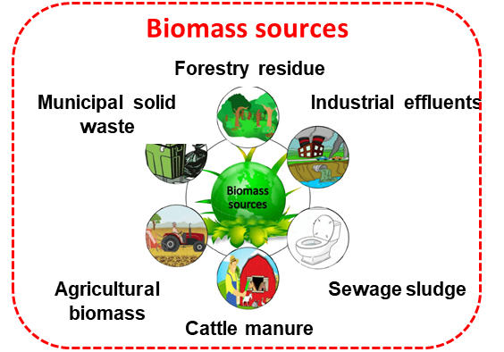
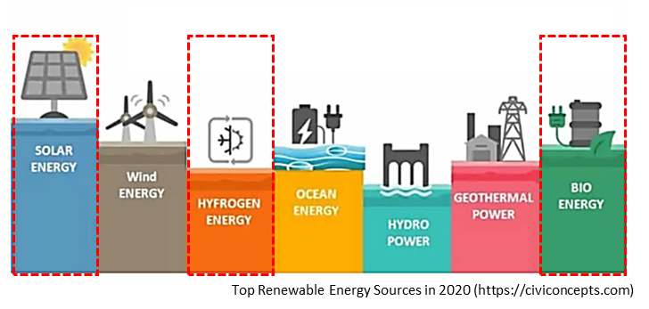
Needs of Renewable Energy Source
Paris Climate Agreement
Green new deal
+
Photoelectrochemical system
Electrode
Issues
hv
Solar
Use of Renewable Energy Source
Reduction of Greenhouse Gases
Production of Valuable Energy Source
Electrolyte
Valubable Energy Source

Slide 3
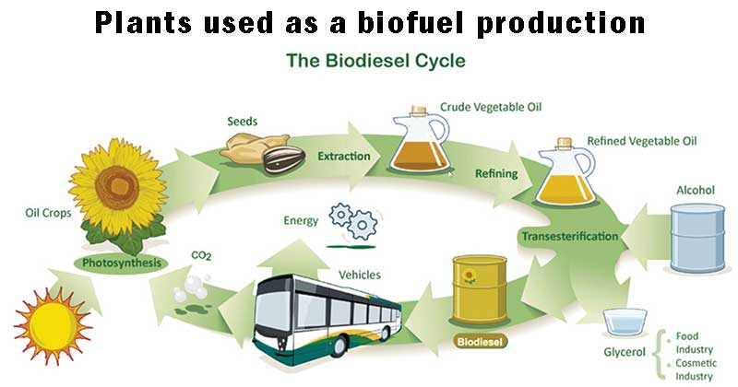
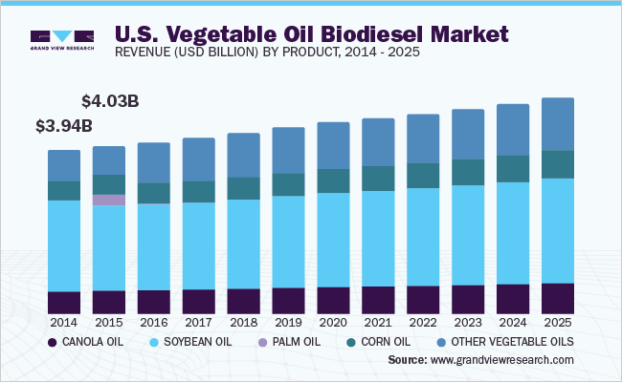
What is the glycerol
Biofuel
Needs to be conberted to
Byproduct
Source: European Biofuel Portal
Glycerol
Valuable products
Cosmetic
Pharamaceutical
Medicine
Byproduct of biodiesel
High viscosity
Low value
Fuel
Chemical

Slide 4
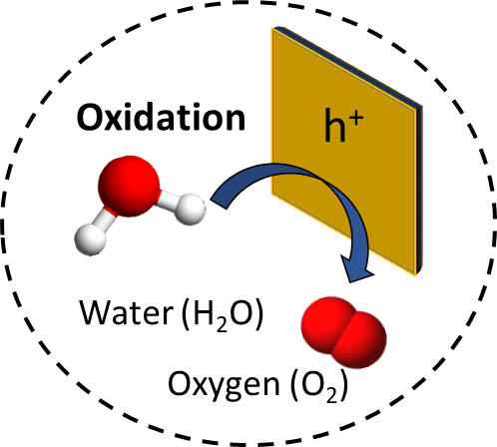
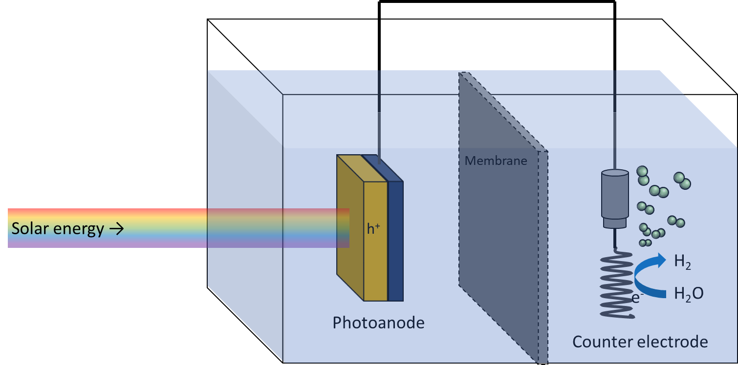
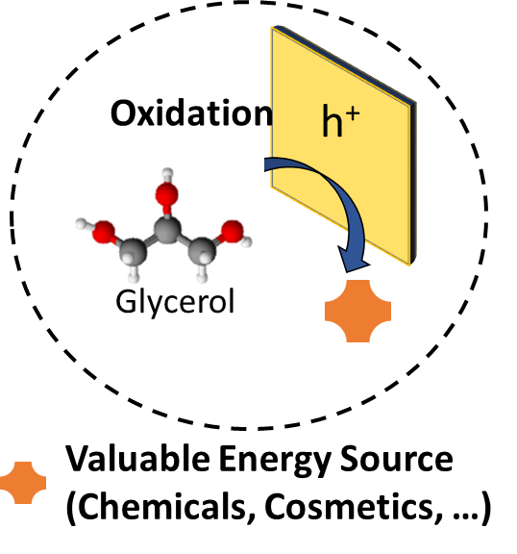
Principles of Photoelectrochemical Glycerol Oxidation
vs. PEC Water Oxidation
Slow reaction
Oxidation: 2H₂O + hv → O₂ + 4H⁺ + 4e⁻
vs. PEC Glycerol Oxidation
Fast reaction compared Water Oxidation
Oxidation: C₃H₈O₃ + hv → C₃H₆O₄, C₂H₄O₃, CH₂O₂, and etc…
Photon-generated hole easily oxidizes glycerol
Glycerol oxidation requires much less energy than water oxidation

Slide 5
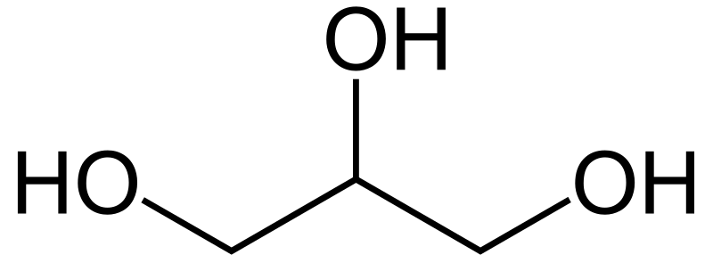
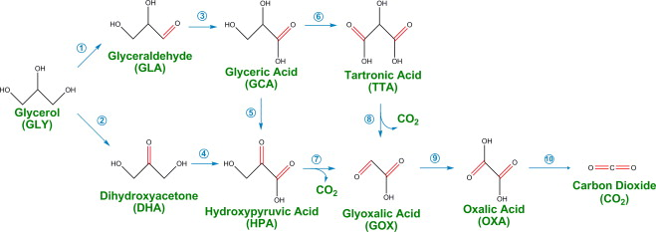
Photoelectrochemical glycerol selective oxidation
Chemical Structure
Glycerol oxidation path
Applied Catalysis B: Environmental, 106(1-2), 123-132.
Chemical structure with three hydroxyl groups
More thermodynamically stable of low value-added products

Slide 6
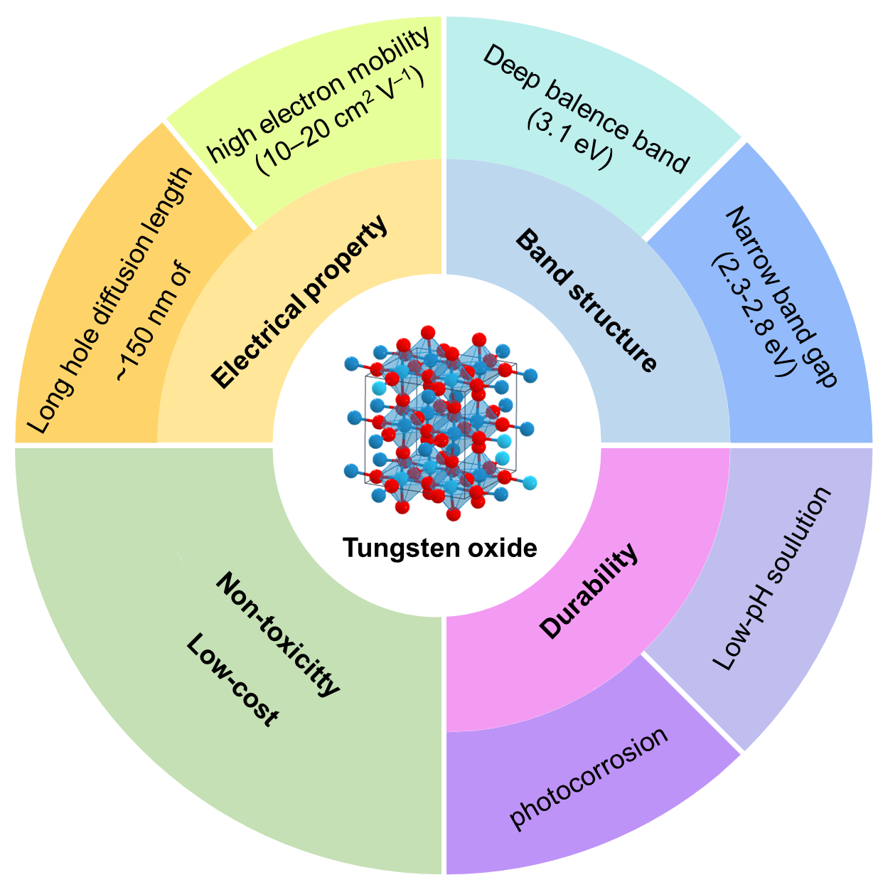
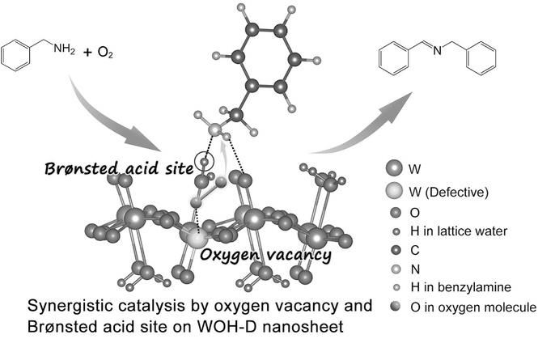
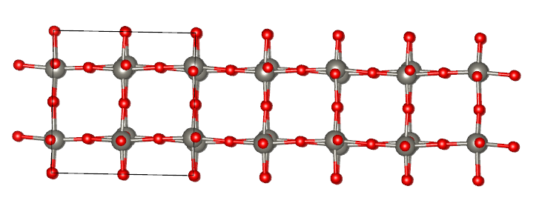
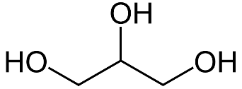
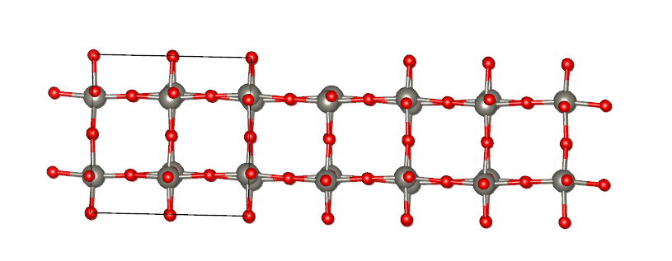
Photoelectrode
Tugsten oxide (WO₃)
Acid sites and vacancies influence C-OH oxidation
Catalysis Today, 352, 73-79.
Small, 13(31), 1701354.
Glycerol selective oxidation by oxygen vacancy modulated
Glycerol
(GLY)
W
O
Glycerol oxidation system still need consideration
Glyceraldehyde
(GLA)

Slide 7
Experimental Setup
Solvothermal synthesis
WO₃ synthesis
Oxygen
Substrate
Solution
160 °C
500 °C
Hydrothermal
synthesis
Annealing
Argon/oxygen
blend
Autoclave set

Slide 8
Results and Discussion
XRD
Raman spectra
FTO
𝒗(W₂O₆ & W₃O₈)
δ (o-w-o)
𝒗_{a}(o-w-o)
𝒗(o-w-o)
WO₃(H₂O)_{0.333}
WO₃
Annealing
WO₃ were successfully synthesized
Vacancy modulated have no noticeable effect on WO₃ structure

Slide 9
Results and Discussion
XPS
FTIR
WO₃ (O/Ar)
WO₃ (bare)
L
B
B
B&L
Bare (C_{L} : C_{B} = 1 : 1.1)
O/Ar (C_{L} : C_{B} = 1: 1.2)
Bare (C_{L}+ C_{B}) < O/Ar (C_{L}+ C_{B})
O_{v}:O_{L} = 1 : 2.2
<
O_{V}:O_{L} = 1 : 3.0
rich vacancy
poor vacancy
WO₃ (O/Ar) has a larger area of O_{v} (oxygen vacancy orbital) than WO₃ (bare)
Oxygen vacancies contributes to the formation of Lewis acid sites and Bronsted acid sites.

Slide 10
Results and Discussion
Photoelectrochemical performance
WO₃ (bare)
WO₃ (O/Ar)
Electrolyte : 0.5 M Na₂SO₄ with/without 2 M glycerol, the pH value was adjusted to 2 by H₂SO₄
Charge separation efficiency improved by vacancy-modulate

Slide 11
Results and Discussion
Photoelectrochemical performance
WO₃ (bare)
WO₃ (O/Ar)
Extract
Extract
Extract
Extract
Extract
Extract
Stable photoelectrochemical reaction for 5 hours
For each potential, samples were collected at 1 h, 3 h, and 5 h of reaction

Slide 12
Results and Discussion
Quantification analysis (HPLC)
GLA
Glycerol can be selectively converted to glyceraldehyde by oxygen vacancy modulated WO₃

Slide 13
Summary
WO₃ on FTO coated glass substrates was successfully fabricated using a solvothermal technique
Oxygen vacancy concentration modulated by annealing condition
The most formed products of glycerol oxidation are glyceraldehyde
Glyceraldehyde accounts for an overwhelming production and it has significant ratio due to the possession of electrode's selectivity

Slide 14
Thank you for your attention!

