Slide 1

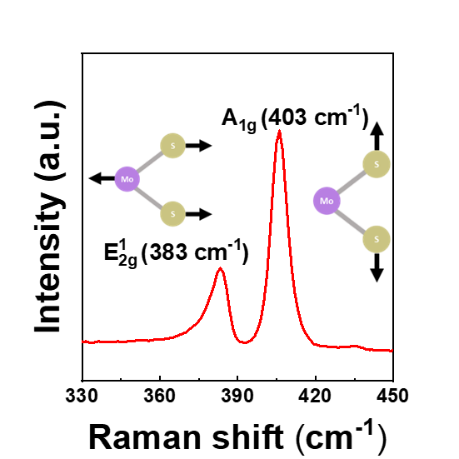
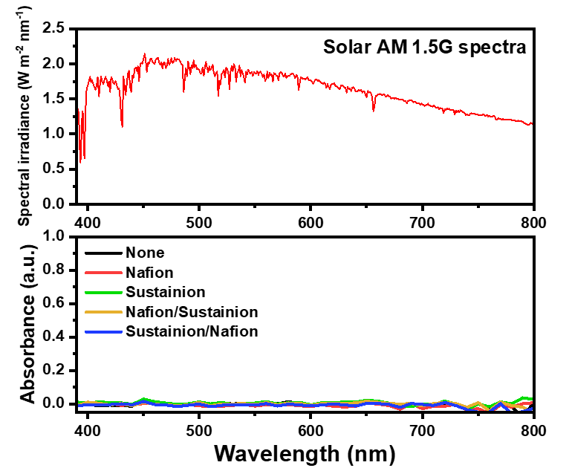
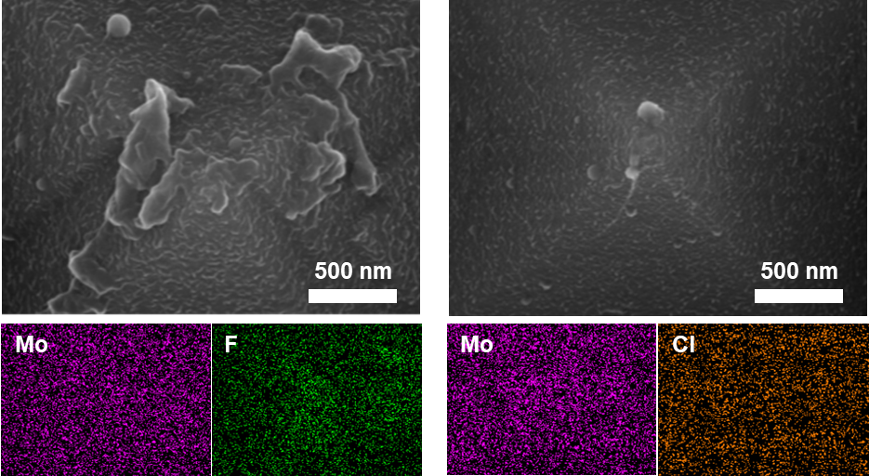
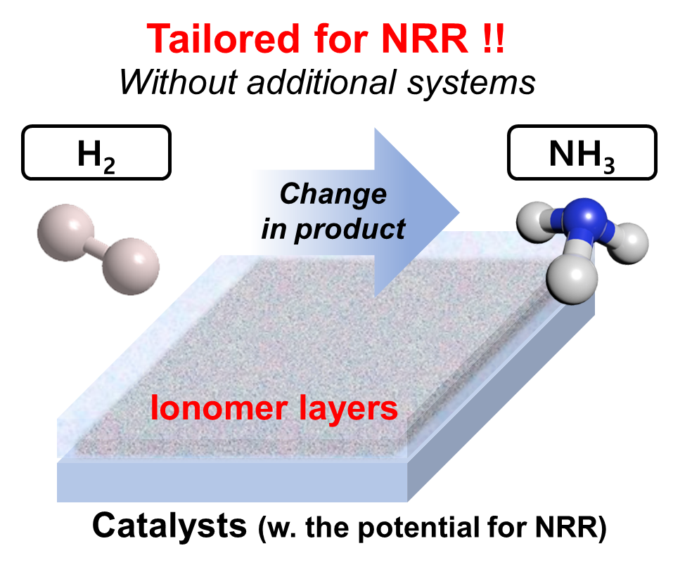
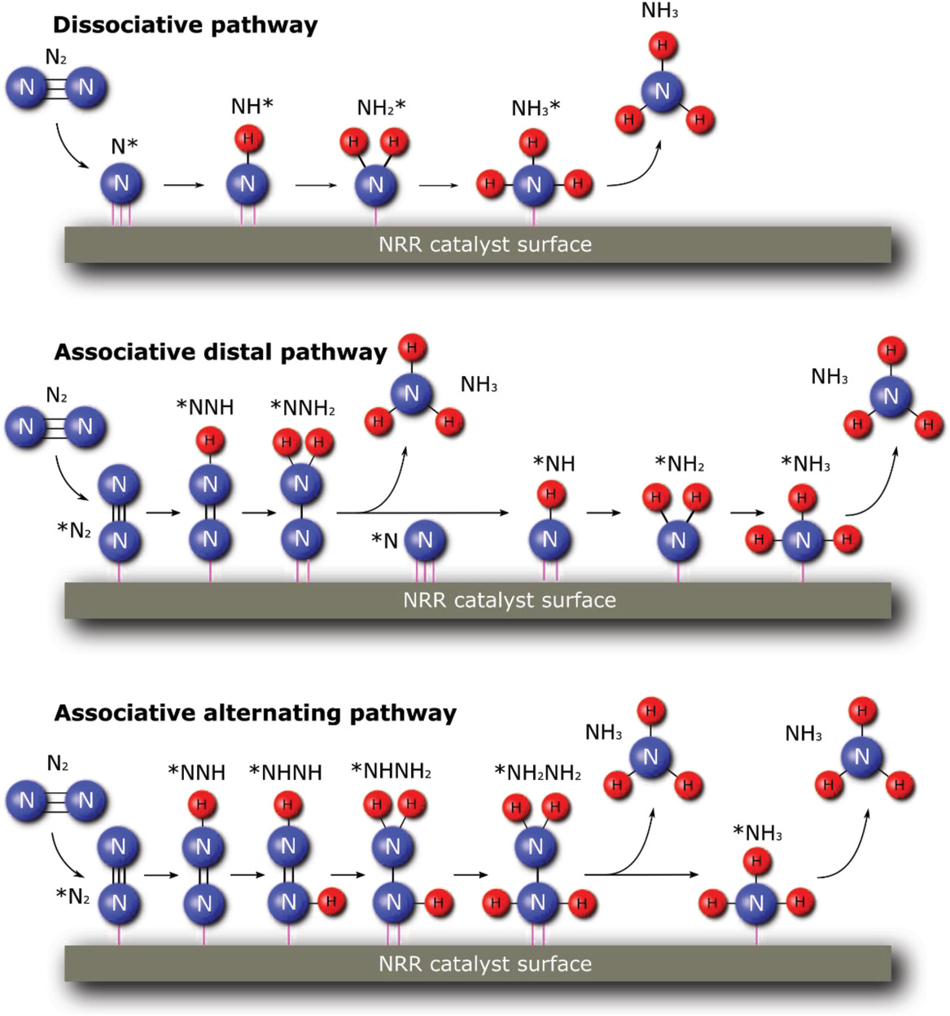
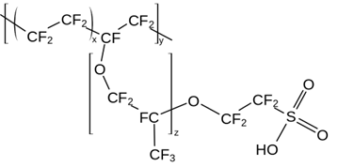
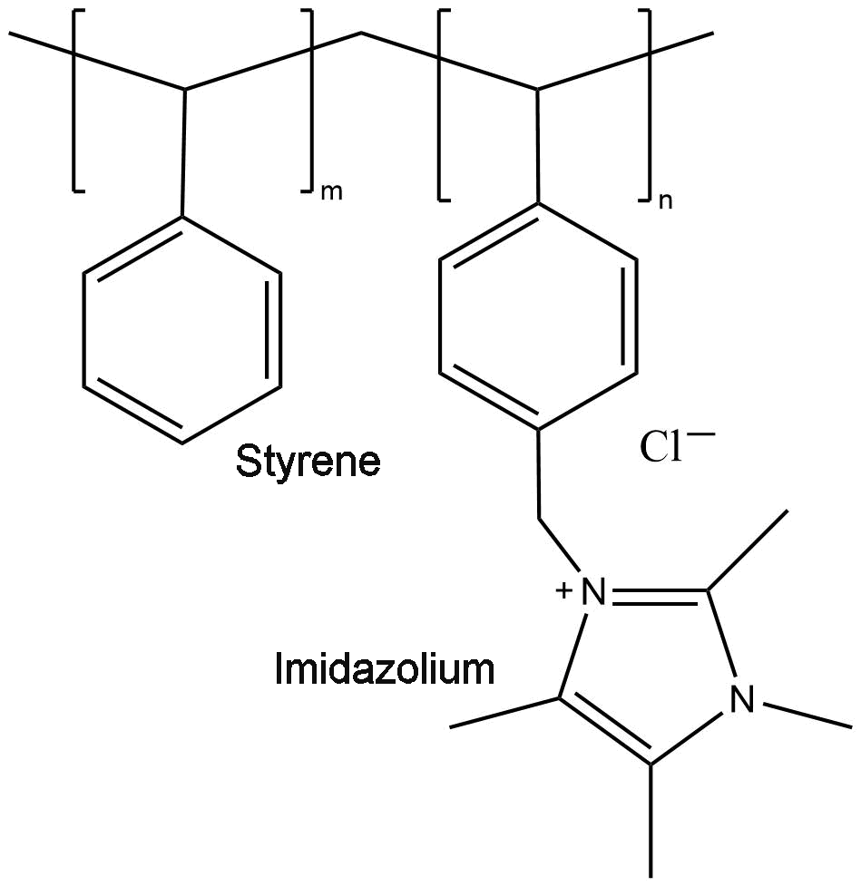
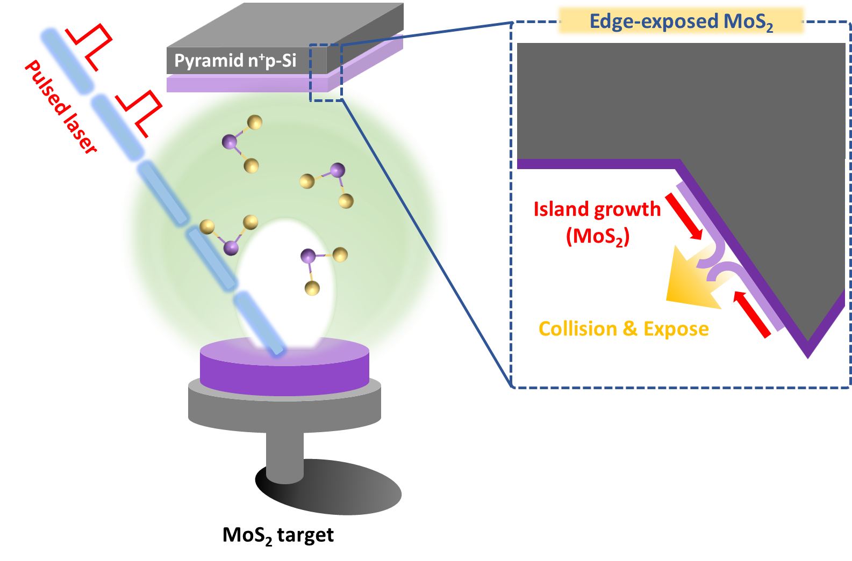
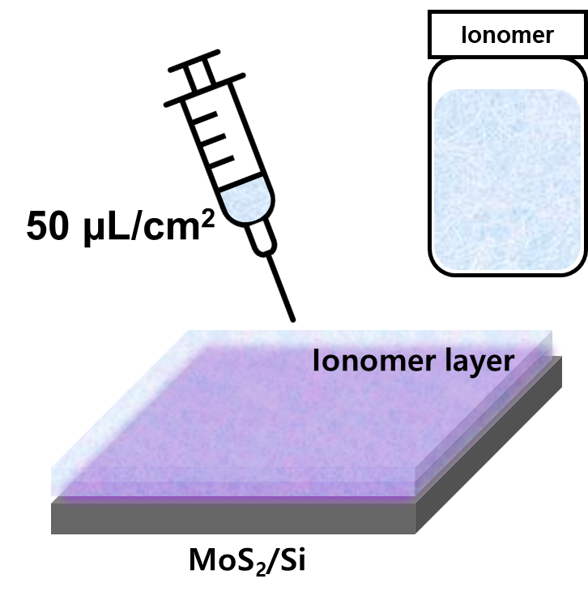
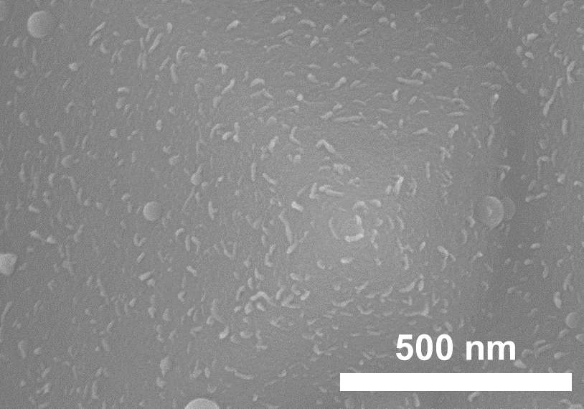
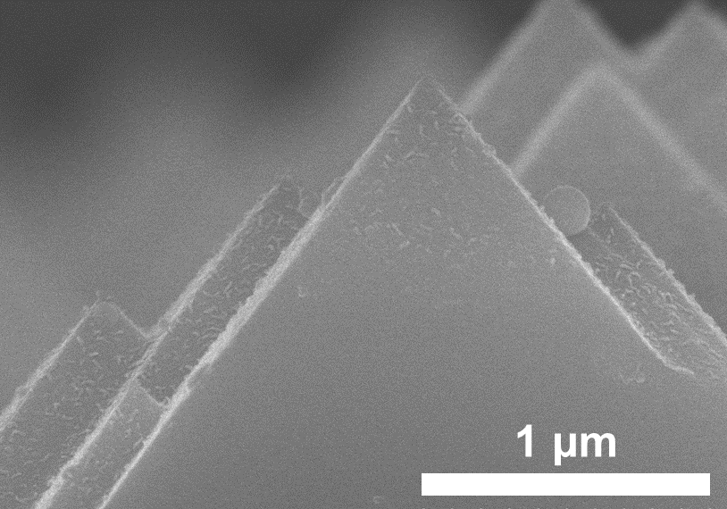
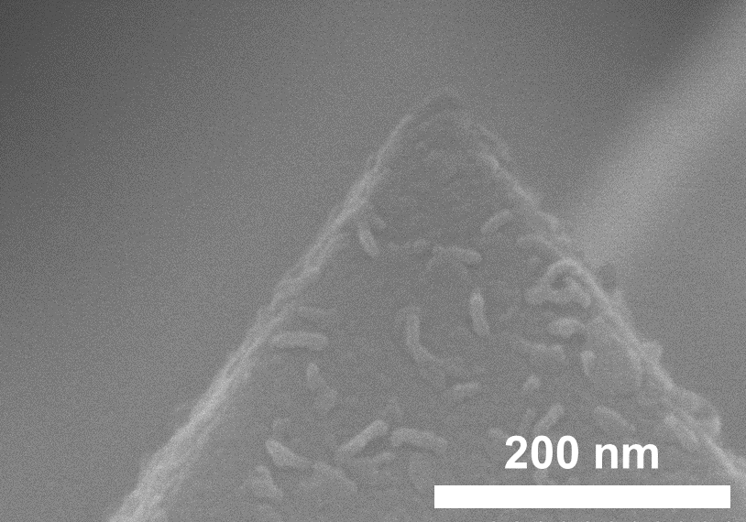


Global Photovoltaic Conference 2023
Advanced Photoelectrochemical Ammonia Production via Tailoring Catalyst-Electrolyte Microenvironment
Yejoon Kim, and Sanghan Lee*
School of Materials Science and Engineering, Gwangju Institute of Science and Technology (GIST), Gwangju, Korea
E-mail: ssh8455@gm.gist.ac.kr, sanghan@gist.ac.kr
1. Introduction
Raman spectrum
PEC activity of MoS₂
Ammonia (NH₃) is a valuable chemical in a variety of applications, including fuel cells, fertilizers, and hydrogen carriers. Photoelectrochemical (PEC) conversion of N₂ to NH₃ is a sustainable alternative to the Haber-Bosch process, which emits significant greenhouse gases. However, its practical application has been challenged by low production yields due to low N₂ adsorption selectivity.
Tailoring catalyst-electrolyte microenvironments is a promising strategy to improve the performance and practicality of photoelectrochemical NH₃ production. We tried to control the microenvironment near the MoS₂ catalyst surface via cation and anion exchange ionomers. (Nafion & Sustainion)
Our results show that the use of these ionomers induced a significant increase in NH₃ yields and conversion efficiency, suggesting that a tailored catalyst-electrolyte microenvironment maximized the N₂ adsorption selectivity of the catalyst layer, thereby improving the performance of photoelectrochemical NH₃ production.
Edge-exposed MoS₂/Si photocathodes show high PEC activity for HER.
Coated ionomers
Nafion coating
Sustainion coating
Schematic of a study
Mechanism of NRR ^{[1]}
Nafion
Sustainion
Both the nafion and the sustainion ionomers were coated without damaging the MoS₂ catalyst layer.
They are transparent and do not interfere with the light absorption of the photoelectrode.
2. Experimental methods
Production yield
by Nafion concentration
by Sustainion concentration
Pulsed laser deposition
Ionomer coating
Ionomer bilayer (Naf/Sus)
Cycling test
Using the pulsed laser deposition method (PLD) method, we fabricated the edge-exposed MoS₂ catalyst layer on a centimeter scale.
The edge-exposed MoS₂ has been reported to be electrocatalytically active sites for N₂ reduction (by DFT calculations).^{[2]}
The ionomer layers were coated on the catalysts by drop casting method.
3. Results
The 0.03 wt.% of sustainion worked best among the ionomer monolayers.
When 0.04 wt.% of nafion was added on top of it, the effect was even higher.
Over the cycling test, it produced NH₃ at a high FE% while maintaining a current density of over 3 mA cm⁻².
SEM images
4. Conclusion
Using a pulsed laser deposition method, we fabricated an edge-exposed MoS₂ catalyst layer with potentials for NRR.
Using an ionomer bilayer, we optimized the microenvironment of the MoS₂ catalyst for NRR by suppressing HER and enriching nitrogen-containing TPCPs.
It showed an excellent ammonia yield of 145.83 μg h⁻¹ cm⁻² and an efficiency of 23.7 %.
Edge-exposed MoS₂ was uniformly deposited on the pyramid Si-photocathode.
5. References
[1] Chen, X. et al. Adv. Energy Mater. 2020, 10, 1903172.
[2] Zhang, L. et al, Adv. Mater. 2018, 30, 1800191.

