Slide 1
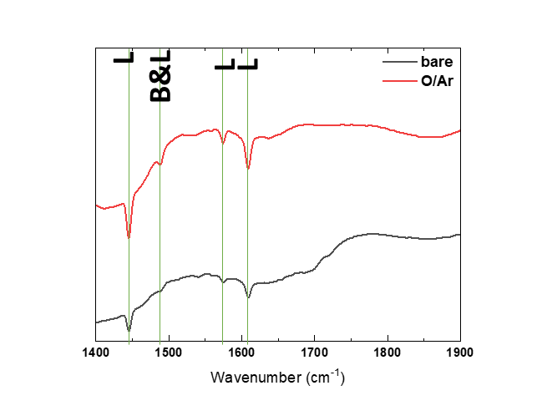
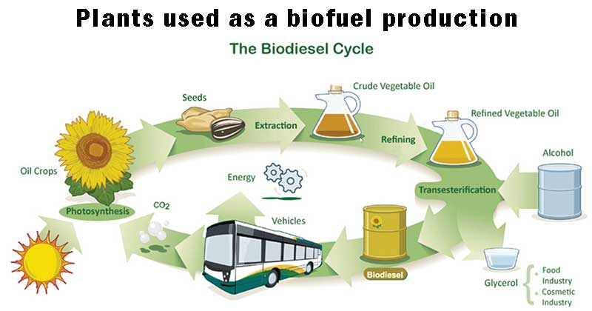
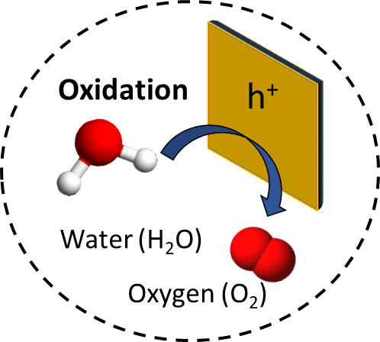
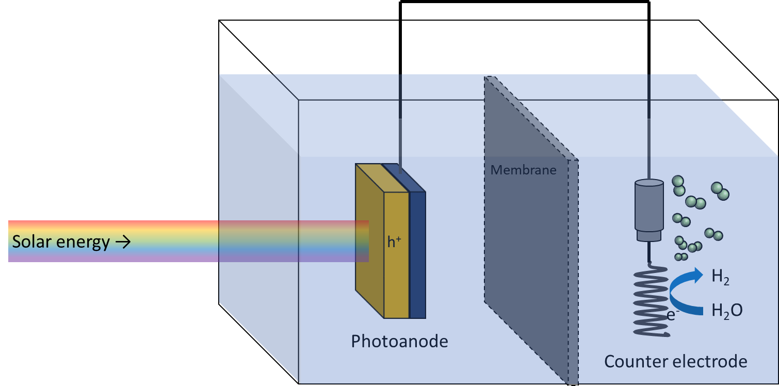
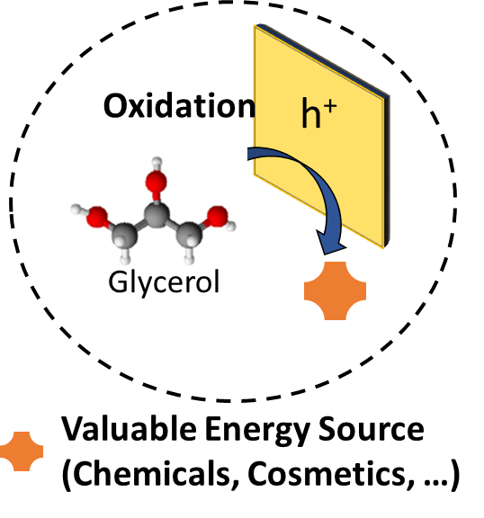
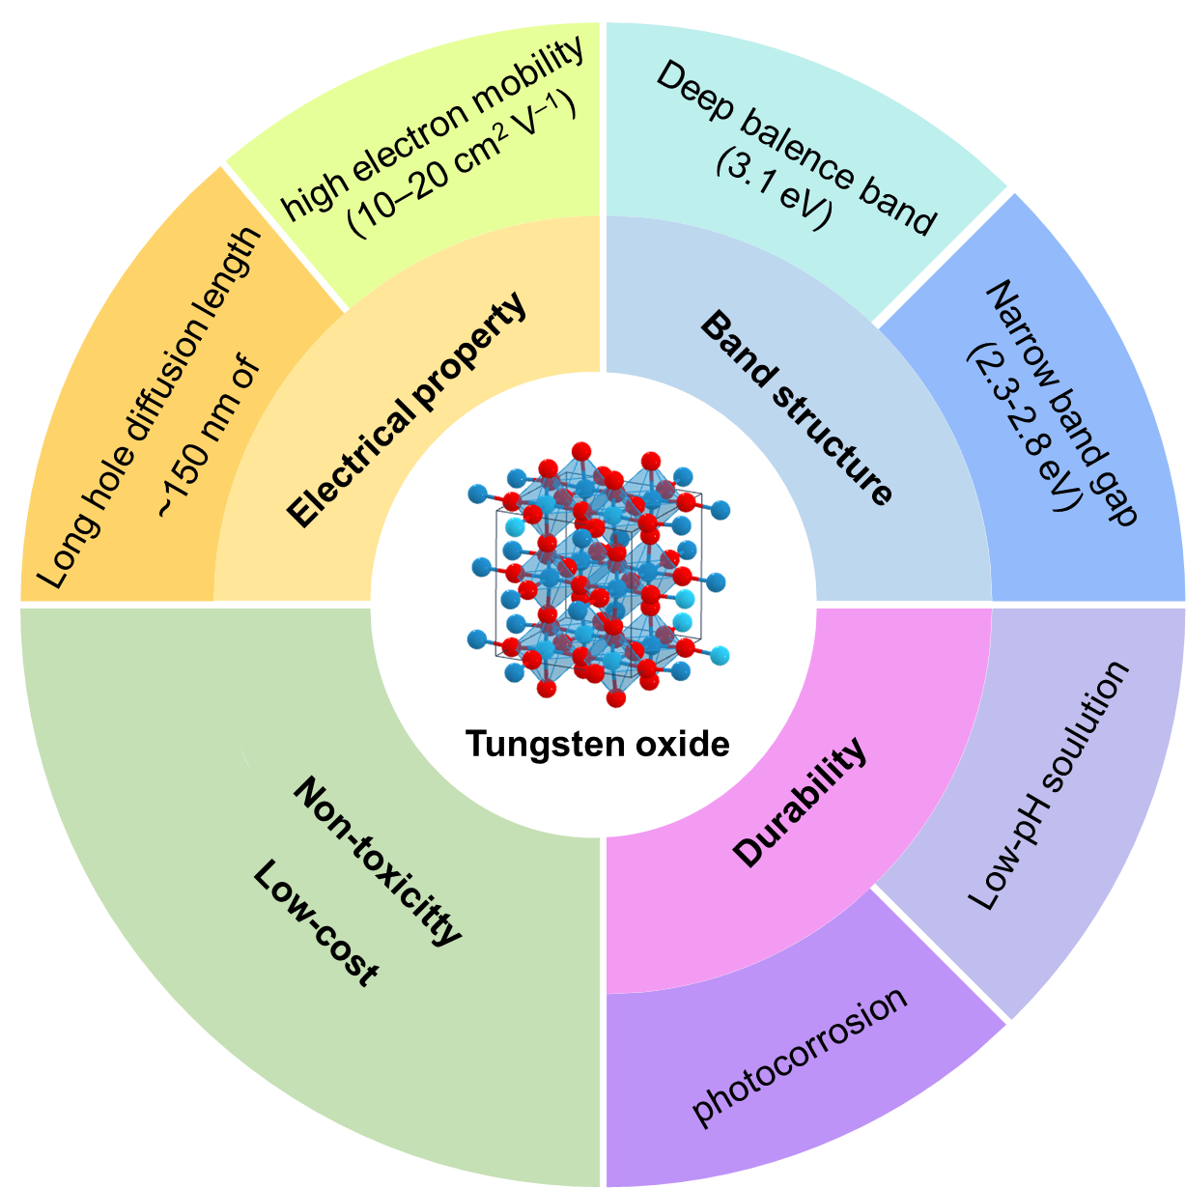
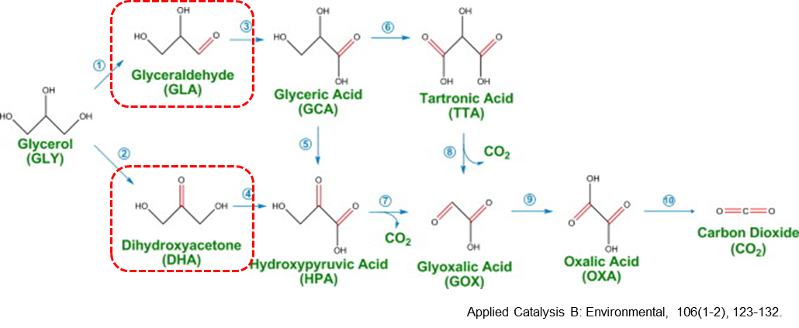
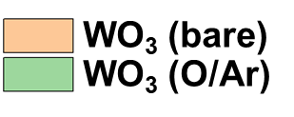
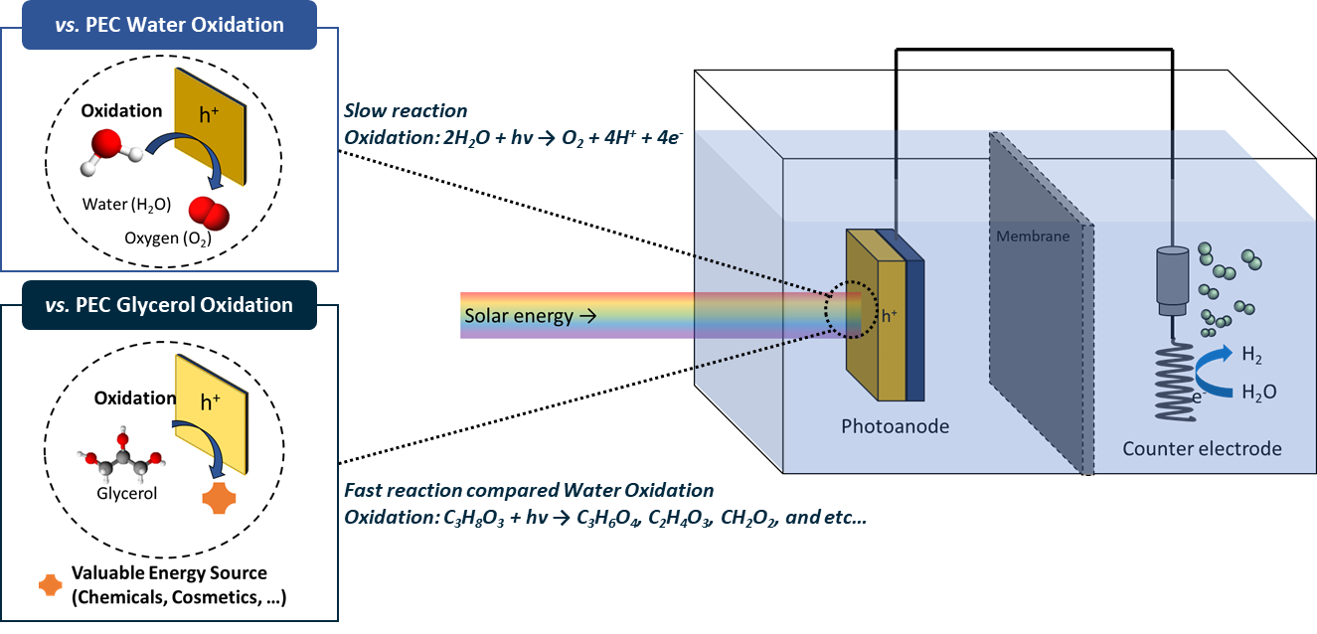
ENHANCED PHOTOELECTROCHEMICAL GLYCEROL OXIDATION PERFORMANCE OF WO₃ VIA OXYGEN VACANCY ENGINEERING
Yoonsung Jung¹, Sanghan Lee^{1*}
¹School of Materials Science and Engineering, Gwangju Institute of Science and Technology, Gwangju 61005, Republic of Korea
Abstract
Results
Photoelectrochemical systems offer a sustainable and environmentally friendly approach to the efficient production of high-value products and hydrogen from biomass and solar energy. The production of glycerol, one of the biomass sources, has increased significantly as the demand for biodiesel has grown. To enhance the value of biodiesel, it is critical to convert useless glycerol into high-value materials. However, the three hydroxyl groups in glycerol present a challenge to achieving selective oxidation, resulting in the formation of low-value products such as carbon dioxide, which hinders the creation of high-value products. Recently, the WO₃ photoelectrode has emerged as a promising candidate for converting glycerol into higher value-added materials. This is attributed to its appropriate bandgap, band edge position, and excellent resistance at low pH conditions. Despite the potential of WO₃ in selectively converting glycerol, the efficiency of glycerol conversion still require improvement. In this study, we focus on the effect of acid sites on the photoelectrochemical glycerol redox by controlling the oxygen vacancy of WO₃ photoelectrodes. By understanding the role of acid sites and oxygen vacancies in the redox process, this study provides a more efficient and selective photoelectrochemical system that contributes to the valorization of useless biomass.
XRD
Raman spectra
FTO
𝒗(W₂O₆ & W₃O₈)
δ (o-w-o)
𝒗_{a}(o-w-o)
𝒗(o-w-o)
WO₃(H₂O)_{0.333}
WO₃
WO₃ was successfully synthesized
The WO₃ structure was not significantly affected by vacancy modulation.
XPS
FTIR
bare
O/Ar
Introduction
WO₃ (bare) has a smaller O_{v} (oxygen vacancy orbital) area than WO₃ (O/Ar).
The formation of Lewis acid sites is attributed to oxygen vacancies.
Glycerol
vs. PEC Water Oxidation
LSV
EIS
High viscosity
Low value
Three hydroxyl group
Slow reaction
Oxidation: 2H₂O + hv → O₂ + 4H⁺ + 4e⁻
bare
O/Ar
Valuable Energy Source
Oxidation
vs. PEC Glycerol Oxidation
Source: European Biofuel Portal
Medicine
Cosmetic
Chemical
Pharamaceitical
Fuel
Fast reaction compared Water Oxidation
Oxidation: C₃H₈O₃ + hv →
C₃H₆O₄, C₂H₄O₃, CH₂O₂, and etc…
Photoelectrochemical conversion is an eco-friendly fuel manufacturing system that can produce hydrogen fuel and valuable energy source continuously without pollutants or energy consumption using solar energy and water.
Biomass is stably converted into a valuable energy source without thermal damage.
bare
CA
O/Ar
Extract
Extract
Extract
Extract
Extract
Extract
Charge separation efficiency is enhanced by modulation of vacancies.
Stable photoelectrochemical reaction for 5 hours.
Tungsten oxide is an inexpensive and efficient photoelectrode that can withstand acidic electrolytes.
Acid sites and vacancies affect the oxidation of C-OH.
GLA
0.8 V_{RHE}
1.0 V_{RHE}
1.2 V_{RHE}
Experiments
Solvothermal synthesis
bare
0.8 V_{RHE}
DHA
1.0 V_{RHE}
1.2 V_{RHE}
O/Ar
The concentration of oxygen vacancies was regulated by the conditions of annealing.
Photoelectrochemical glycerol oxidation
0.5 M Na₂SO₄ with/without 2 M glycerol,
the pH value was adjusted to 2 by H₂SO₄
FE
O/Ar
1h
3h
5h
Photon-generated holes can readily oxidize glycerol.
The oxidation of glycerol requires less energy than the oxidation of water.
The most formed products of glycerol oxidation are glyceraldehyde.
Glyceraldehyde is produced selectively due to the presence of oxygen vacancy in WO₃.

