Slide 1
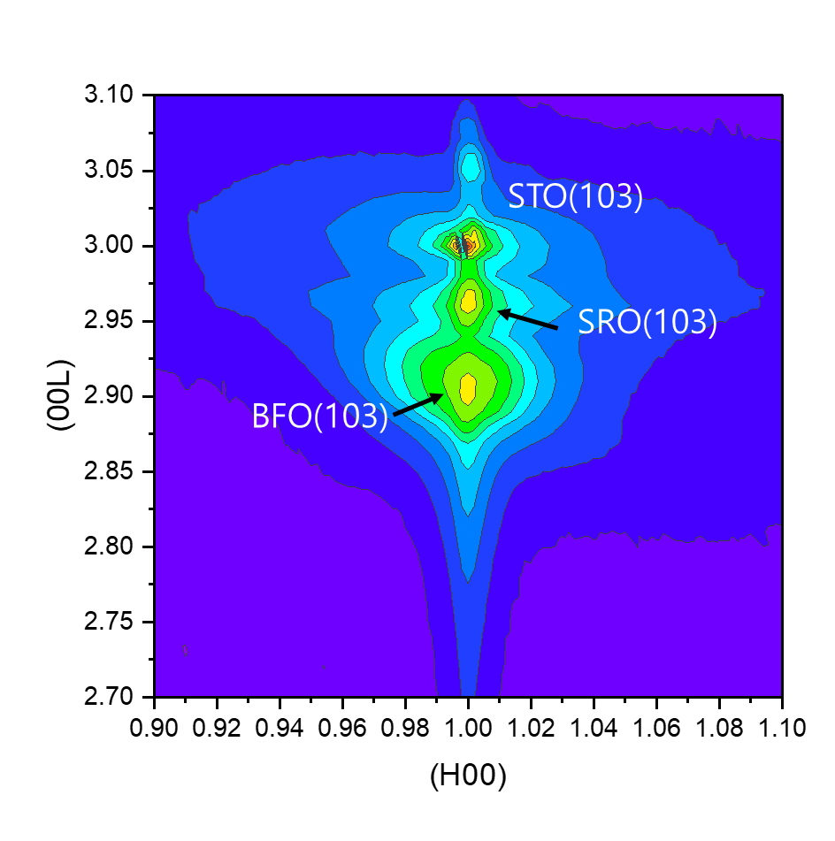
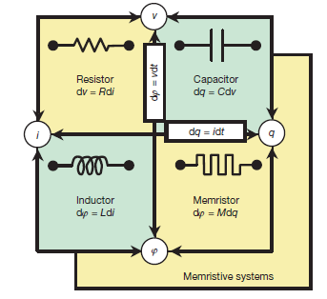
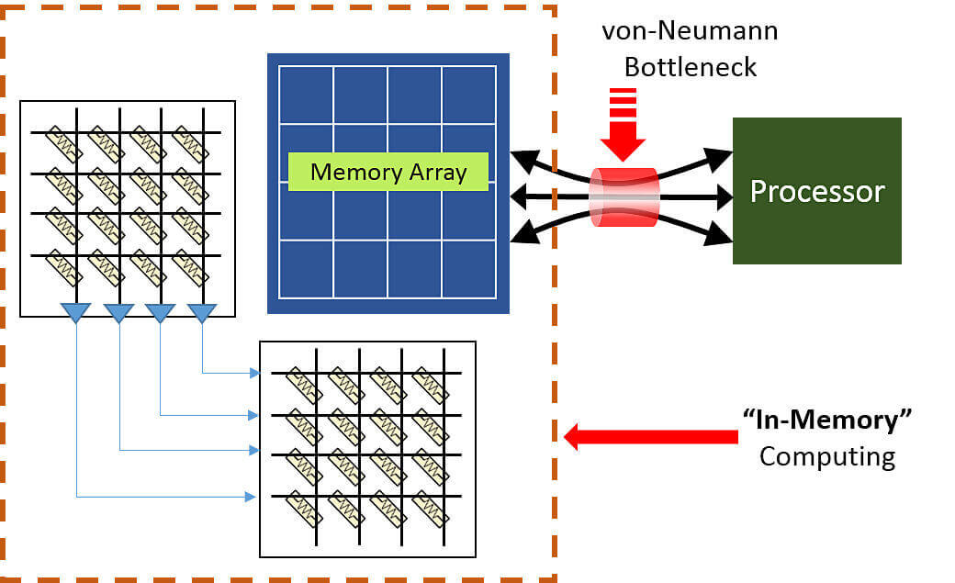
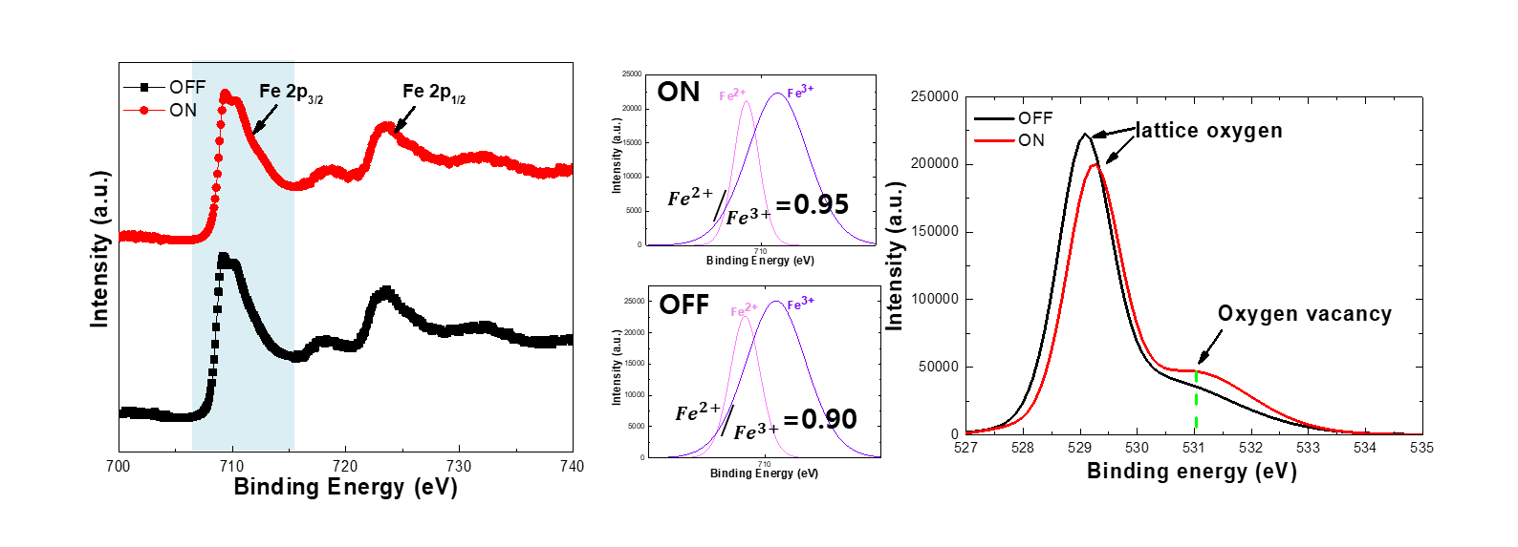
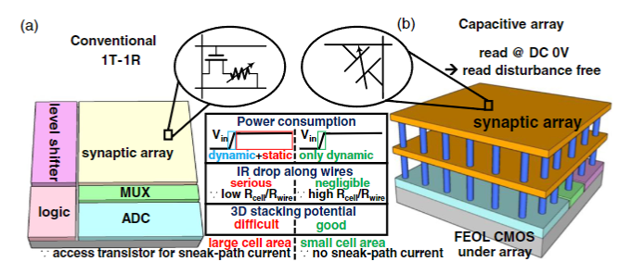
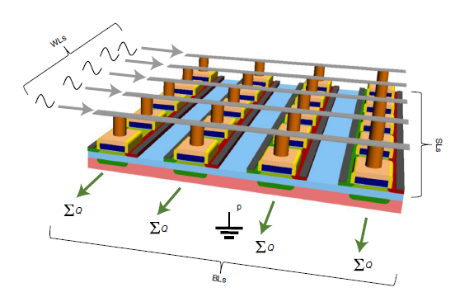
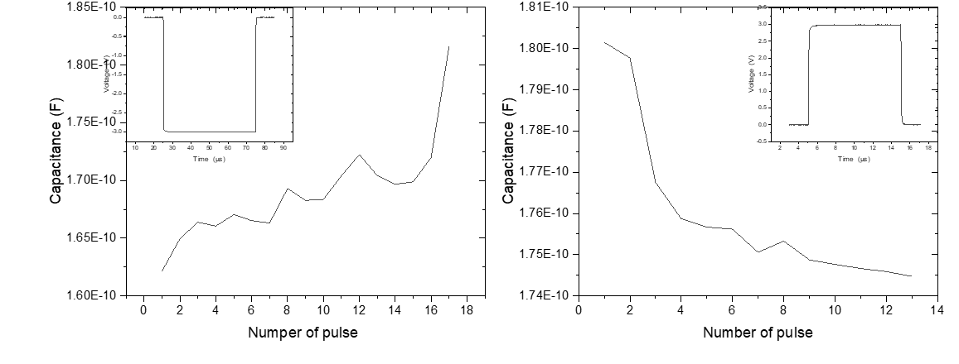
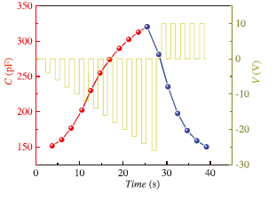
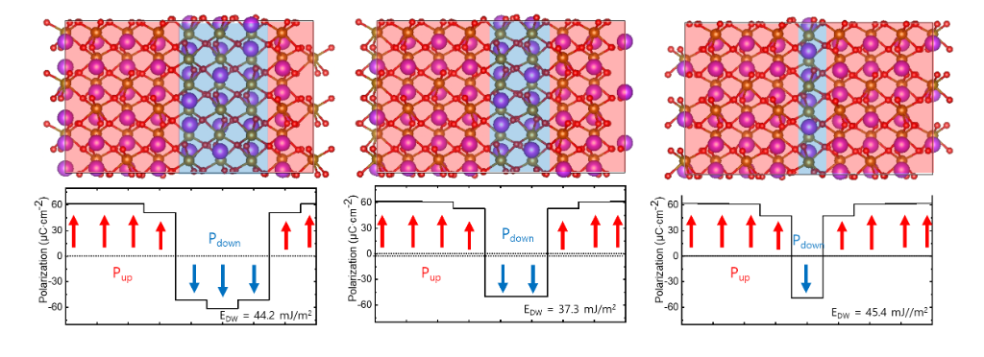
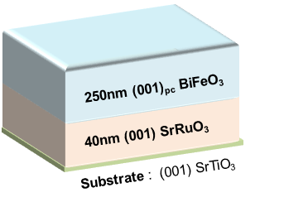
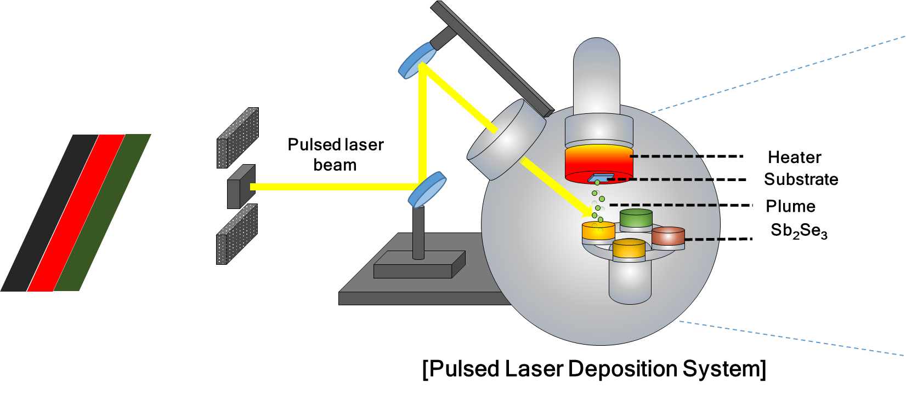
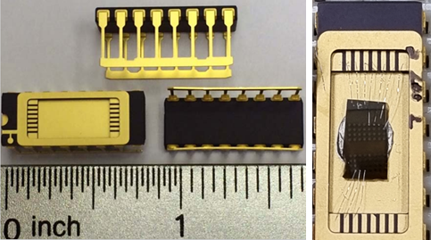
Energy-Efficient Memcapacitor Based on BiFeO₃ : A Feasible In-Memory Computing
Jiwoong Yang,ª and Sanghan Lee*^{,a}
ª School of Materials Science and Engineering, Gwangju Institute of Science and Technology, Gwangju, Korea
Abstracts
Results
In-memory computing technology is gaining significant attention as a next-generation memory aimed at overcoming existing memory limitations, including the Von-Neumann bottleneck. A leading candidate for in-memory computing technology is the memcapacitor, which modulates capacitance through an external voltage. Memcapacitors are simple two-terminal devices with non-volatile capacitance, making them an attractive option. This study explores the application of memcapacitor using BiFeO₃, known for its multiferroic characteristics and stable resistance modulation properties
Epitaxial thin films of BiFeO₃(BFO)/SrRuO₃(SRO) on a SrTiO₃ (001) substrate were successfully fabricated using pulsed laser deposition (PLD). Based on the X-ray photoelecron spectroscopy (XPS) measurement, we found that the origin of memcapacitive properties in the Pt/BFO/SRO capacitor structure was caused by the Fe oxidation state and the presence of oxygen vacancies of the BFO layers. To confirm the stable memory characteristics of the optimized BFO thin film, we connected it to SPECTRUM's DIP commercial device through wire bonding.
Our observations uncovered distinguishable capacitance states depending on external bias voltage, including multilevel capacitive states that were repeatable and reproducible in the Pt/BFO/SRO capacitor structure. The capacitance state was continuously modulated by applying repeated pulse voltages of 3 V, 50 μs, demonstrating the potential of BFO for use in neuromorphic devices. This study introduces the possibility of manufacturing ultra-low power in-memory devices as an experiment that the capacitance of BFO varies by a small pulse voltage.
x-ray diffraction measurement
STO(00l)
SRO(00l)
BFO(00l)
FWHM – 0.1 º
The highly oriented crystallinity of BFO thin films on STO substrate.
Capacitive switching property
As the set voltage increased, the capacitance gradually increased
more than 20 discrete level
Introduction
Memcapacitor
Memory + Capacitor → Memcapacitor
Capacitance switching through an external voltage
Simple two-terminal devices
Non-volatile memory
XPS Surface Analysis
Available for
in-memory computing
nature, 2008, 453.7191: 80-83.
Advantage
Prevention of sneak current
High effective resistance
Consume only dynamic power
Low write & read energy
Gradually Switching Property by Pulse Voltage
Advanced Intelligent Systems, 2022, 4.8: 2100258.
Challenges
The capacitance state was continuously modulated by applying repeated pulse voltages
Potentiation 3 V, 50 μs
Depression -3 V ,10 μs
Capacitance modulation in simple capacitor structures
stable multilevel characteristics
Capacitance varies linearly by short pulse voltage
Nature Electronics, 2021, 4.10: 748-756
Exploration. 2023. p. 20220126.
Our Work
Conclusion
BiFeO₃ : Ferroelectric material can maintain various polarizations stably (DFT calculated)
Epitaxial deposition via PLD
Apply voltage stably via wire bonding → capacitance state was continuously modulated by applying repeated pulse voltages
We fabricated a BFO / SRO heterostructure with highly oriented crystallinity on STO substrates via Pulsed Laser Deposition.
We achieved implementation of more than 20 distinct capacitance states in the basic Pt / BFO / SRO capacitor structure.
We observe a alteration in the ratio of oxygen vacancies as capacitance undergoes modulation
We successfully modulated capacitance state using a short pulse voltage
the stability of even small-sized domains, attributed to the comparatively low domain wall energy (DFT)
E-mail : yjw@gist.ac.kr
TEL : 01084513457

