Slide 1
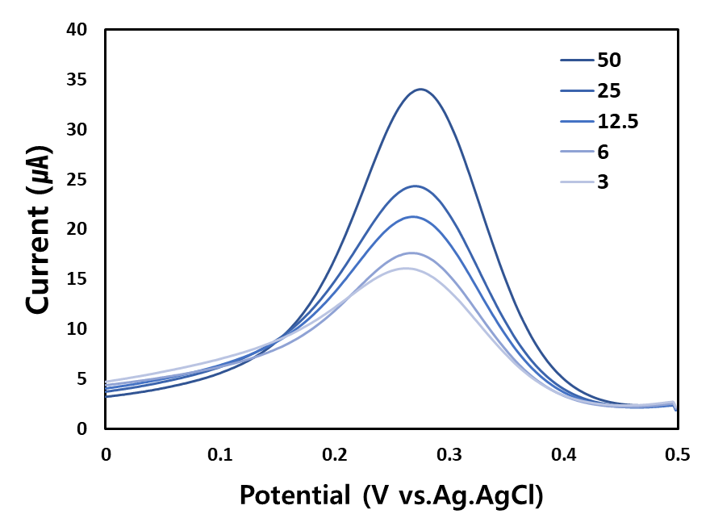
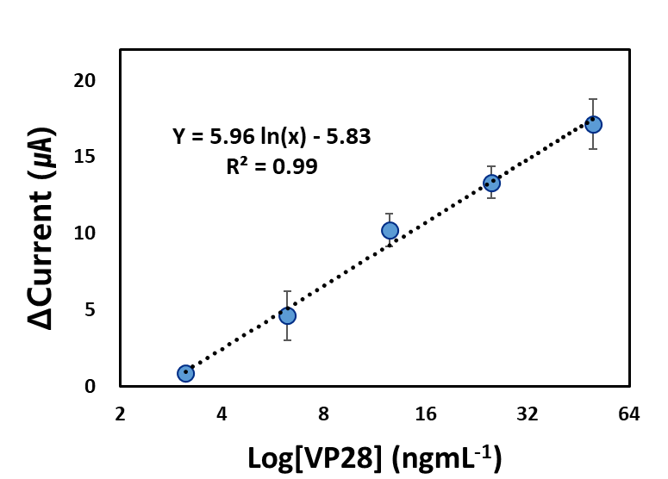
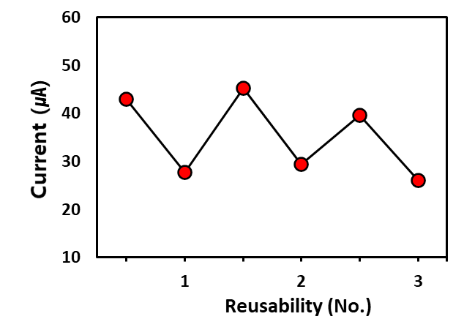
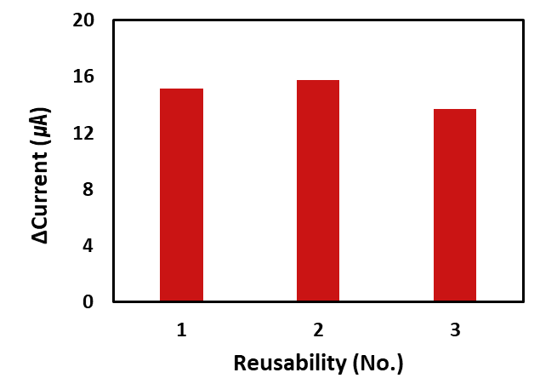
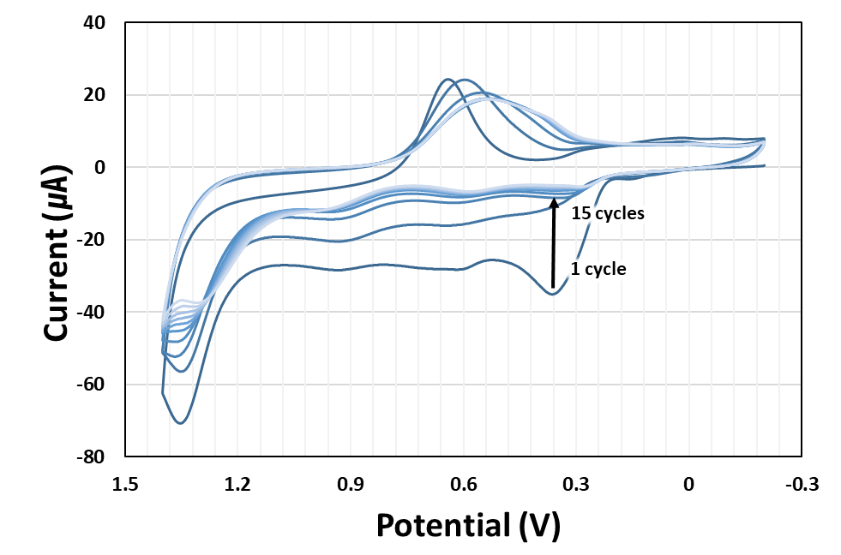
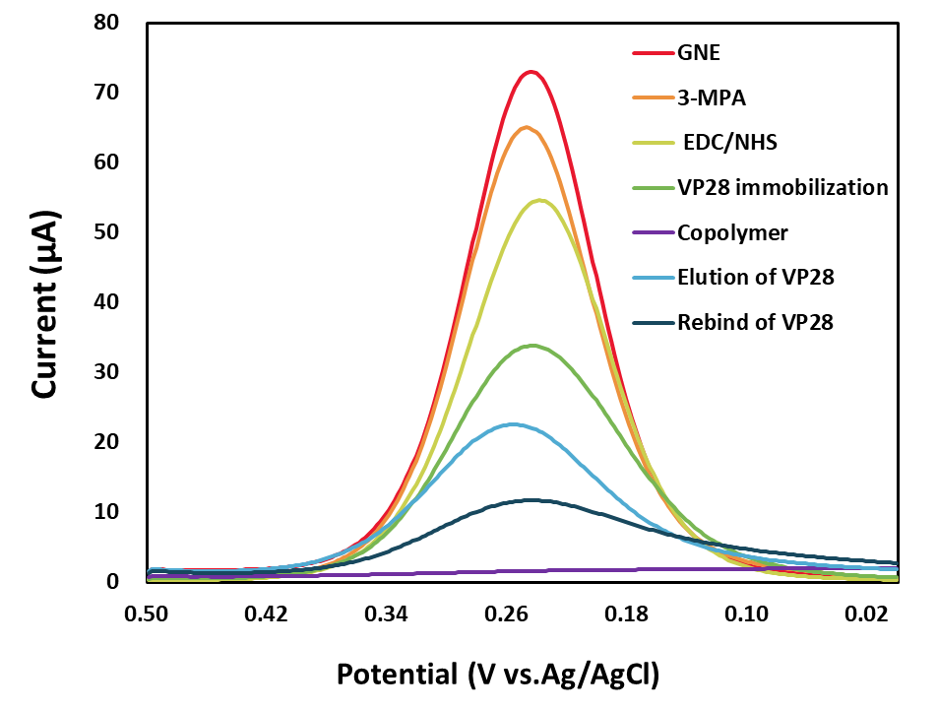
Development of WSSV detection sensor based on
molecularly imprinted polymer using the electropolymerization
¹ Young-Ran Yun, and ^{1,2} Sung Yang*
¹Department of biomedical science and engineering, ² School of mechanical engineering, Gwangju Institute of Science and Technology(GIST), Gwangju, 61005, Republic of Korea
Abstract
Molecularly imprinted polymers (MIP) provide biomolecular recognition sites and can be synthesized through electropolymerization. When applied to electrochemical sensors, they can be used as a quantitative antigen detection tool based on electrical signal read-out. This study aims to develop a molecularly imprinted polymer sensor for white spot virus antigens (VP28) using gold nanostructured electrodes with high electrochemical surface activity and two functional monomers (o-PD and o-AP). The copolymer synthesis was confirmed by a cyclic voltage-current curve showing redox reactions under appropriate electropolymerization conditions. The fabrication process of the sensor, including molecule immobilization and copolymer formation, was established in the form of a reasonable differential voltage-current curve. The developed sensor was evaluated for quantitative signal analysis of white spot virus antigens and the reusability of the sensor.
Introduction
Electrochemical detection of VP28 antigen
• The MIP-based electrochemical sensor provides artificial binding sites for the rebinding virus antigen with particular and stable current changes. In contrast to the immunoassay, this method offers a cost-effective fabrication process and good reusability.
• WSSV mainly causes shrimp mortality, which causes massive damage in aquaculture. However, it was limited to PCR detection, which is neglected to prevent an infection. So, the MIP-based electrochemical sensor for detecting virus antigens is expected to be useful for simple pre-diagnosis tools.
(A)
(B)
Figure 3. (A) DPV plots and (B) linear curve pf VP28 with a detection range from 3 to 50 ng/mL. The correlation between the Δ current and VP28 concentration was calculated with the difference in the peak current after and before the rebinding of VP28. Measurements were performed in 1X PBS containing 5 mM [Fe(CN)₆]³⁻/⁴⁻ and 0.1 M KCl (n=3).
Methods
Schematic of the fabrication process for MIP sensor
Reusability of the developed MIP sensor
Elution (VP28)
RSD = 5.9 %
Detection (VP28)
Figure 1. Schematic representation of the WSSV detection principle by MIP sensor. The MIP sensor has several specific polymer-based cavities for the WSSV antigen. After rebinding the VP28, the electrode surface responds with a hindered electron transfer, which leads to a decreasing peak current. This changeable electrochemical signal allows the quantitative analysis results depending on the VP28 concentration.
Figure 4. Reusability was evaluated by measurement of the current on the MIP-based electrode over three sequential VP28 elution-detection cycles. The elution and detection were performed in the high pH solution for 20 min and rebinding with 100 ng/mL of VP28 for 10 min at room temperature. The Δ current results presented a low relative standard deviation (RSD) of approximately 5.9 % between cycles.
Experimental Result
Conclusion
Electropolymerization process for the formation of copolymer
• This study displayed the detection of VP28 as a target marker of WSSV by the MIP-based electrochemical sensor.
• The copolymer synthesis for providing the specific matrix to bind with VP28 was verified in the repeated cycling of current with redox reaction.
• Also, the formation of template cavities and target detection supported the reasonable current changes through a successfully fabricated MIP sensor.
• The developed MIP sensor revealed quantitative electrochemical signals and good reusability until three times.
(A)
(B)
Fig 2. (A) Cyclic voltammograms of the copolymer synthesis by the electropolymerization method. The electrochemical response showed a decreased peak current in the redox reaction due to the coated copolymer on the electrode surface. 1st peak current at 0.35 V means an oxidized monomer in an acid solution, 2nd and 3rd peak currents at 1.4 and 0.7 V occur by the redox reaction of the copolymer. (B) Differential pulse voltammograms of the MIP sensor following fabrication. The VP28-immobilized electrode provides rebinding sites of the analyte after the template elution process. It shows the variable peak current by the MIP sensor process.
Acknowledgement
This work was supported by GIST Research Project grant funded by the GIST in 2022 and the National Research Foundation of Korea(NRF) grant funded by the Korea government(MSIP) (NRF- 2021R1A2C3008169).

