Slide 1
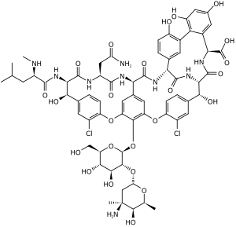
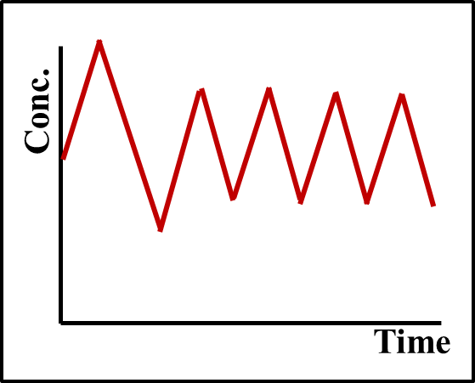
Development of a detection sensor based on lateral flow immunoassay for monitoring vancomycin in whole blood
¹Yugyung Jung, ²Seonjong Kim, ²Min-Gon Kim, and ^{1,3}Sung Yang*
¹Department of biomedical science and engineering, ²Department of Chemistry, ³School of mechanical engineering, Gwangju Institute of Science and Technology(GIST), Gwangju, 61005, Republic of Korea
Abstract
Vancomycin (VAN) is a glycopeptide antibiotic effective against Gram-positive bacteria, including methicillin-resistant Staphylococcus aureus (MRSA). However, VAN may cause nephrotoxicity when administered at high concentrations, while at low concentrations, it may not be effective enough, resulting in treatment failure and the development of vancomycin-resistant bacteria. Therefore, VAN is a drug for which therapeutic drug monitoring is recommended to maintain optimal dosage and minimize toxicity. In this study, we developed a sensor based on lateral flow immunoassay that can simply and rapidly detect VAN concentration for customized drug treatment for individual patients. The sensor used a generally gold nanoparticle (AuNP) as a reporter, and a secondary antibody (Ab) was used to amplify the signal. The developed sensor is expected to maintain optimal treatment effectiveness and minimize side effects by immediately monitoring VAN concentration in the field.
Introduction
Experimental result
Vancomycin (VAN)
Experiment with and without RBC antibodies
Therapeutic drug monitoring (TDM)
Without RBC Ab
With RBC Ab
Without RBC Ab
With RBC Ab
0 µg/mL
10 µg/mL
: measuring specific drugs at designated intervals to maintain a constant concentration in blood stream.
Without RBC Ab → RBC flow toward the membrane and cause clogging
With RBC Ab → RBC aggregation occurs in the sample pad, without affecting the membrane.
Glycopeptide Antibiotics; effective against Gram-positive bacteria, including MRSA.
First line & empirical treatment
Side effects at high doses: Ototoxicity, Nephrotoxicity
One of the recommendation drugs for TDM
Selectivity test
Condition
All antibiotics were spiked into the blood at equal concentrations (100 µg/mL).
Principal & Preparation
N=3
Glycopeptide:
Vancomycin(VAN), Teicoplanin (TEC)
3rd generation of cephalosporin:
Cefotaxime (CTX), Ceftriaxone (CRO)
Aminoglycoside:
Gentamicin (GEN)
* The avobe drugs are used together with VAN or have a similar structure.
Principle of LFIA
LFIA
Competitive
Direct
*Indirect
→ A sample with VAN exhibits notably lower test line intensity compared to other antibiotics.
Negative
Positive
Performance of LFIA in human blood
N=3
Condition
VAN conc.: 0, 10¹, 10², 10³, 10⁴, 10⁵ ng/mL in human blood
Assay: sample (5 µL) added assay buffer (45 µL)
Assay time: 20min
Preparation of LFIA strip
- Gold nanoparticle (AuNP) conjugation
100 µL of 0.1M borate buffer add to 1 mL of AuNP (Dia. 40nm)
Add 1mg/mL of mouse IgG antibody, 10 µL → incubation 1h, RT
Add 10% BSA, 10 µL → incubation 1h, RT
Washing with 10mM borate buffer (9000rpm, 15min, 10℃)→ three times
As VAN concentration increases, the intensity of the test line decreases.
The graph shows R²=0.95 with a logistic fitting.
- Fabrication of strip
Conclusion
Conjugate pad
Sample pad: 10 mg/mL of RBC antibody treatment Conjugate pad: Pre-treatment buffer → 200 µg/mL VAN Ab
→ 10×Ab-AuNP
- An experiment was performed in which the VAN concentration ranged from 0 − 10⁴ ng/mL, and a graph with an R²=0.95 was obtained through logistic fitting.
VAN Ab
Ab-AuNP
Control line
(goat IgG Ab)
Test line
(VAN-BSA)
NC membrane
: 500 µg/mL of VAN-BSA (Test line)
250 µg/mL goat IgG Ab (Ctrl line)
Sample pad
(including RBC Ab)
Nitrocellulose membrane
Absorbent pad
*All pads should be dried before use.
- The developed LFIA strip can detect VAN from whole blood in one-step without a plasma separation process.
Reference
Al-Maqbali, Juhaina Salim, et al. "Vancomycin therapeutic drug monitoring (TDM) and its association with clinical outcomes: a retrospective cohort." Journal of Infection and Public Health 15.5 (2022): 589-593.
Alhammadi, Munirah, et al. "A highly sensitive lateral flow immunoassay for the rapid and on-site detection of enrofloxacin in milk." Frontiers in Nutrition 9 (2022): 1036826.
Jung, Yugyung, et al. "One-Step Detection of Vancomycin in Whole Blood Using the Lateral Flow Immunoassay." Biosensors 14.3 (2024): 129.
Acknowledgement
This work was supported by the National Research Foundation of Korea(NRF) grant funded by the Korea government(MSIT). (No. NRF-2021R1A2C3008169)

