Slide 1
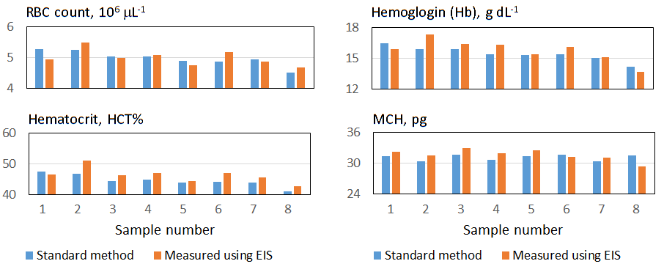
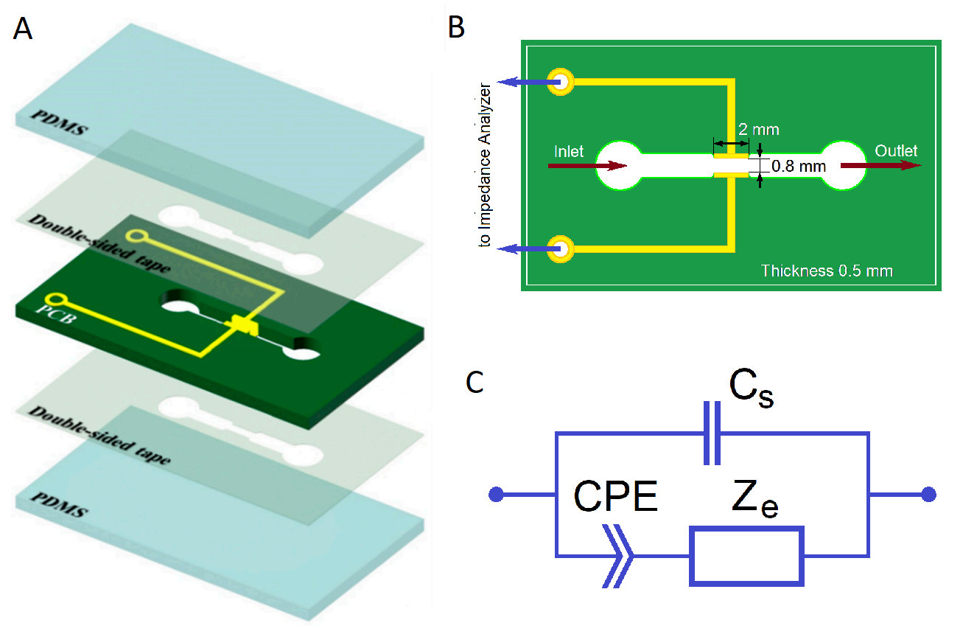
Hematocrit Measurement and Evaluation of Hemoglobin Level, Tonicity and Dielectric Properties of Human Blood Using Electrochemical Impedance Spectroscopy
¹Alexander Zhbanov, ¹Ye Sung Lee, ²Minkook Son and ^{1,2}Sung Yang*
¹School of Mechanical Engineering, ²Department of Biomedical Science and Engineering,
Gwangju Institute of Science and Technology (GIST), Gwangju, 61005, Republic of Korea
Abstract
The physical properties of blood can indicate a patient's health status. To measure these properties, a microfluidic channel with two electrodes was designed for electrochemical impedance spectroscopy (EIS) of flowing blood. For this study, we used venous blood from healthy volunteers. The blood was considered a suspension of erythrocytes in plasma, where the erythrocyte cytoplasm is a colloid of hydrated hemoglobin molecules in intracellular fluid. The study applied the effective medium theory to determine the hematocrit and hemoglobin levels, tonicity, and dielectric properties of each blood sample. The average properties of normal blood from a healthy person were established, and the deviations of each blood sample from normal were estimated. Additionally, EIS-based sensors enable the determination of ion concentration inside erythrocytes and the viscosity of erythrocyte cytoplasm, which is crucial in clinical practice. Further development is required for the clinical use of EIS.
Introduction
Results and discussion
EIS of blood has great potential for assessing the health of patients. Erythrocytes and plasma mainly determine the physical properties of blood. This study aims to determine the hematological parameters of blood based on its dielectric properties.
Eight blood samples the were studied. A comparison of clinical hematological tests and the developed technique shows that EIS demonstrates high accuracy and has great potential for medical application.
Materials and methods
Table 1. Properties of measuring devices and blood samples.
Biological materials
Venous blood of volunteers was used for this study. Informed consents were obtained from all the subjects before blood samplings.
The measuring system
The assembly diagram of measuring device is shown in Fig. 1A; the dimensions of the device are shown in Fig. 1B. Impedance spectra were obtained with an Agilent 4294A Precision Impedance Analyzer at frequency from 1 kHz to 110 MHz. The total impedance is determined by the blood impedance (Z_{e}), the stray capacitance of the measuring system (C_{s}) and the surface polarization effect modeled by the constant phase element (CPE) (Fig. 1C). The calibration procedure for determining the parameters CPE (n_{CPE} and Q_{CPE}), stray capacitance (C_{s}) and cell constant (α) has been described in our previous work ^{[1]}.
Sample | #1 | #2 | #3 | #4 | #5 | #6 | #7 | #8
C_{s}, pF | 1.64 | 2.30 | 1.83 | 2.15 | 2.15 | 2.19 | 2.23 | 1.94
α, pF | 0.0147 | 0.0142 | 0.0143 | 0.0142 | 0.0137 | 0.0144 | 0.0148 | 0.0143
n_{CPE} | 0.867 | 0.868 | 0.880 | 0.873 | 0.879 | 0.877 | 0.886 | 0.836
Q_{CPE}, nS s^{n} | 254 | 232 | 219 | 215 | 206 | 180 | 204 | 329
τ | 1.00 | 0.99 | 0.99 | 0.98 | 1.00 | 0.97 | 1.00 | 0.97
φ_{RBC} | 0.465 | 0.510 | 0.463 | 0.469 | 0.445 | 0.471 | 0.457 | 0.427
φ_{Hb} | 258 | 254 | 265 | 0.259 | 0.258 | 0.257 | 0.248 | 0.240
ε_{p} | 54.3 | 54.0 | 54.0 | 54.0 | 54.0 | 54.5 | 54.5 | 54.5
σ_{p}, S m⁻¹ | 1.16 | 1.16 | 1.16 | 1.16 | 1.16 | 1.16 | 1.16 | 1.16
ε_{m} | 13.2 | 15.2 | 12.8 | 12.8 | 12.8 | 15.2 | 14.0 | 11.5
ε_{f} | 17.5 | 17.4 | 17.4 | 17.4 | 17.4 | 22.5 | 18.3 | 22.5
σ_{f}, S m⁻¹ | 0.606 | 0.588 | 0.565 | 0.565 | 0.565 | 0.488 | 0.538 | 0.488
σ_{Hb}, S m⁻¹ | 0.674 | 0.660 | 0.667 | 0.667 | 0.667 | 0.687 | 0.724 | 0.653
ε_{d} | 268 | 274 | 260 | 260 | 260 | 248 | 273 | 287
ε_{δ} | 96.2 | 85.4 | 84.5 | 84.5 | 84.5 | 77.4 | 89.8 | 73.5
σ_{δ}, S m⁻¹ | 0.0412 | 0.0412 | 0.0412 | 0.0412 | 0.0412 | 0.0326 | 0.0396 | 0.0310
Fig. 1. Device Schematic (A) Assembly of device (B) Dimensions of measuring device (C) Equivalent circuit of measured impedance in two-electrode configuration.
Fig. 4. RBC count, Hematocrit, Hemoglobin level, and MCH measured by standard method (blue bars) and by analysis of EIS spectra (orange bars).
Theoretical model
Table 2. Hematological parameters of eight blood samples: red blood cell count (RBC), hemoglobin level (Hb), hematocrit (HCT), mean corpuscular volume (MCV), mean corpuscular hemoglobin (MCH), mean corpuscular hemoglobin concentration (MCHC), relative root mean square error (RRMSE).
The erythrocyte was modeled by an ellipsoid with semi-axes a_{x}=a_{y}=4.306 µm and a_{z}=τ·1.210 µm, where τ =1, >1 and <1 is the tonicity factor for normal, hypotonic and hypertonic erythrocytes, respectively. The thickness of erythrocyte membrane was δ_{m}=75 nm and the membrane conductivity was σ_{m}=5 µS m⁻¹ (Fig. 2A). The radius of Hb molecule was 26.74 Å and its relative permittivity was ε_{Hb}=2.9. The thicknesses of the Hb primary and secondary hydration shells were d=3.86 Å and δ=1.99 Å, respectively. (Fig. 2B).
The effective medium theory for estimation the dielectric properties of blood was developed in our previous work ^{[2]}.
Sample | #1 | #2 | #3 | #4 | #5 | #6 | #7 | #8 | RRMSE
RBC count,10⁶ μL⁻¹ | 5.27 | 5.24 | 5.03 | 5.03 | 4.89 | 4.87 | 4.95 | 4.51 | 3.99%
 | 4.95 | 5.48 | 4.98 | 5.09 | 4.74 | 5.17 | 4.86 | 4.68
Hemoglobin (Hb), g dL⁻¹ | 16.5 | 15.9 | 15.9 | 15.4 | 15.3 | 15.4 | 15.0 | 14.2 | 4.65%
 | 15.9 | 17.3 | 16.4 | 16.3 | 15.4 | 16.1 | 15.1 | 13.7
Hematocrit (HCT), % | 47.6 | 46.7 | 44.3 | 44.9 | 44.0 | 44.1 | 44.0 | 41.1 | 5.16%
 | 46.5 | 51.0 | 46.3 | 46.9 | 44.5 | 47.1 | 45.7 | 42.7
MCV, fL | 90.3 | 89.1 | 88.1 | 89.3 | 90.0 | 90.6 | 88.9 | 91.1 | 4.00%
 | 94.0 | 93.0 | 93.0 | 92.1 | 94.0 | 91.1 | 94.0 | 91.1
MCH, pg | 31.3 | 30.3 | 31.6 | 30.6 | 31.3 | 31.6 | 30.3 | 31.5 | 4.06%
 | 32.2 | 31.5 | 32.9 | 31.9 | 32.5 | 31.2 | 31.1 | 29.3
MCHC, g dL⁻¹ | 34.7 | 34.0 | 35.9 | 34.3 | 34.8 | 34.9 | 34.1 | 34.5 | 2.91%
 | 34.3 | 33.9 | 35.3 | 34.7 | 34.5 | 34.3 | 33.0 | 32.1
The top values in each cell are data from clinical hematology testing; the bottom values were obtained by analyzing the dielectric spectra.
Conclusion
Fig. 2. Theoretical model for dielectric properties of blood. (A) Erythrocyte suspension (B) Hemoglobin colloid in intracellular fluid
EIS allows determining hematocrit and hemoglobin levels, tonicity, and dielectric properties of human blood.
References
A. Zhbanov, S. Yang. Anal. Methods 9, 3302 (Jun. 2017)
A. Zhbanov et al. Electrchim Acta 438 (Jan. 2023)
Acknowledgement
This work was supported by a National Research Foundation of Korea (NRF) grant funded by the Korean government (MSIT) (No. 2021R1A2C3008169)

