Slide 1
Host specific drought stress-ameliorating effect of EPS-producing seed endophytes from invasive Lactuca serriola
2024. 08. 07.
Evolutionary Ecology Laboratory
School of Environment and Energy Engineering
Gwangju Institute of Science and Technology
Seoring Jeong^{p}
2024 ESA Annual Meeting
Notes:
Good afternoon. I’m seorin jeong from the Gwangju Institute of Science and Technology in Korea. I’d like to introduce my research titled ‘Host specific drought stress-ameliorating effect of EPS-producing seed endophytes from invasive Lactuca serriola’.

Slide 2
Plant-bacteria interaction
Introduction
Mutual interaction between invasive plant and bacteria
Plant holobiont (Elsheikh et al., 2021; Ali et al., 2014; Truyens et al., 2015)
Diverse plant growth-promoting (PGP) microbiomes associate with plant
Stress ameliorating effects against biotic and abiotic stress
Seed endophyte: advantage from vertical-transmission
Host-specificity (Liu et al., 2012; Zhalnina et al., 2018)
Further increase of competitive ability
Newly arrived habitat
Notes:
In nature, plants form an assembly with diverse microbes, called a ‘holobiant’.
Some of these microbes are known to promote plant growth and even ameliorate biotic and abiotic stresses.
Among them, the seed endophytes inhabiting plant seeds have the advantage of being vertically transmitted to the next generation. Thus they are expected to be an important factor in plants at early growth stage or for exotic plants invading new habitats.
However, this plant-microbe interaction is known to produce distinctive outcomes depending on the species or genotype of the host plant. If these bacteria are exclusively beneficial to their host, they would increase the competitive ability of the invasive plant.
Based on this knowledge, I want to observe the drought stress-ameliorating effect of seed endophytes in invasive plants, and whether it is affected by species or genotype of the host plant.

Slide 3
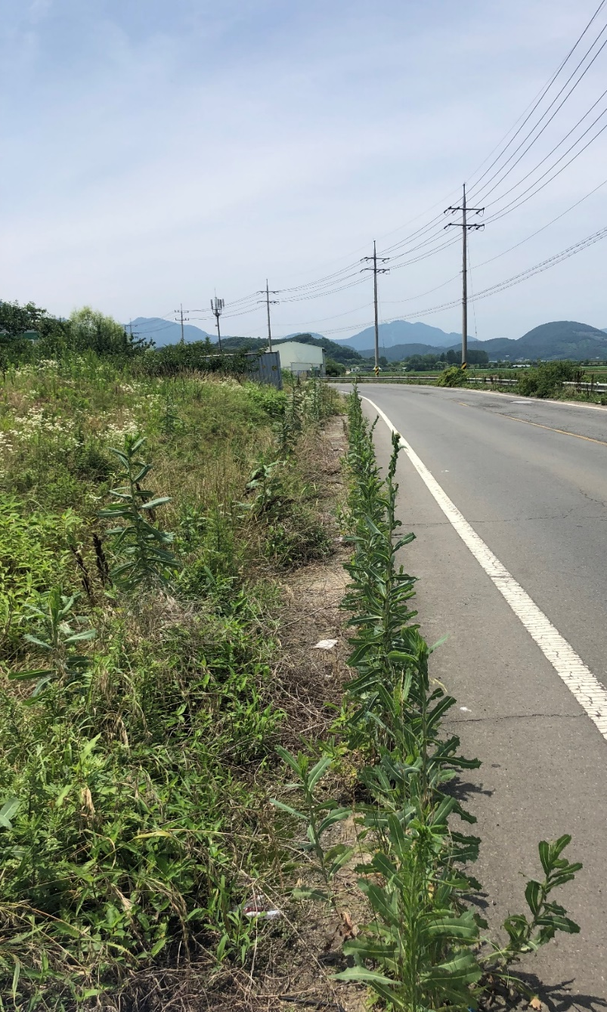
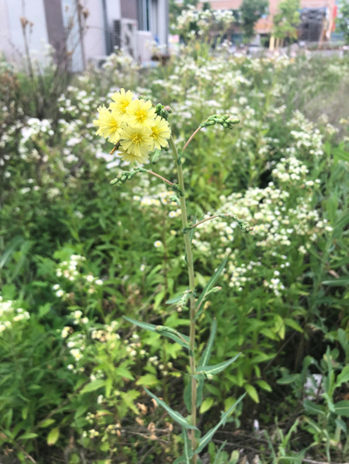
Study species
Introduction
Plant species: Lactuca serriola (Asteraceae)
Annual or biennial plants
Wild ancestor of cultivated lettuce (Lebeda et al., 2007)
Introduced to Korea in 1978 from Europe (Kim et al., 2013)
Resistance to drought condition (Chadha et al., 2021)
Significant agricultural and environmental weed in many contries
Notes:
This is the study species, the invasive plant Lactuca serriola.
L. serriola is an annual or biennial plant and a wild ancestor of cultivated lettuce. It is native to Europe and was first introduced to Korea in 1978.
Because of its vigorous growth and reproduction under drought conditions, it is considered as significant agricultural and environmental weed in many contries, including Korea.

Slide 4
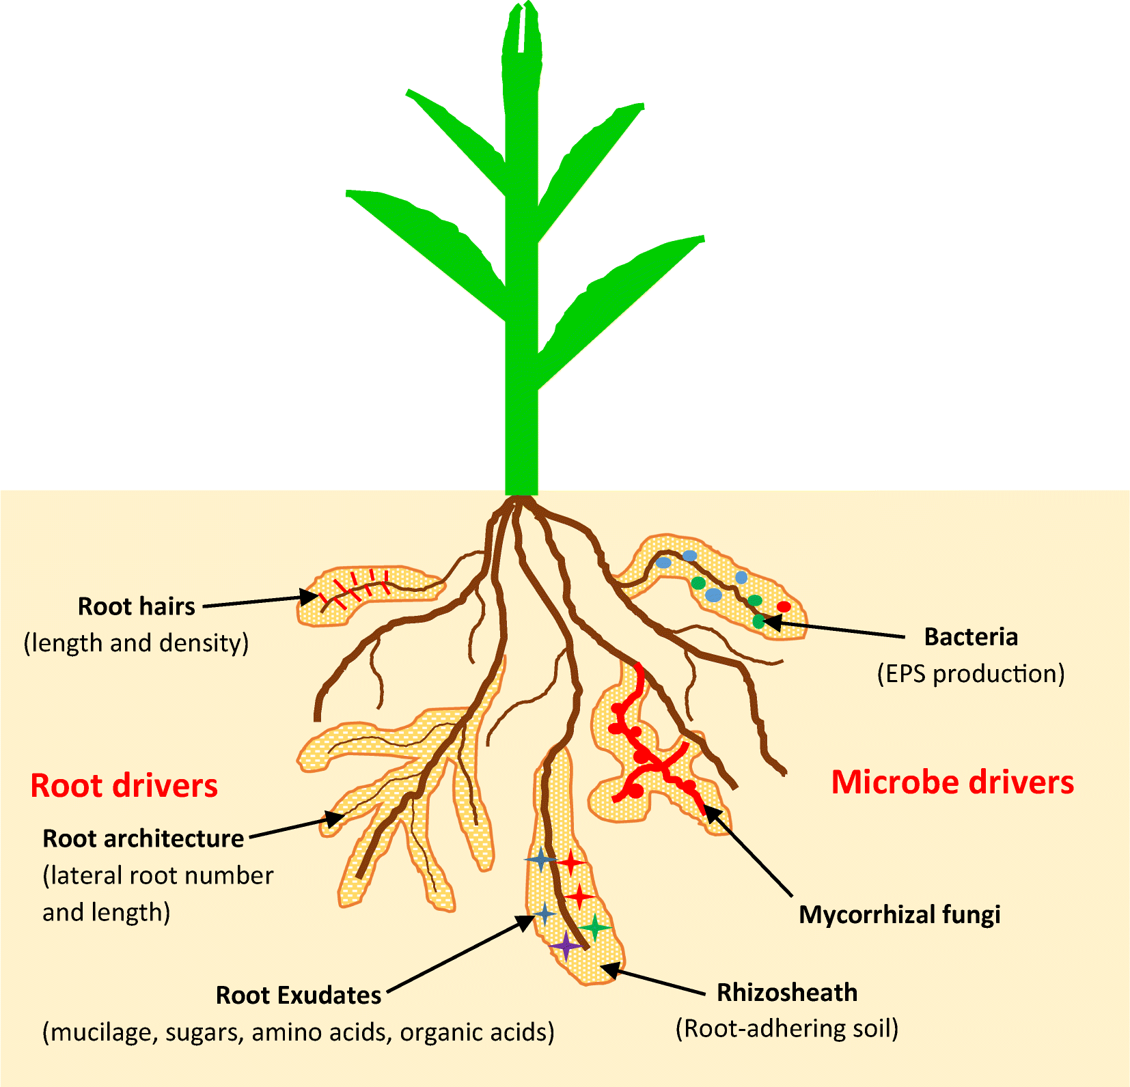
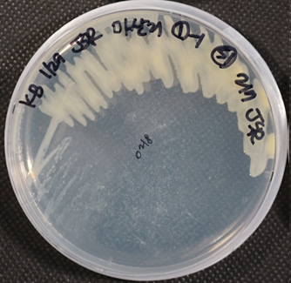
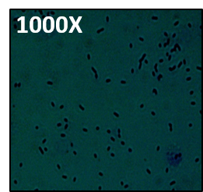
Study species
Introduction
Bacterial strain: Exopolysaccharide (EPS) producing seed endophytes
Originated from L. serriola seeds
EPS-producing bacteria: Contribute to rhizosheath formation
Improve water retention (Ndour et al., 2020)
Twelve strains: YJ1, YJ4, YJ6, SD1, SD16, SD25, MS1, MS24, MS26, GG1, GG17, GG19
(Ndour et al., 2020)
Notes:
This is the bacterial strain we used. We previously isolated the bacteria from the seeds of L. serriola. They showed viscosity in the medium, and a transparent capsule structure was observed, indicating the production of the specific compound, exopolysaccharide.
Generally, EPS-producing bacteria are known to contribute to root-adhering soil formation, called rhizosheath.
Because the rhizosheath is known to improve soil water retention, we expected that EPS-producing bacteria would affect the drought-tolerance of their host, L. serriola.
We used 12 EPS-producing bacterial strains in this experiment.
Bacterial strains were inoculated into the seeds of Arabidopsis and L. serriola, then the plant traits under control and drought conditions were measured to confirm the species-specific effect.
In addition, to confirm genotype-specific plant-bacteria interaction, we used five different genotypes of L. serriola from the same population.

Slide 5
Effect of EPS-producing bacteria on A. thaliana
Results
Kosakonia cowanii GG1 increase the shoot fresh weight and preserve soil water contents under drought condition
Notes:
This is the result of A. thaliana.
The shoot fresh weight and soil water contents under drought conditions are shown. C represents the uninfected control, and infected plants were compared with this control using multiple comparisons.
For A. thaliana, only one isolate, identified as Kosakonia cowanii GG1, increased the shoot fresh weight and preserve the soil water contents under drought stress.

Slide 6
Effect of EPS-producing bacteria on L. serriola
Results
Some of the isolates ameliorate the stress of L. serriola depends on host’s genotype
Notes:
This is the result of L. serriola.
The graph shows the plastic responses of each L. serriola genotype to bacterial treatments under drought conditions. The results for shoot fresh weight and soil water contents are shown.
Each plant genotype is represented with a different color. A positive RDPI value means the bacterial infection incrased the corresponding trait under drought stress compared to uninfected control.
Most of the isolates increased the shoot fresh weight and soil water content for genotype 3, which is represented with green.
Additionally, some of the isolates have a positive effect on other genotypes, but with different patterns.

Slide 7
Effect of EPS-producing bacteria on L. serriola: Corrleogram
Results
RDPIs, except soil polysaccharide concentration, were strongly correlated
Contribution of RAS to water stress amelioration
Notes:
Then we calculate Pearson’s coefficient between measured traits.
All of the measurements, except soil polysaccharide concentration, showed a strong correlation with each other.
Particularly, plant biomass and soil water contents strongly correlate with root-adhering soil, indicating that rhizosheath formation by infected isolates sequentially improve soil water retention and plant biomass as expected.
However, contrary to our expectations, EPS production was not a direct mechanism for ameliorating drought stress, as evidence by the absence of correlation between soil polysaccharide concentration and other measurements.

Slide 8
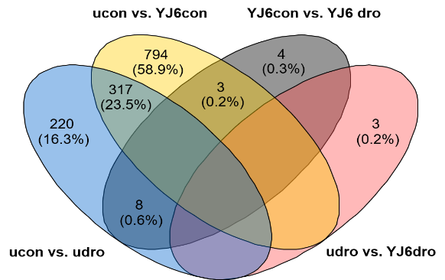
Effect of drought and YJ6 infection on gene expression of L. serriola
Results
YJ6 induced drought stress-like gene expression changes under control conditions
Differentially expressed genes (DEGs) analysis
▪ ucon: uninfected plants under control
▪ udro: uninfected plants under drought
▪ YJ6con: YJ6-infected plants under control
▪ YJ6dro: YJ6-infected plants under drought
ucon vs. udro
ucon vs. YJ6con
Notes:
To unravel the drought stress amelioration mechanism, we selected the L. serriola P2 and YJ6 pair for the transciprome analysis.
Changes in L. serriola gene expression were analyzed across for four comparisons.
The Venn diagram illustrates the number of differentially expressed genes in each comparison. Interestingly, more than half of the DEGs induced by drought stress were equally affected by bacterial treatment, even under control conditions.
Subsequently, pathway enrichment analysis was conducted. Below graph represents ptathways significantly affected by drought or YJ6 infection.
Five pathways were equally affected by both drought and YJ6 infection.

Slide 9
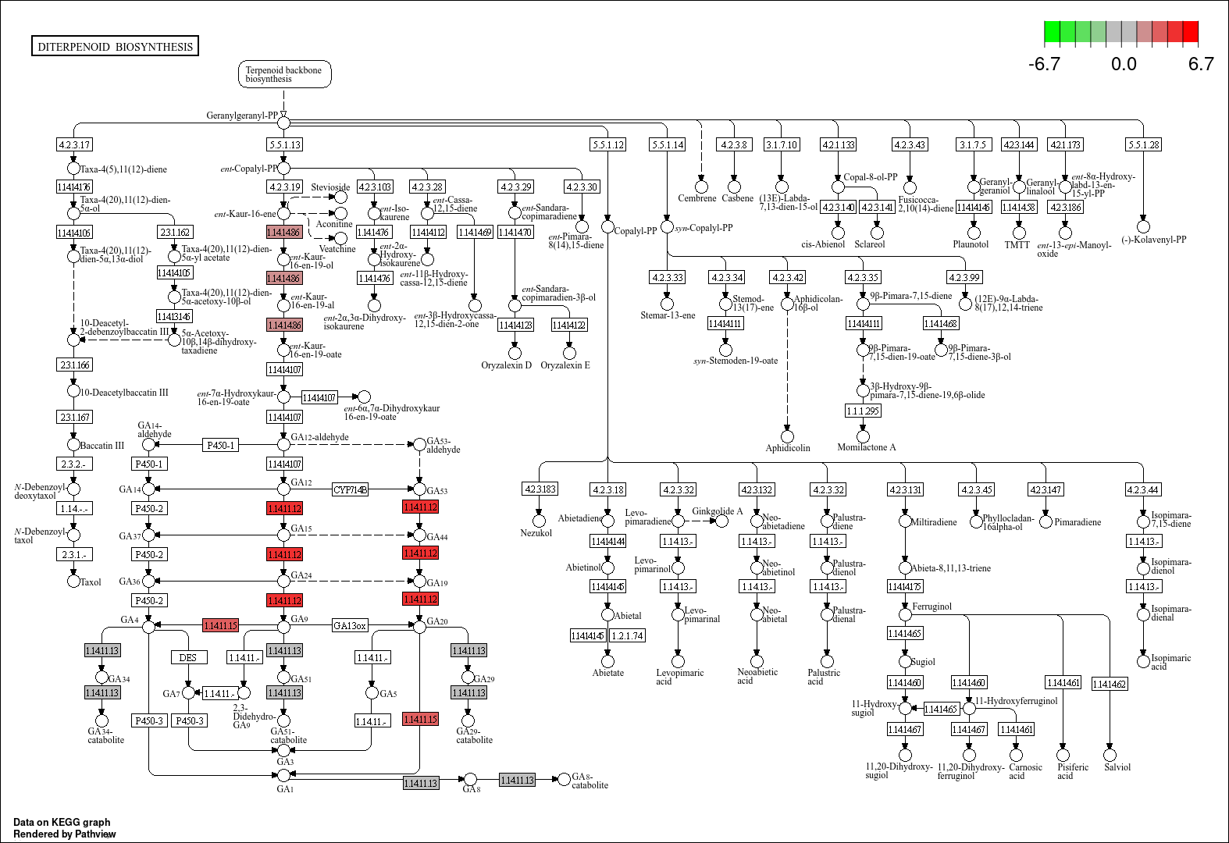
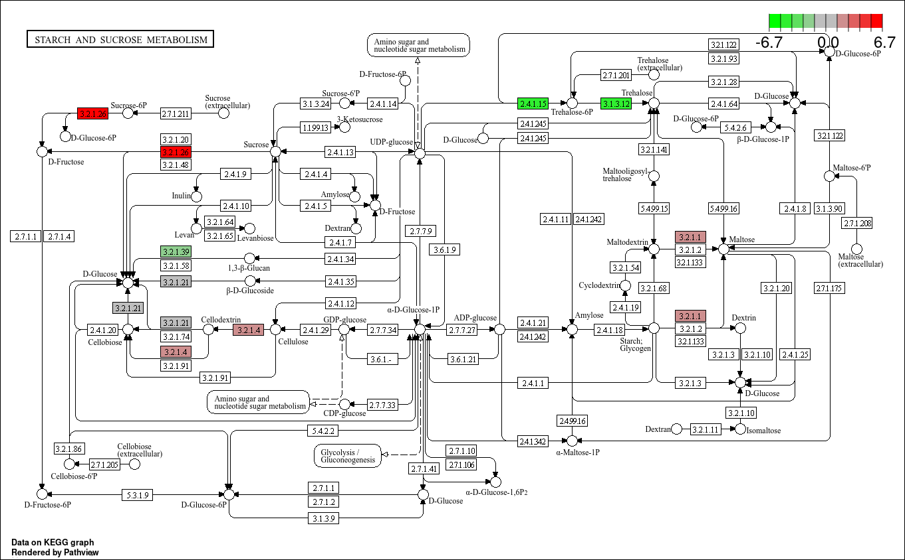
Effect of drought and YJ6 infection on gene expression of L. serriola
Results
YJ6 infection induce ABA signal transduction and osmolyte production without drought stress
Notes:
We examined the pathways affected by YJ6 under control conditinons in detail.
Firstly, YJ6 induces the signal transduction of the stress hormone ABA.
Specifically, ABF, a transcription factor that regulates the expression of numerous stress-related genes in plants, including those involved in osmolyte production, was highly up-regulated.
Consistent with this, pathways related to osmolyte production such as starch and sucrose metabolism, and phenylpropanoid biosynthesis, were affected.
These changes induce stress resistance in plants, commonly observed under drought stress. The important poit is that YJ6 infection induces these changes even under control conditions.
While it is generally known that induced resistance under non-stress conditions can lead to growth reduction due to trade-offs, it is expected that there would be no growth inhibition in this case because the biosynthesis of the growth-promoting phytohormone Gibberellins has been induced.

Slide 10
Role of E. tasmaniensis YJ6 as priming agents
Results
Bacteria as ‘priming agents’
Beneficial bacteria as priming agents (Lephatsi et al., 2021)
Priming: stress memory of the plant defense system by mild stress, chemicals, or biostimulatns
Plants react to abiotic stress more rapidly and actively
Induce systemic resistance without any inhibitory effect on growth and reproduction (Alagna et al., 2020)
faster, stronger
Primed state
Stress response
Basal state
time
Notes:
Based on the results of transcriptome analysis, we conclude that E. tasmaniensis YJ6 acts as a ‘priming agents’.
Priming refers to the stress memory of the plant defense system induced by mild stress, chemicals, or biostimulants.
Plants in a primed state react more rapidly and effectively when exposed to stress.
It is known that priming with beneficial bacteria induces systemic resistance without any inhibitory effect on growth and reproduction.
Despite the importance of priming in plant resistance, the detailed mechanisms remain unknown. This study presents a new aspect to the role of beneficial bacteria in the adaptive mechanisms of plants against drought stress.

Slide 11
Conclusion
Conclusion
Stress-ameliorating seed endophytes from L. serriola Diverse EPS-producing bacterial isolates have beneficial effects on the performance of L. serriola and A. thaliana under drought stress.
Host-specificity of bacterial performance Most of the isolates affect plant performance differently depending on genotype and species of the infected host.
Mechanism of stress amelioration: Priming against drought stress E. tasmaniensis YJ6 induce drought-stress like gene expression changes under benign water conditions by eleviating ABA signal transduction.
Seed endophytes from xerophytic L. serriola could ameliorate the drought stress in plant through rhizosheath formation, acting as biological priming agents
Notes:
We can summarize the result as follow.
Firstly, EPS-producing seed endophytes ameliorate stress and improve plant growth under drought conditions in their original host, L. serriola, and the model plant, A. thaliana. Next, this stress-ameliorating effect shows host-specificity. Most isolates positively affect L. serriola, particularly genotype 3, while only one isolate decreases the drought stress in A. thaliana.
Lastly, the stress-amelioration of endophytes is achieved through priming plants. E. tasmaniensis YJ6 induces drought-stress like gene expression changes under control conditions, with elevation of ABA signal transduction considered a key regulation.
Thus we conclude that seed endophytes from xerophytic L. serriola could ameliorate drought stress in plants through rhizosheath formation, acting as biological priming agents.

Slide 12
Thank you for listening
Notes:
Thank you for your listening. Any question?

Slide 13
Q and A

