Slide 1
GIST SMSE- NTUST SYMPOSIUM
Development of high-performance room-temperature gas sensor using visible light activation of photosensitizer
Presenter : Yeonji Yuk
Advisor: Sanghan Lee
Sustainable Energy and Electronic Devices Lab. (SEED)
School of Materials Science and Engineering (SMSE)
Gwangju Institute of Science and Technology (GIST)
2024.10.17

Slide 2

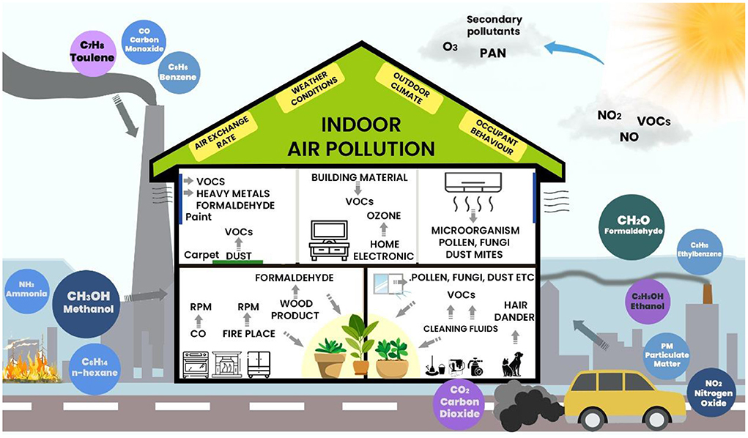

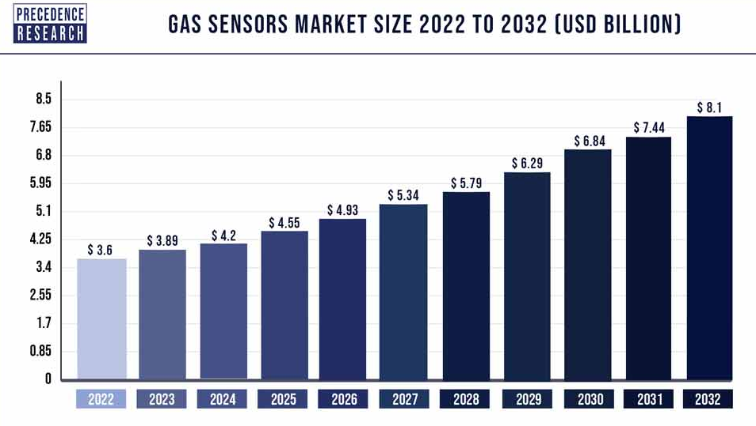
Rising demand for gas sensors in various industries
Ref) Mater. Horiz., 2021, 8, 661
Sensing material
(metal oxide)
Electrode
Insulator
Heater
Substrate
Drawback
Operating temperature > 473.15K
Heater required
Ref) frontiersin.org
The demand for gas sensors is increasing.
It is crucial to develop Room temperature(RT) gas sensors.
Notes:
There are a lot of various gases in our environment.
The detection of toxic, harmful and volatile gases cannot be separated form gas sensor.
It is used to monitor food spoilage, health care and air pollution.
So, the demand is increasing.
Chemiresistive type gas sensor uses mostly metal oxide as sensing layer because of cost and stability.
However, operating high temperature is essential to enhance the sensitivity of gas sensor, so heater must be required.
It cause high power consumption and poor device lifetime, so it’s important to develop room temperature gas sensors.

Slide 3
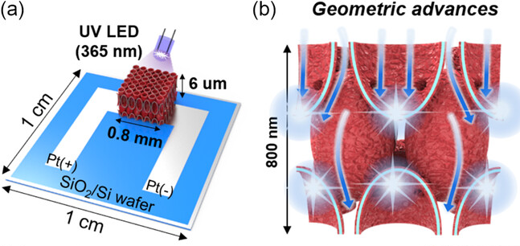
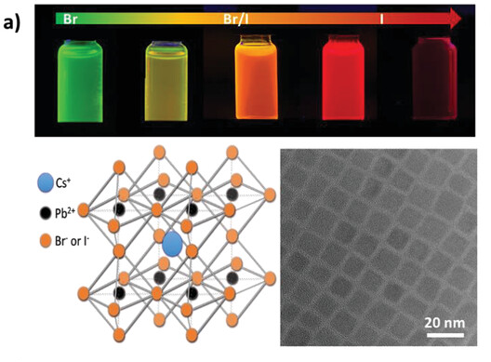

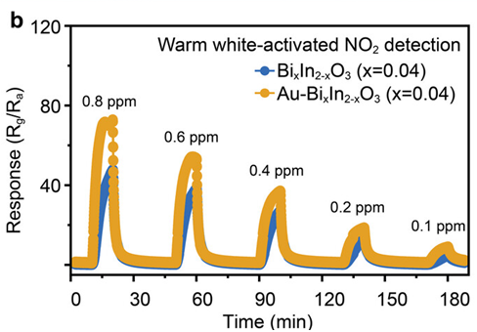
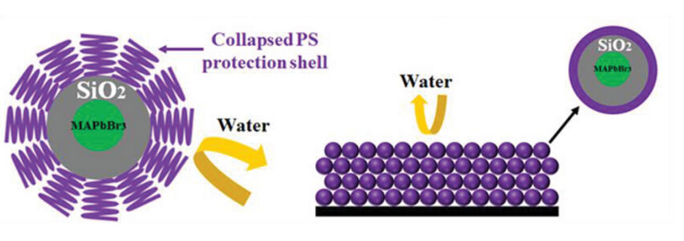
Visible light-activated room-temperature gas sensors using metal oxide
Issue
1) Light source : UV LED
Metal halide perovskite(MHP) Photosensitizer
Advantages
Tunable narrow bandgap
Excellent photoactive properties
Facile synthesis
Disadvantages
Degradation in the humidity environment >> solved by encapsulation engineering
“Visible light”
Ref) Small Struct. 2024, 5, 2300503
High power consumption, Harmful to human health
2) Rampant use of Noble metal
Ref) Small Methods, 2024, 8, 2300417
Encapsulation Engineering
“Suitable to
photosensitizer material”
Ref) Adv. Mater. 2024, 36, 2313731
High cost, Scarcity
Ref) Adv. Funct. Mater. 2024, 34, 2312175
3/11
Notes:
Light activation have attracted attention as alternative energy to heater.
Many researcher has studied the decoration of metal oxide surface with noble metal under ultraviolet.
But UV requires high power consumption and is harmful to human health. Also, noble metal has cost issue.
Therefore, we need to find new non noble metal material that can be operate under long wave lengths.
we focused on perovskite material as non noble metal photosensitizer under visible light.
It has advantage of tunable narrow bandgap , excellent photoactive properties and easy synthesis.
Encapsulation engineering is an effective strategy to prevent perovskite degradation in humid environments.

Slide 4
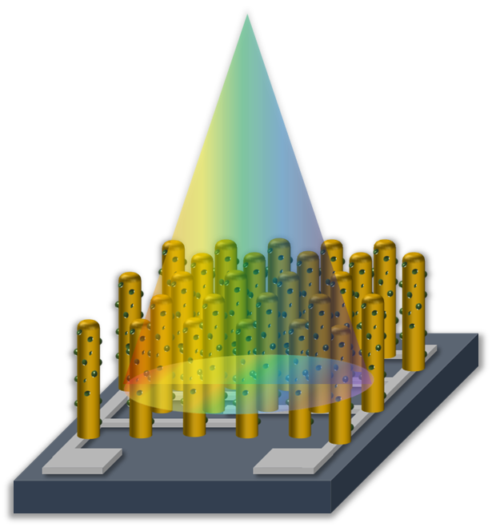
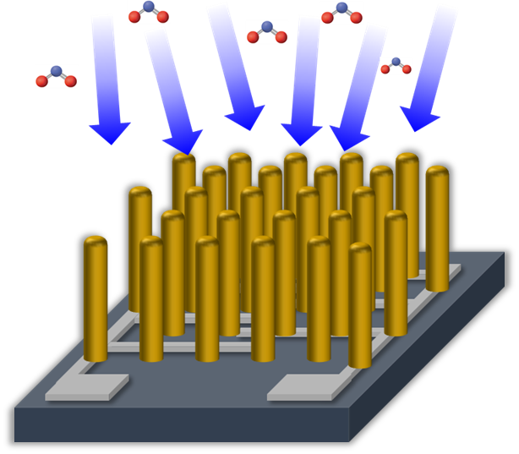
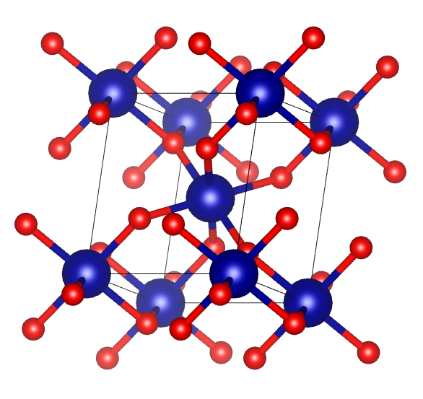
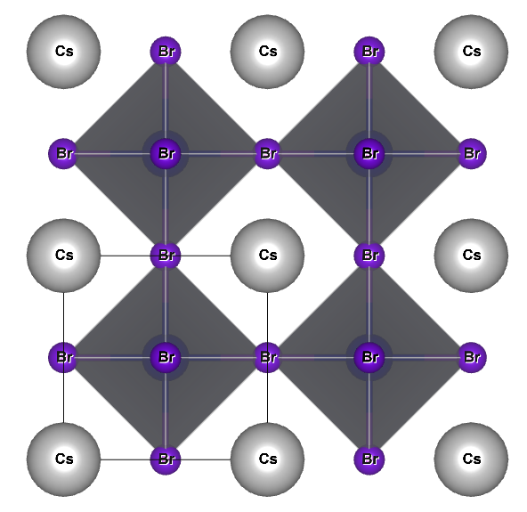
Fabrication of metal oxide-based RT gas sensor using MHP
Strategy 1. porous nanostructure
Strategy 2. photosensitizer decoration: MHP
Target gas
Visible
Light
via glancing angle deposition(GLAD)
Well-aligned porous nanostructure
Dual valency with Sn oxidation state
Increase electron density
under green light
Inorganic halide perovskite
Stable humidity condition
Tin dioxide(SnO₂)
CsPbBr₃@ SiO₂
4/11
Notes:
Based on previous slide, the strategies is established as follow.
The first strategy is to maximizing surface area via glaning angle deposition. It can be fabricated well aligned porous nanostructure.
And we selected SnO2 which is easily adsorbed by oxygen due to dual valency with Sn oxidation state.
The second strategy is to decoreated MHP as photosensitzer.
It increase electron density under green light due to narrow bandgap and electron-hole pair generation.
Also, cesium lead bromide is consisted of inorganic halide material. It is more stable than other MHP.
And encapsulating SiO2 shell also improves stability under humidity condition.

Slide 5
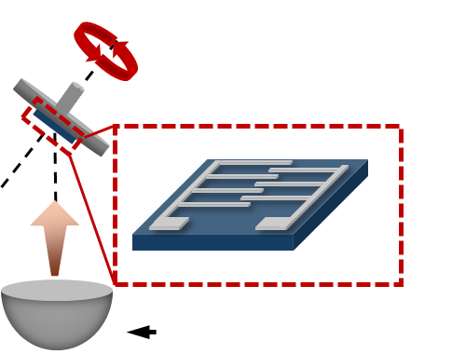
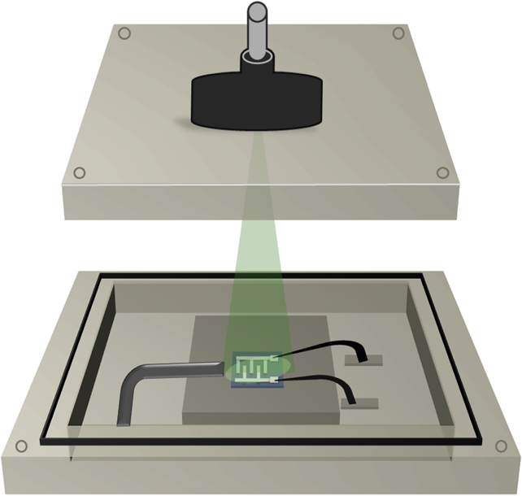
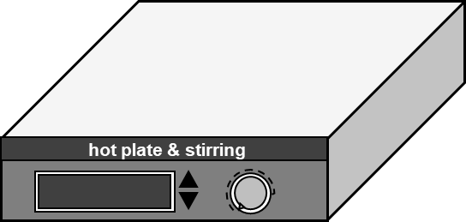
Material process
Axis Rotation
Angle control
Pt 50nm /Ti 3nm
Heating zone
Light 505nm
sample
SiO₂ 100nm/ Si
holder
Crucible(SnO₂)
873.15K, 2hour, air
Gas
In
GLAD
2. Post annealing
5. Drying
4. Spin coating
3. Colloidal synthesis
CsPbBr₃
Collaborated with
Dr. Chang-Lyoul Lee(APRI)
SnO₂
CsPbBr₃
NC
5/11
Notes:
we synthesized and analysis the sensing layer using the following process.

Slide 6
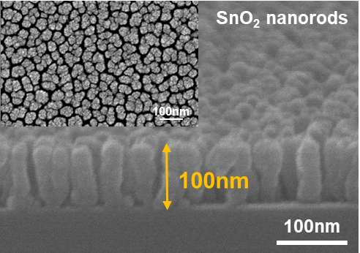
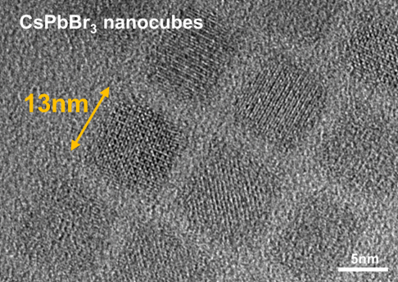
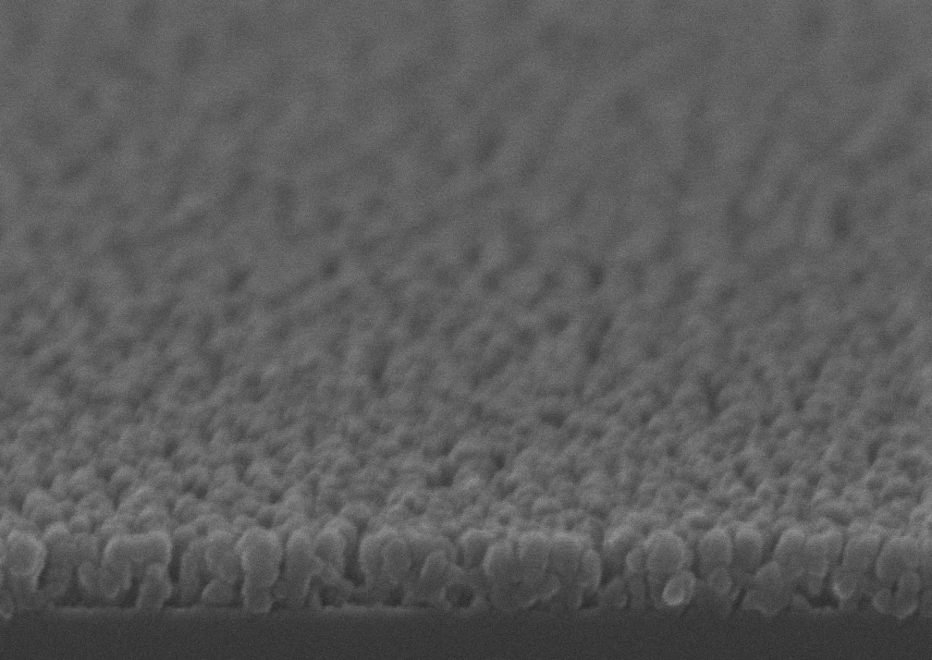
morphology characterization
Scanning Electron Microscopy (SEM) cross image
Transmission Electron Microscopy
(TEM) image
SEM tilt image
CsPbBr₃ @ SiO₂ nanocubes/SnO₂ nanorod
100nm
The SEM images show that vertically aligned 100 nm SnO₂ nanorods array was deposited via GLAD.
TEM image reveals that 13 nm SiO₂@CsPbBr₃ nanocubes array were synthesized via colloidal method.
SiO₂@CsPbBr₃ nanocubes was decorated on SnO₂ nanorod without collapse of the structure.
6/11
Notes:
TEM and SEM images confirmed the successful synthesis of Vertically align SnO2 nanorod array and CsPbBr3 encapsulated in SiO2.
Also, right image reveals that Photosensitizer is decorated on SnO2 nanorod without collapse of the structure.

Slide 7


Crystallinity & optical characterization
X-ray Diffraction (XRD)
Photoluminescence (PL)
Tauc plot
PL intensity (a.u)
Intensity (a.u)
PL peak:
513 nm
($αhυ$)²
~2.44 eV
Wavelength (nm)
~2.41 eV
Photon energy (eV)
~2.67 eV
2$θ$ ($°$)
XRD data reveals SnO₂ rutile phase and CsPbBr₃@SiO₂ cubic phase are observable without any phase change.
PL data shows that CsPbBr₃@SiO₂ /SnO₂ wavelength is same as CsPbBr₃@SiO₂ .
The bandgap decorated with CsPbBr₃@SiO₂ was found to be approximately 2.41 eV and 2.44 eV, which is a red shift from pristine SnO₂ (E_{g}=2.67 eV).
7/11
Notes:
When PQD decorated on SnO2, it show same crystallinity and optical property compared to pristine.
it demonstrate that the phase or wavelength has not change.
And the band gap is red shift from pristine tin oxide, it reveal that it can be possible to absorbed green light.

Slide 8




Gas sensing properties
CsPbBr₃@SiO₂/SnO₂ NR under dark and Light 505nm
Response (R_{a}/R_{g})
Response (R_{a}/R_{g})
19.45
2.09
$τ_{Res}$
116s
$τ_{Res}$
269s
$τ_{Res}$
-s
$τ_{Rec}$
129s
Time (min.)
Time (min.)
CsPbBr₃@SiO₂/SnO₂ shows n-type oxide semiconductor gas sensor mechanism.
The presence of CsPbBr₃@SiO₂ doesn’t affect response and recovery time under dark.
Sensitivity and response/recovery time is improved under light 505nm.
8/11
Notes:
And then, we analysis gas sensing property under dark and 505nm wavelength as green light.
Both are shown n-type oxide semiconductor mechanism.
The presence of SiO₂@CsPbBr₃ doesn’t affect response and recovery time under dark.
On the other hand, when green light source is irradiated, sensitivity and recovery/response time is improved.

Slide 9
Gas sensing properties
Selectivity test
Reproducibility test
Long stability test
Response (R_{a}/R_{g})
Response (R_{a}/R_{g})
Response (R_{a}/R_{g})
Gas out
13.8-fold
Gas in
Time (min.)
NO₂
NH₃
Analytes
Acetone
Day1
Day2
Day3
H₂S
CO
H₂
When compared to other reference gases, SiO₂@CsPbBr₃/SnO₂ shows excellent NO₂ Selectivity.
it exhibited stable performance over 3 cycle and 3 days through reproducibility and long stability test.
9/11
Notes:
It shows excellent NO2 selectivity compared to other reference gases.
Finally, it exhibit stable performance 3 cycle and 3 days through reproducibility and long stability test.

Slide 10
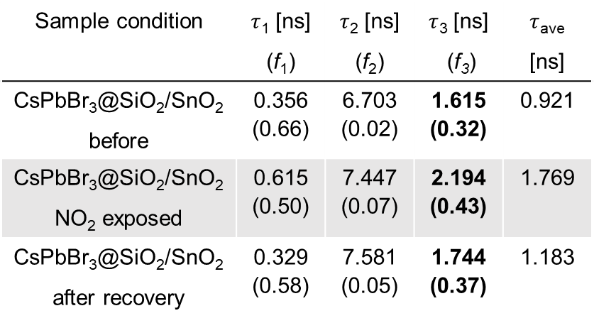
Suggested gas sensing mechanism
Photoluminescence(PL)
Time Resolved Photoluminescence(TRPL)
Integrated PL int. (x10⁶ cnt.)
Sample condition | $τ$₁ [ns] (f₁) | $τ$₂ [ns] (f₂) | $τ$₃ [ns] (f₃) | $τ$_{ave} [ns]
CsPbBr₃@SiO₂/SnO₂ before | 0.356 (0.66) | 6.703 (0.02) | 1.615 (0.32) | 0.921
CsPbBr₃@SiO₂/SnO₂ NO₂ exposed | 0.615 (0.50) | 7.447 (0.07) | 2.194 (0.43) | 1.769
CsPbBr₃@SiO₂/SnO₂ after recovery | 0.329 (0.58) | 7.581 (0.05) | 1.744 (0.37) | 1.183
CsPbBr₃@SiO₂/SnO₂ : ~21% decrease
CsPbBr₃@SiO₂ : ~1% decrease
NO₂ exposed
PL data indicates that electrons have transferred from CsPbBr₃ to SnO₂ .
TRPL data shows distinct trend in $τ$₃ which is longer decay time when NO₂ exposed.
10/11
Notes:
To prove the role of the photosensitizer, we analyzed the mechanism via PL and TRPL.
PL intensity decrease after exposure to NO2 gas compared to pristine perovskite. It indicates that electron have transferred from CsPbBr3 to SnO2.
Furthermore, TRPL data revealed distinct trend in tau 3 which is longer decay time when NO2 exposed.

Slide 11

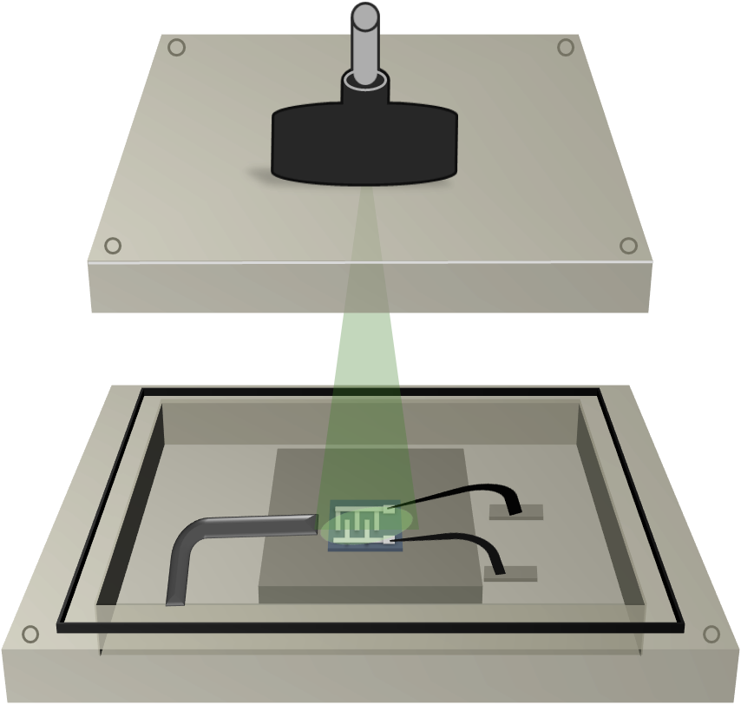


SiO₂@CsPbBr₃/SnO₂
It can be operated at room temperature under green light.
It exhibited significantly fast recovery and high response compared to pristine SnO₂.
The photosensitizer mechanism is demonstrated via PL intensity and TRPL.
<Light>
Light
source
Response (R_{a}/R_{g})
19.45
$τ_{Res}$
116s
Gas
In
$τ_{Rec}$
129s
Probe Tip
11/11
Notes:
It can be operated at room temperature undere green light and exhibited fast recovery and high response compare to pristine SnO2.
Also the phososensitizer mechanism is demonstrate via PL intensity and TRPL.

Slide 13
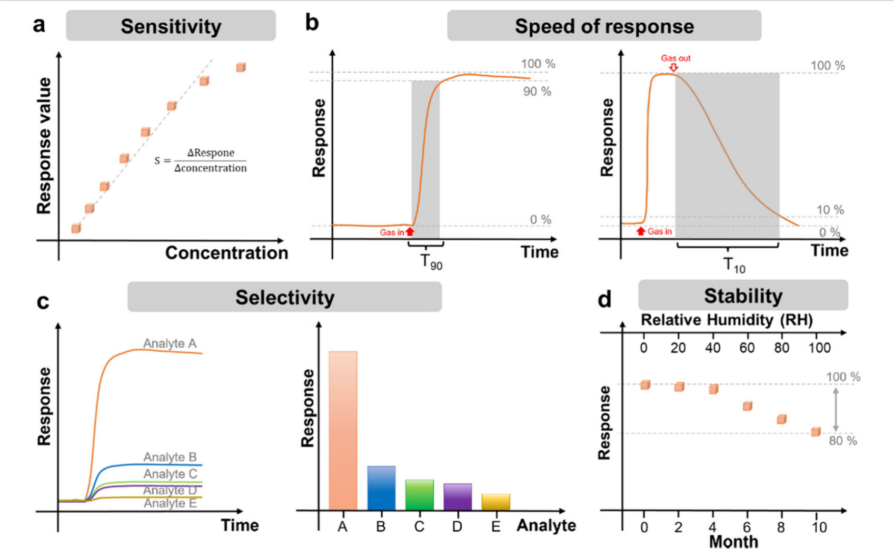

Slide 14
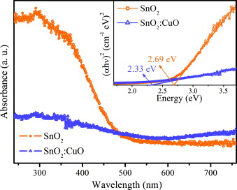
Ref) Sensors and Actuators B 169 (2012) 199–207

Slide 15
SiO₂@CsPbBr₃
SiO₂ shell

Slide 16
Pristine SnO₂ NR
Response : 1.74
Response time : 269s
Recovery time: -s
Response : 5.73
Response time : 40s
Recovery time: 455s
5.0E+04
Response : 2.86
Response time : 273s
Recovery time: -s
3.4E+04
2.9E+02
Pristine SnO₂ is shown n-type oxide semiconductor gas sensor mechanism.
Photoactivation affects the recovery time of pristine SnO₂ due to reactive oxygen species and electron-hole pair.

Slide 17
CsPbBr₃/SnO₂ NR
Test 1)
Response time : 55s
Recovery time: 265s
Test 2)
Response time : 54s
Recovery time: 260s
Response | test1 | test2
1cycle | 7.82 | 7.82
2 cycle | 5.16 | 4.73
3 cycle | 2.81 | 3.94
With each cycle, there is a decrease in response due to CsPbBr₃ core only photosensitizer degradation.

Slide 18
CsPbBr₃ film PL intensity
CsPbBr₃ /SnO₂ film
SiO₂@CsPbBr₃: ~2.9% decrease
CsPbBr₃ : ~59% decrease
SiO₂@CsPbBr₃ /SnO₂: ~27.6% decrease
CsPbBr₃ /SnO₂ : ~22.4% decrease

Slide 19
TRPL

Slide 20


TRPL
Sample condition | τ₁ [ns] (f₁) | τ₂ [ns] (f₂) | χ² | τ_{ave} [ns]
SiO₂@CsPbBr₃ before | 0.696 (0.78) | 2.937 (0.22) | 1.171 | 1.189
SiO₂@CsPbBr₃ after | 0.724 (0.76) | 2.908 (0.24) | 1.169 | 1.252
CsPbBr₃ before | 0.998 (0.73) | 3.909 (0.27) | 1.209 | 1.781
CsPbBr₃ after | 1.059 (0.69) | 4.194 (0.31) | 1.264 | 2.036
$∆τ$ =0.028ns
<
$∆τ$ =0.061ns

