Slide 1



The 10th International Water Industry Conference (IWIC 2024)
Analysis of total nitro compounds in water via batch reactor UV photolysis and colorimetric detection of nitrite
2024.11.14
Nguyen Cong-Hau, Valentin Rougé, Pham Thi Thai Ha Nguyen, Hyunjin Kim, Taekeun Son, and Yunho Lee*
*Email: yhlee42@gist.ac.kr

Slide 2
Contents
Formation of (halo) nitro compounds (NCs) in water.
Method optimization and development.
Applications:
Determining NC products from ozonation of amines/amino acids.
Occurence of NCs in river water and wastewater effluents.

Slide 3
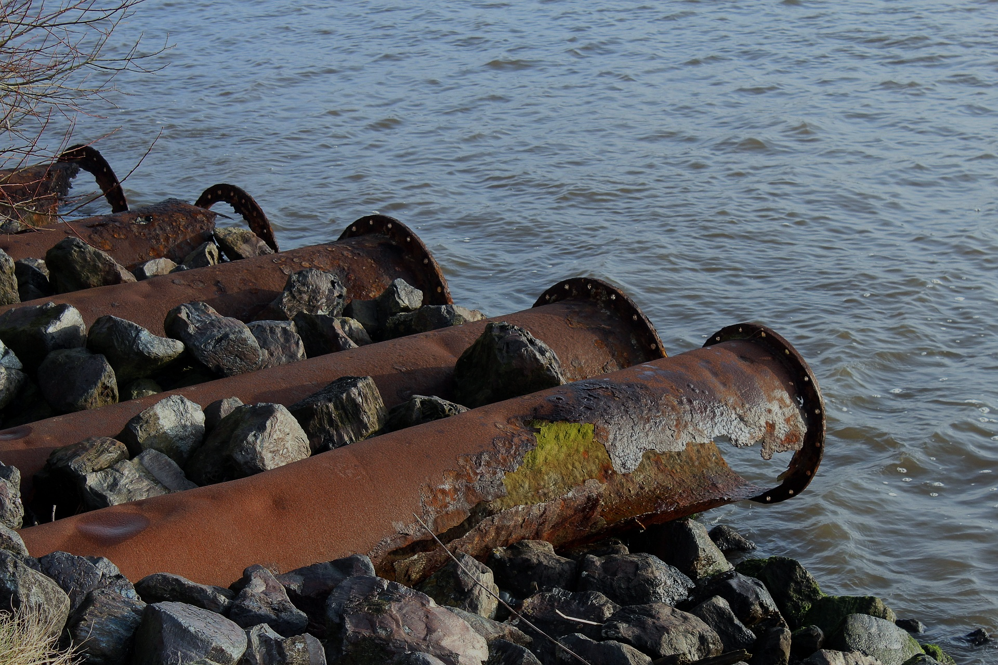


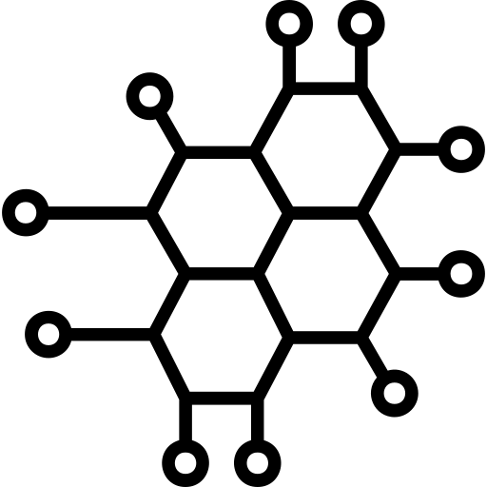
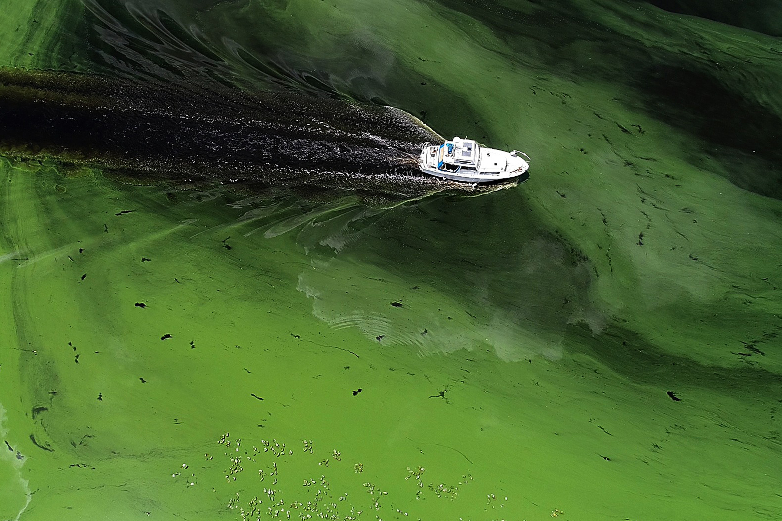
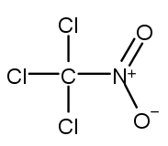
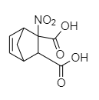
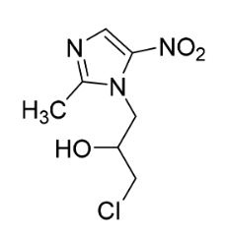
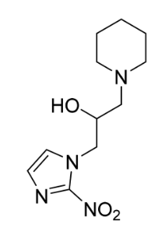
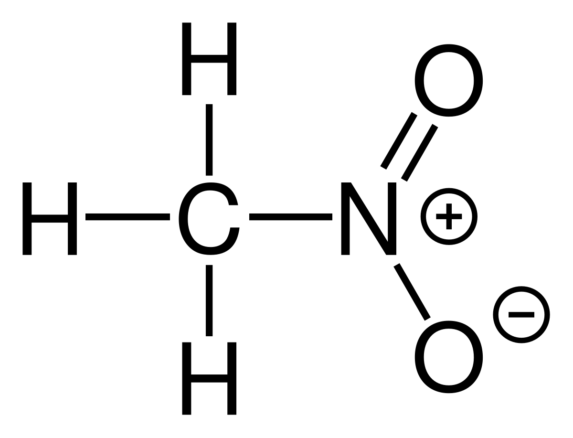

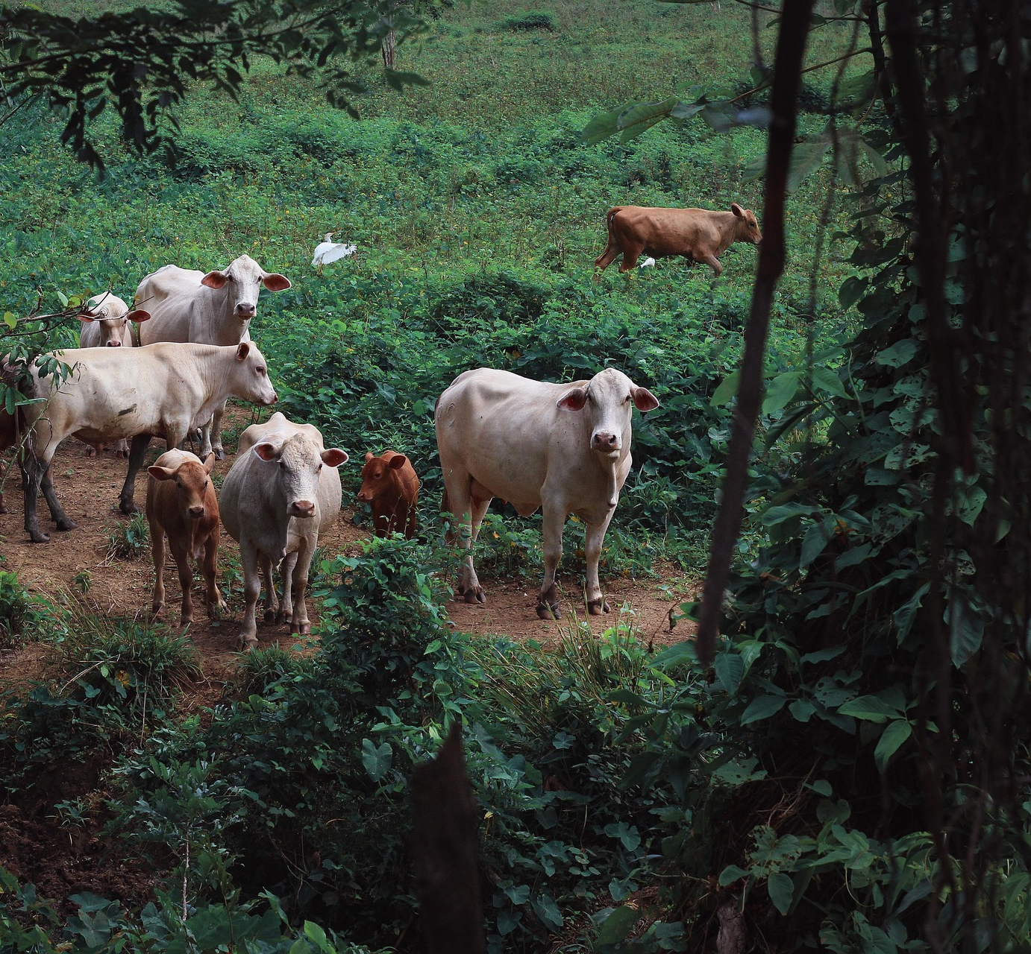
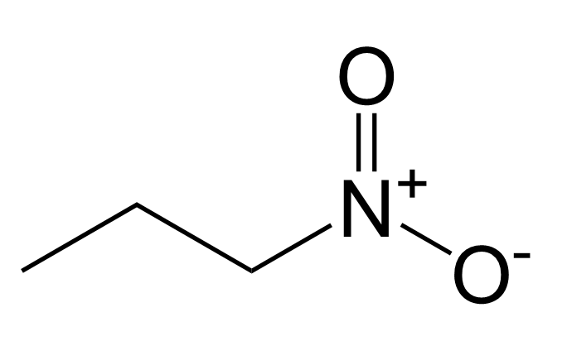
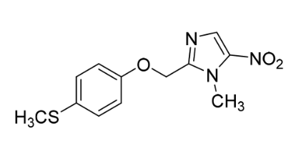
Formation of (halo) nitro compounds (NCs) in water
Protein
Fertilizer
Elements
Amino Acids
Humics
...
Sewage Discharge
Water
Intake Sources
Water Domestic Use
O₃, UV/H₂O₂ or Cl₂
Dissolved Organic Nitrogen
Disinfection/
Oxidation Treatment
Nitrogenous DBPs
Known Substances
UnKnown Substances
Algal blooms
Eutrophication
Nitromethane
Chloropicrin
Agriculture
Animals
1-nitropropane

Slide 4
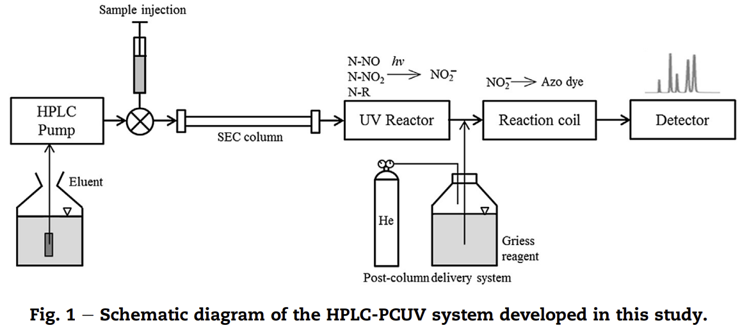
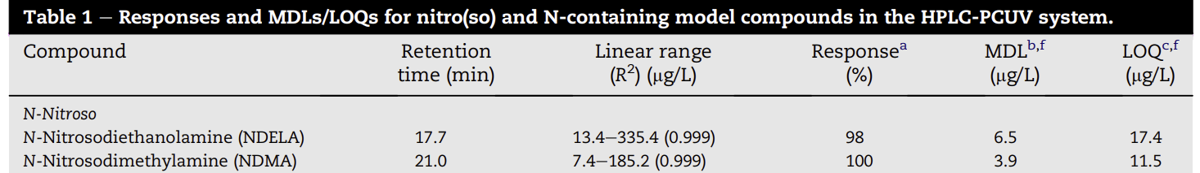
UV photolysis for quantifying total nitro(so) compounds
limited number of nitro compounds

Slide 5
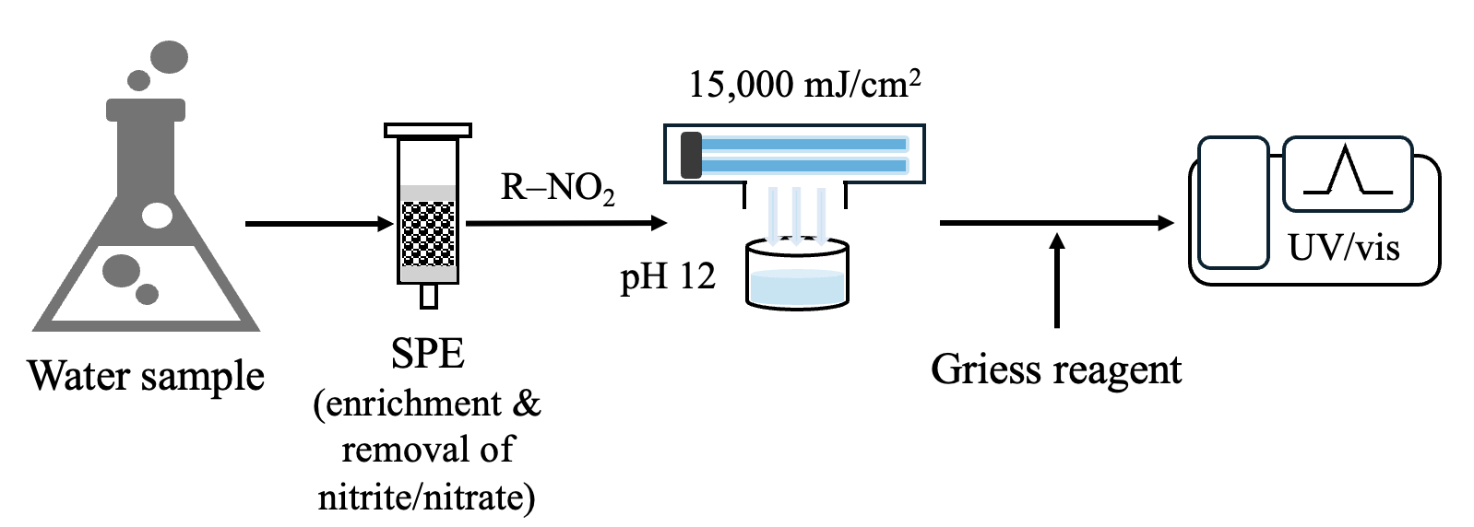

Research objectives
15,000 mJ/cm²
R–NO₂
UV/vis
pH 12
Water sample
SPE
(enrichment & removal of nitrite/nitrate)
Griess reagent
Flow of batch-reactor UV₂₅₄ photolysis for total NC quantification in waters.
to develop total nitro compound (NC) quantification method based on batch reactor UV₂₅₄ photolysis and colorimetric detection of nitrite;
to apply the method in water analysis and management.

Slide 6
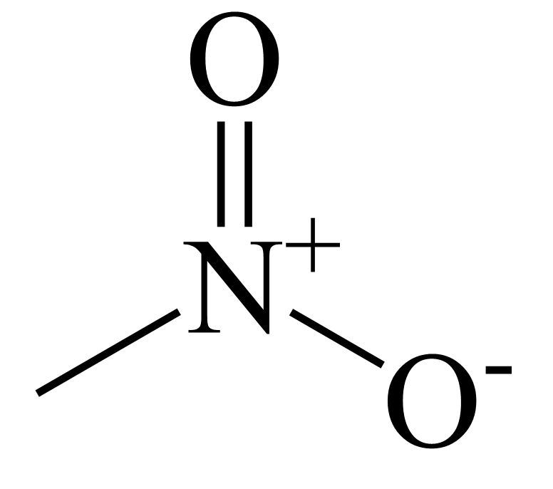
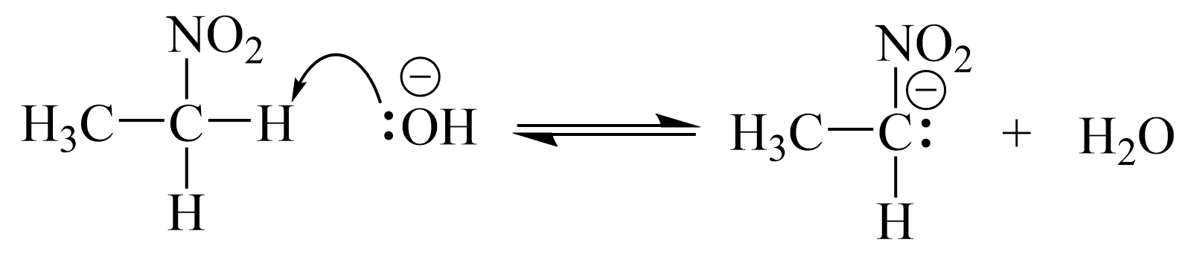
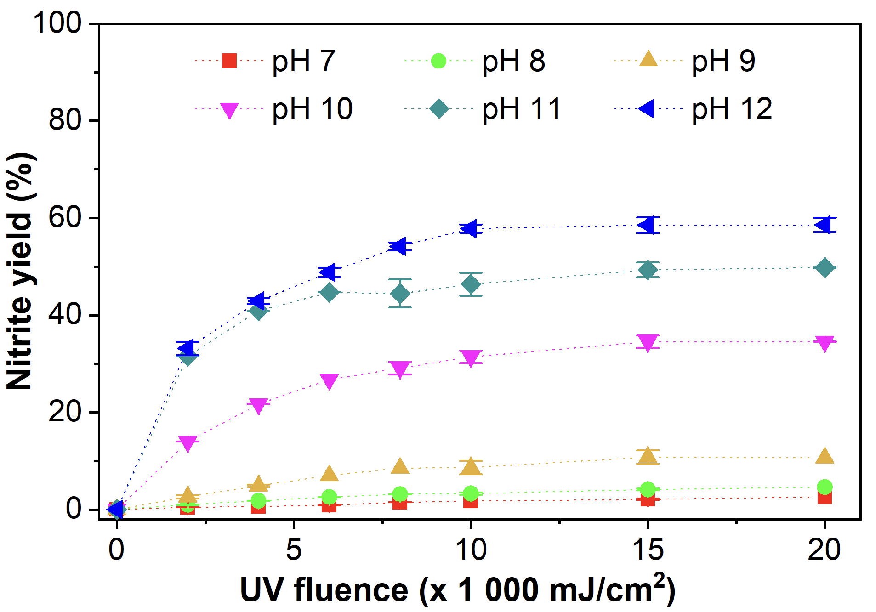
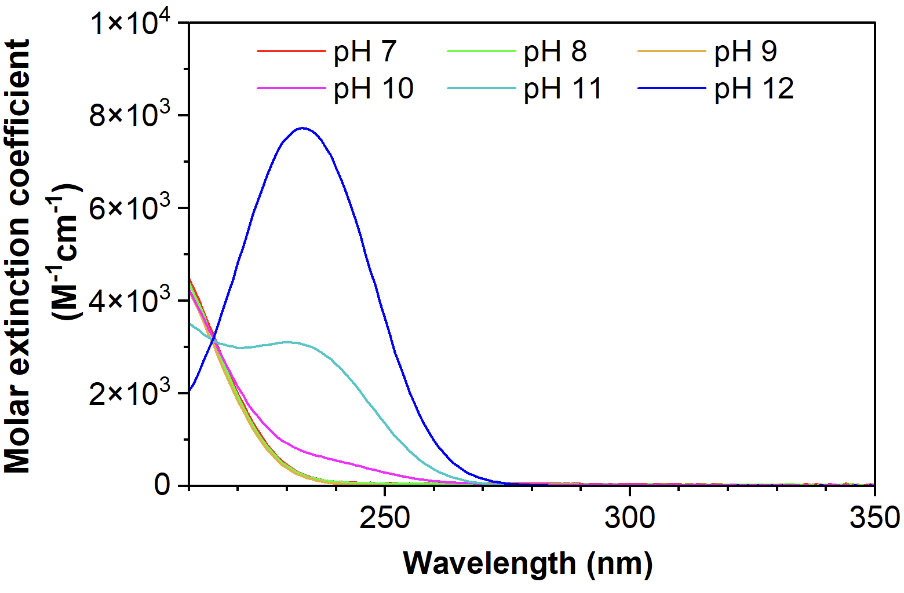

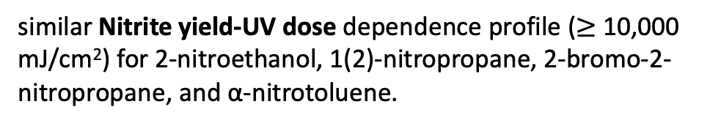
Effect of UV fluence and pH on nitrite yield
https://www.sciencedirect.com/topics/chemistry/nitroalkane
nitromethane
pKa = 10.6
$\sim$2319 M⁻¹ cm⁻¹ at 254 nm
210
similar Nitrite yield-UV dose dependence profile ($≥$ 10,000 mJ/cm²) for 2-nitroethanol, 1(2)-nitropropane, 2-bromo-2-nitropropane, and α-nitrotoluene.
Shi et al, ES&T, 2021 also reported enhanced UV light absorption in strongly alkaline condition. The molar extinction coefficient (pH 12) was shown as 2066 M⁻¹cm⁻¹.
Notes:
nitromethane

Slide 7
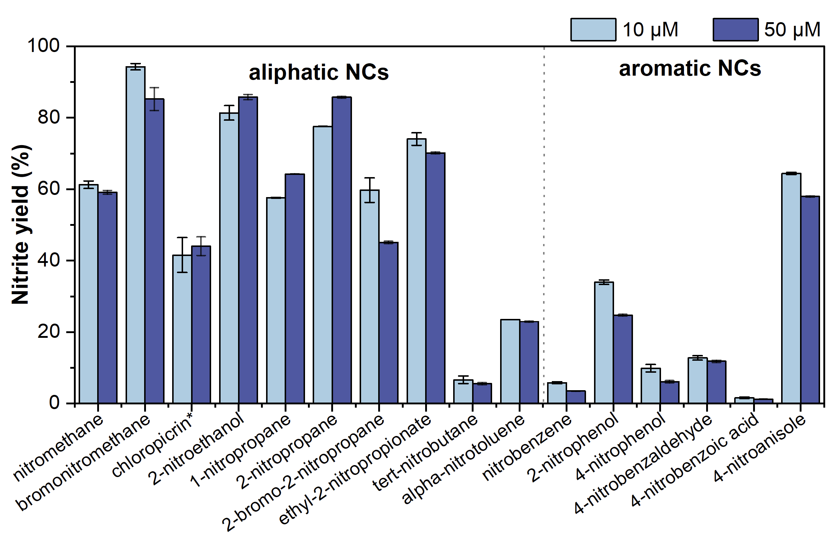
Nitrite yields from UV photolysis of NCs with different structures
15,000 mJ/cm²
68(±17)%, n=8
0.01 M NaOH (pH 12)
15,000 mJ/cm²
57(±27)%, n=10
19(±23)%, n=6
11(±11)%, n=5
Chloropicrin*: chlorinated products of nitromethane. Triplicate experiments.

Slide 8
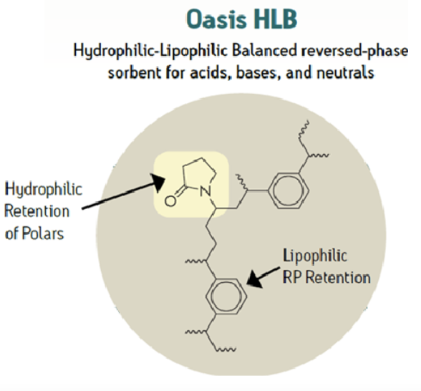
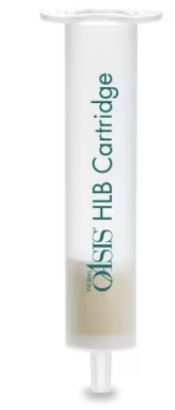
Preconcentration procedure by solid phase extraction (SPE)
Conditioning
3.0 mL of MeOH
Loading
Wash
2.5 mL of ACN
Elution
3.0 mL of DIW
Flow rate: 10 mL/min
Sample volume: 1000 mL
Flow rate: 10 mL/min
Air flush: 5 min
50.0 mL of 1 mol/L NaCl
50.0 mL of DIW
Dry under gentle N₂ (6 min)
Flow rate: 10 mL/min
Flow rate: 2 mL/min
Batch UV photolysis
for total NC
+
2 mL ACN
8 mL H₂O (NaOH)
10 mL
80-fold
sample enrichment

Slide 9
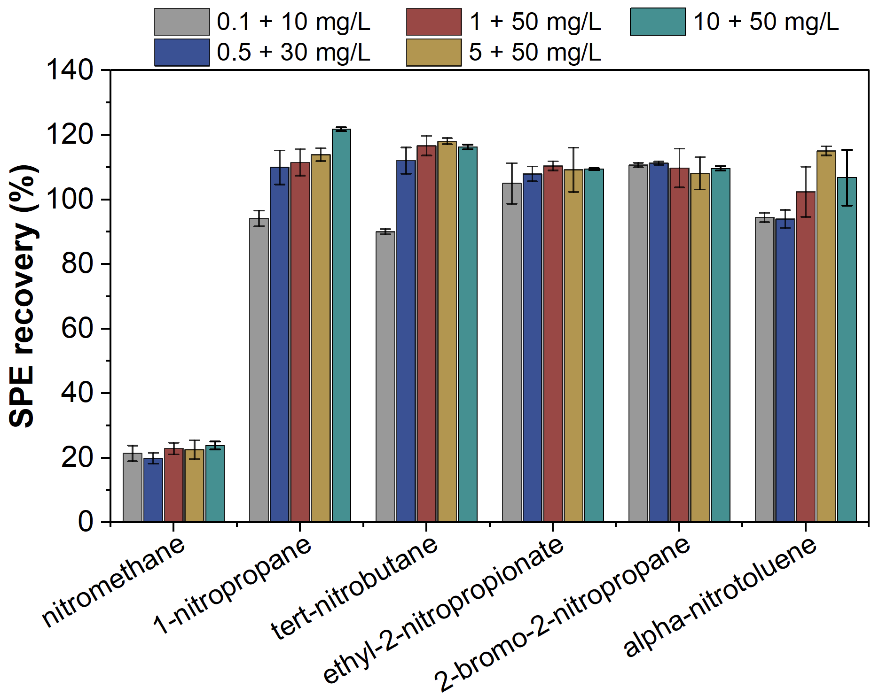
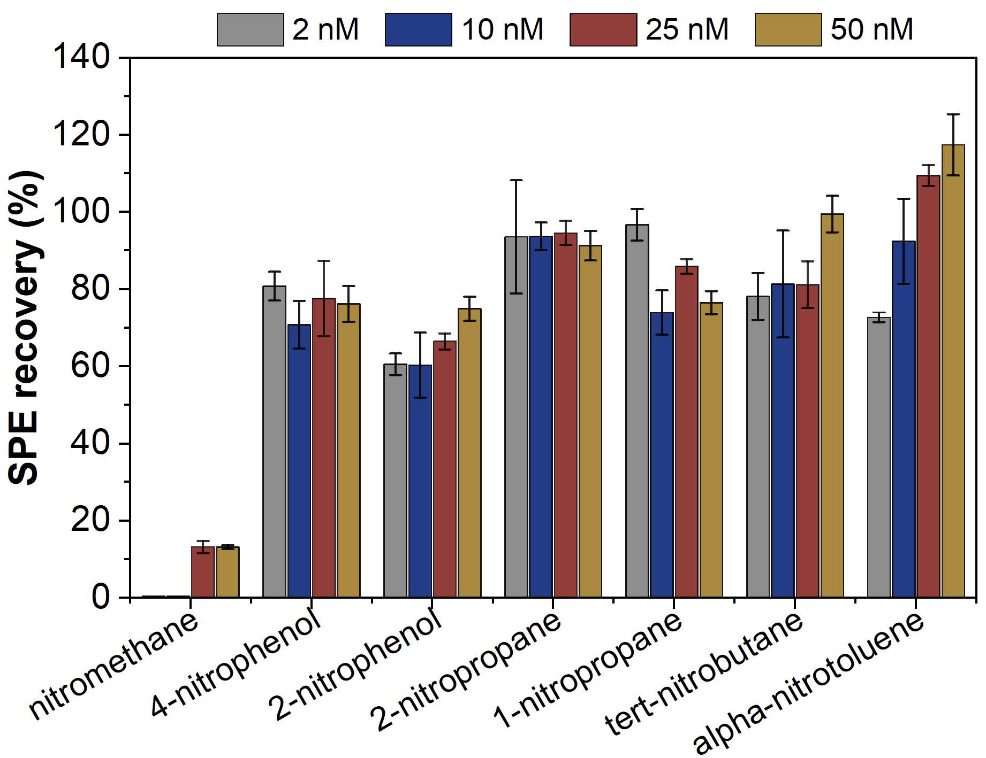


Extraction efficiency during SPE for NCs
Selected NCs spiked in UW in the presence of NO₂– + NO₃ –
Selected NCs spiked in tap water
200 nM
$\sim 22$%
$\sim$13%
With SPE, LODs estimated as 2 nM (57% nitrite yield) for aliphatic NCs and 6 nM (19% nitrite yield) for aromatic NCs, with the overall enrichment factor of 80.

Slide 10
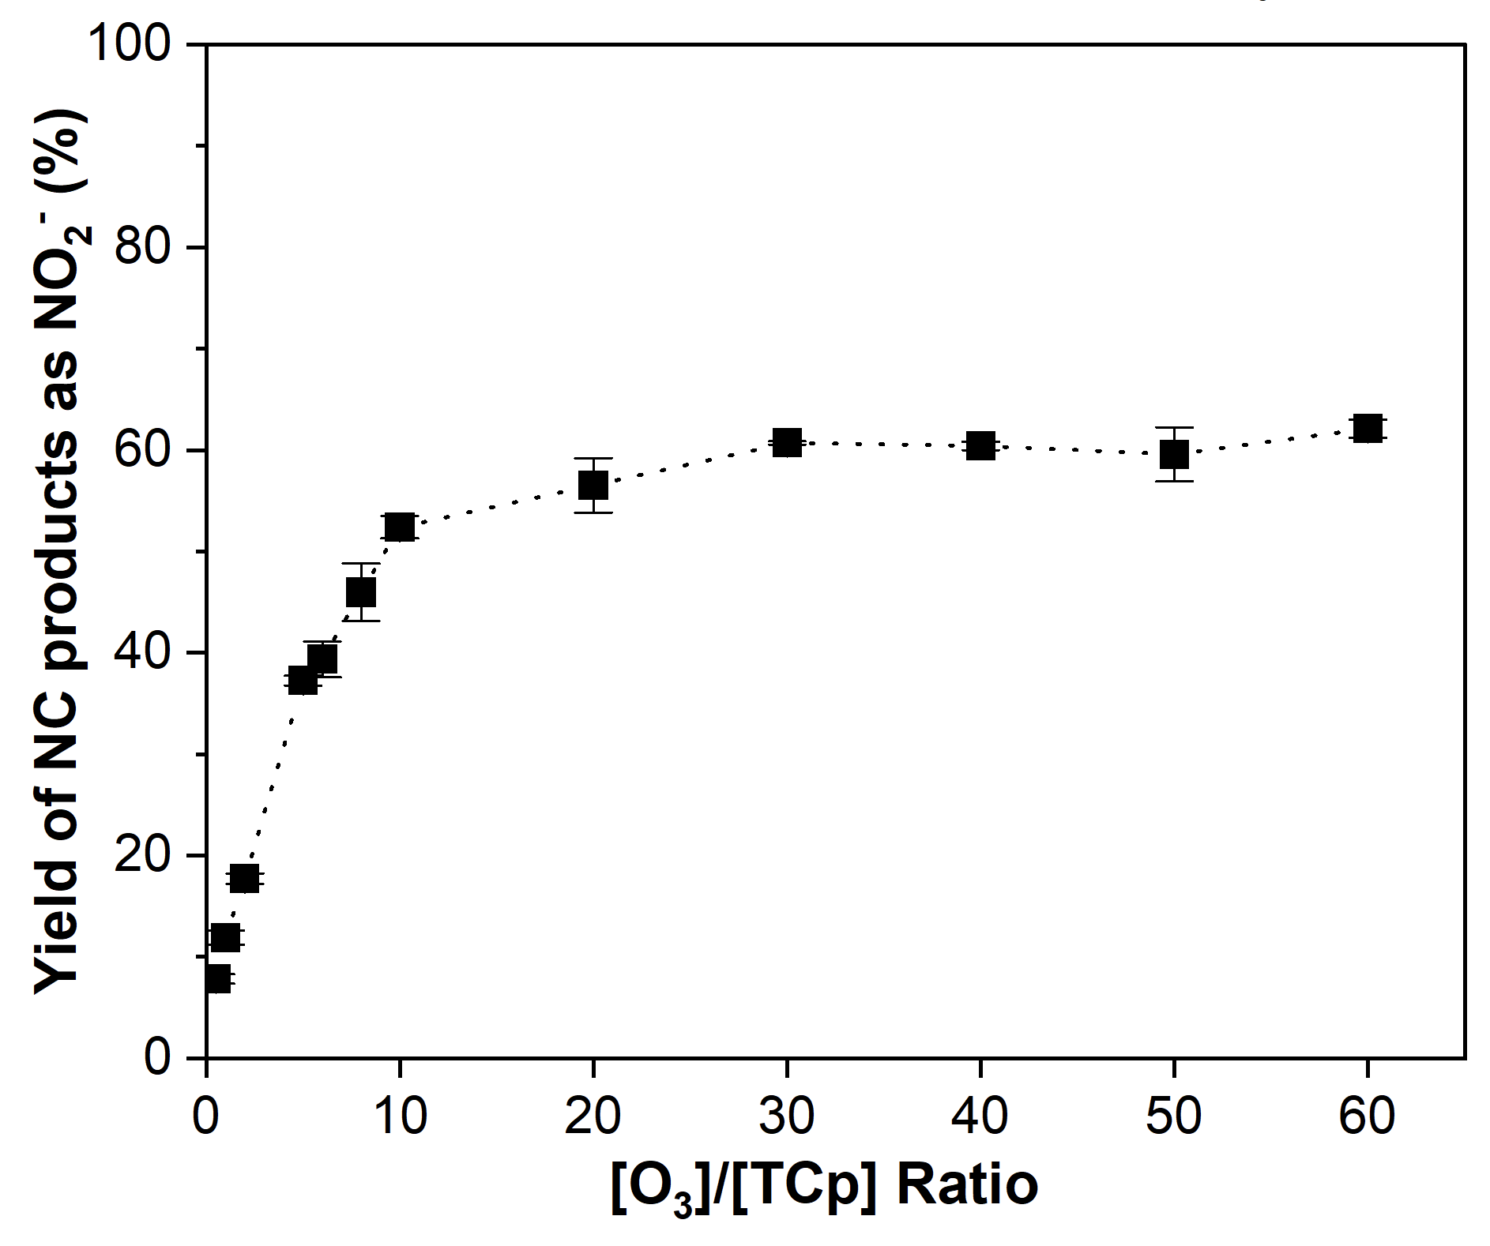


NC products from ozonation of amines and amino acids
Ozonation of propylamine (PA)
At [O₃]₀/[PA]₀ = 10
indirect calculation from batch UV photolysis:
60% as mol-NO₂⁻ per mol PA (total NC method)
O₃
UV_{254nm}
NO₂–
53% NO₂– yield
53% NO₂– yield
61% NO₂– yield
NC yield = (53/61)*100 = 87%
[PA]₀ = 10 μM, [O₃]₀ = 10 – 600 μM
[t-BuOH] = 10 mM, pH 7 (5 mM PBS)
direct determination by LC/UV with standard: 97%
[O₃]₀/[PA]₀
From the pre-determined NO₂– yield (53%) from UV photolysis of nitropropane, NC product yield (i.e., nitropropane) was calculated to be 87% (by batch UV photolysis). The calculated result was comparable to direct determination by LC/UV analysis (97%) using an authentic standard of nitropropane.

Slide 11
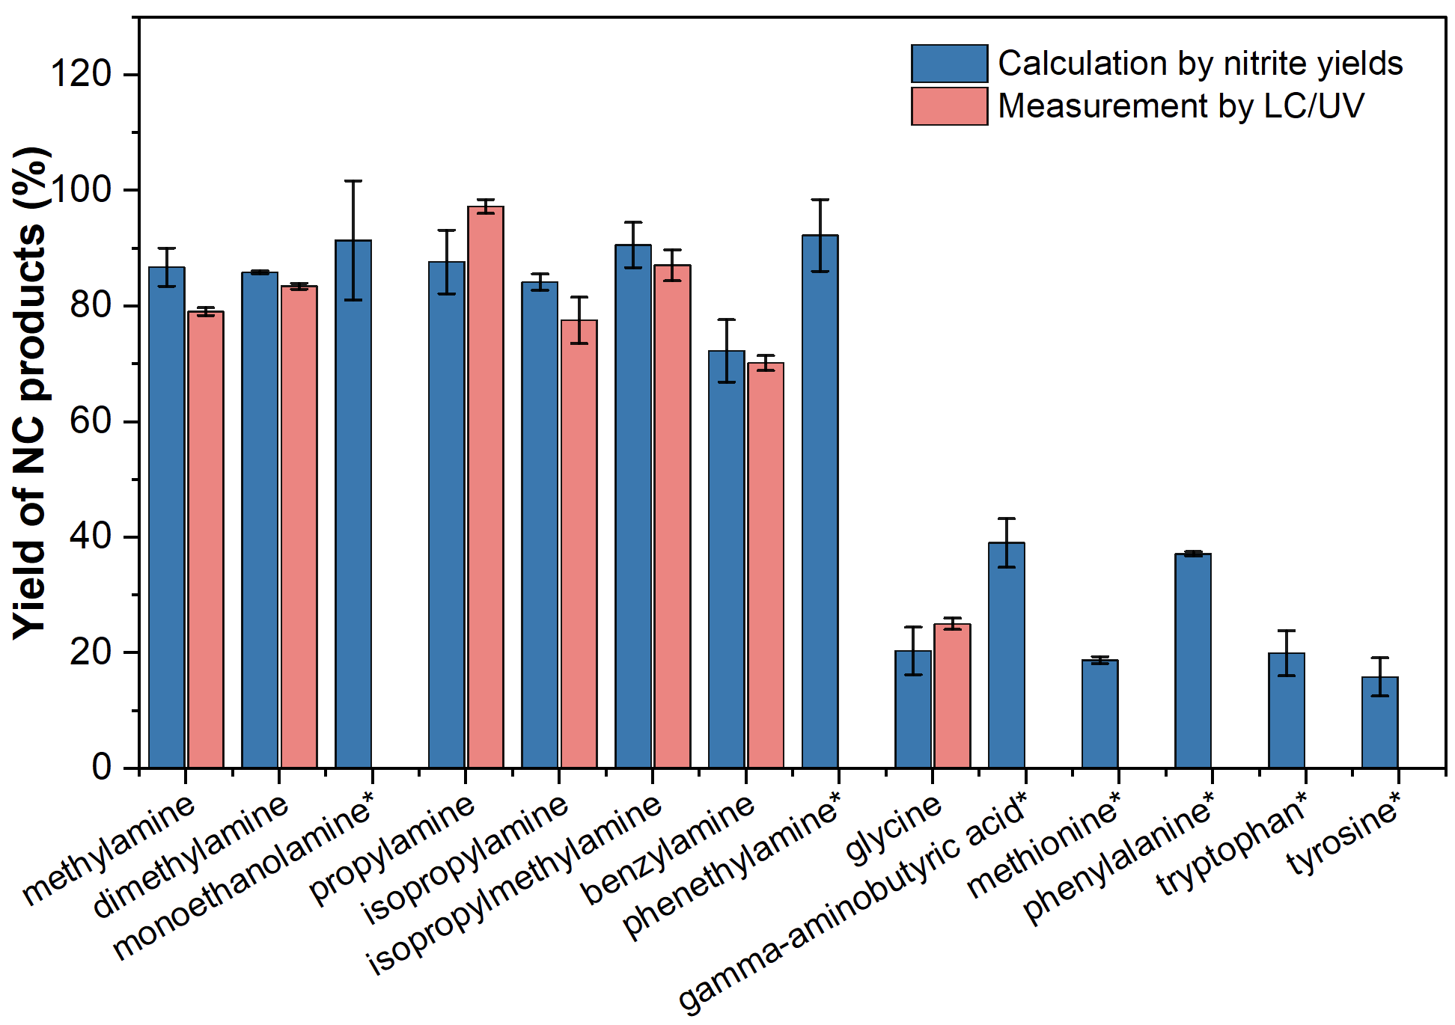
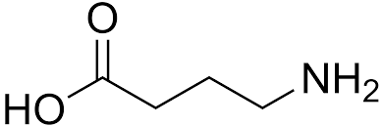

NC products from ozonation of amines and amino acids
Estimation approach for NC yields (%) using total NC method
[Amine]₀ = 10 μM, [O₃]₀ = 100 μM
[t-BuOH] = 10 mM, pH 7 (5 mM PBS)
*
Ref. 2:
75%
Ref. 1: McCurry et al. (2016). Env Sci Tech, 50, 1209-1217 (O₃ of 6-10 times target amines/amino acids).
Ref. 1:
$\sim$100%
Ref. 3:
60%
Ref. 2: Shi & McCurry (2020). Env Sci Tech, 54, 2182-2191 (O₃ of 10 times target amines/amino acids).
83(±6)%, n=8
Ref. 3: Essaïed, K. A. et al. Water Research, 209, 117864. (O₃ of 5 times target amines/amino acids).
Ref. 1:
26%
22(±8)%, n=6
*When the standards for expected nitro products are unavailable, the average nitrite yield of 68% (0.68) for aliphatic NCs during batch UV photolysis method was used.
Notes:
Yield of NC products (%) from ozonated amines and amino acids.
Nitrite yield of respective aliphatic NCs was used for calculating yield of NC products, except for (*), using average nitrite yield of aliphatic NC mixture.
Spiked 10 µM/each vs. 100 µM O₃, 10 mM t-BuOH, and pH 7 (5 mM PBS).

Slide 12
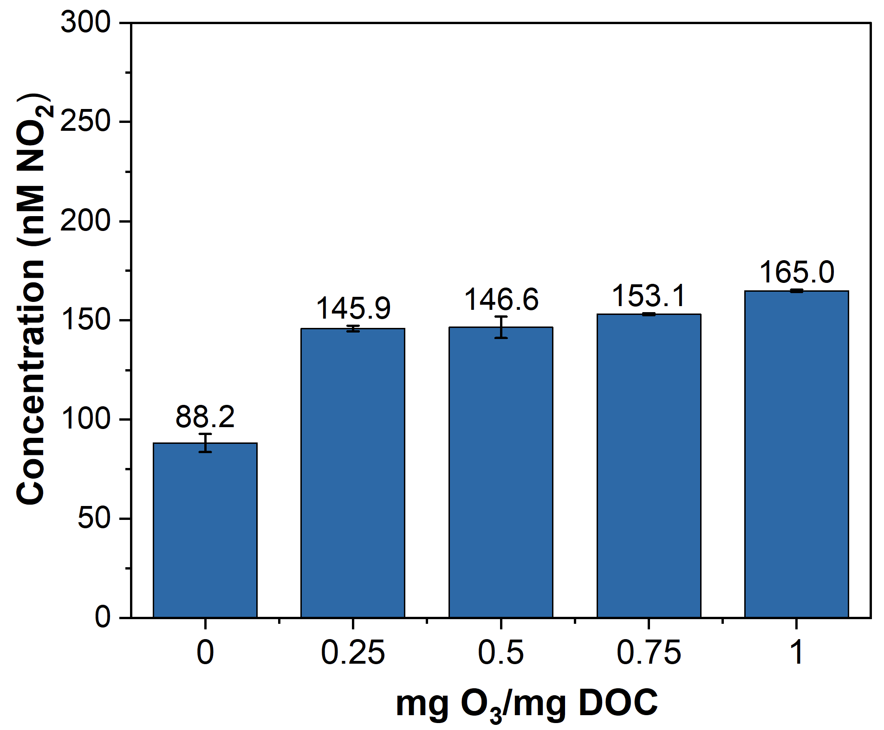
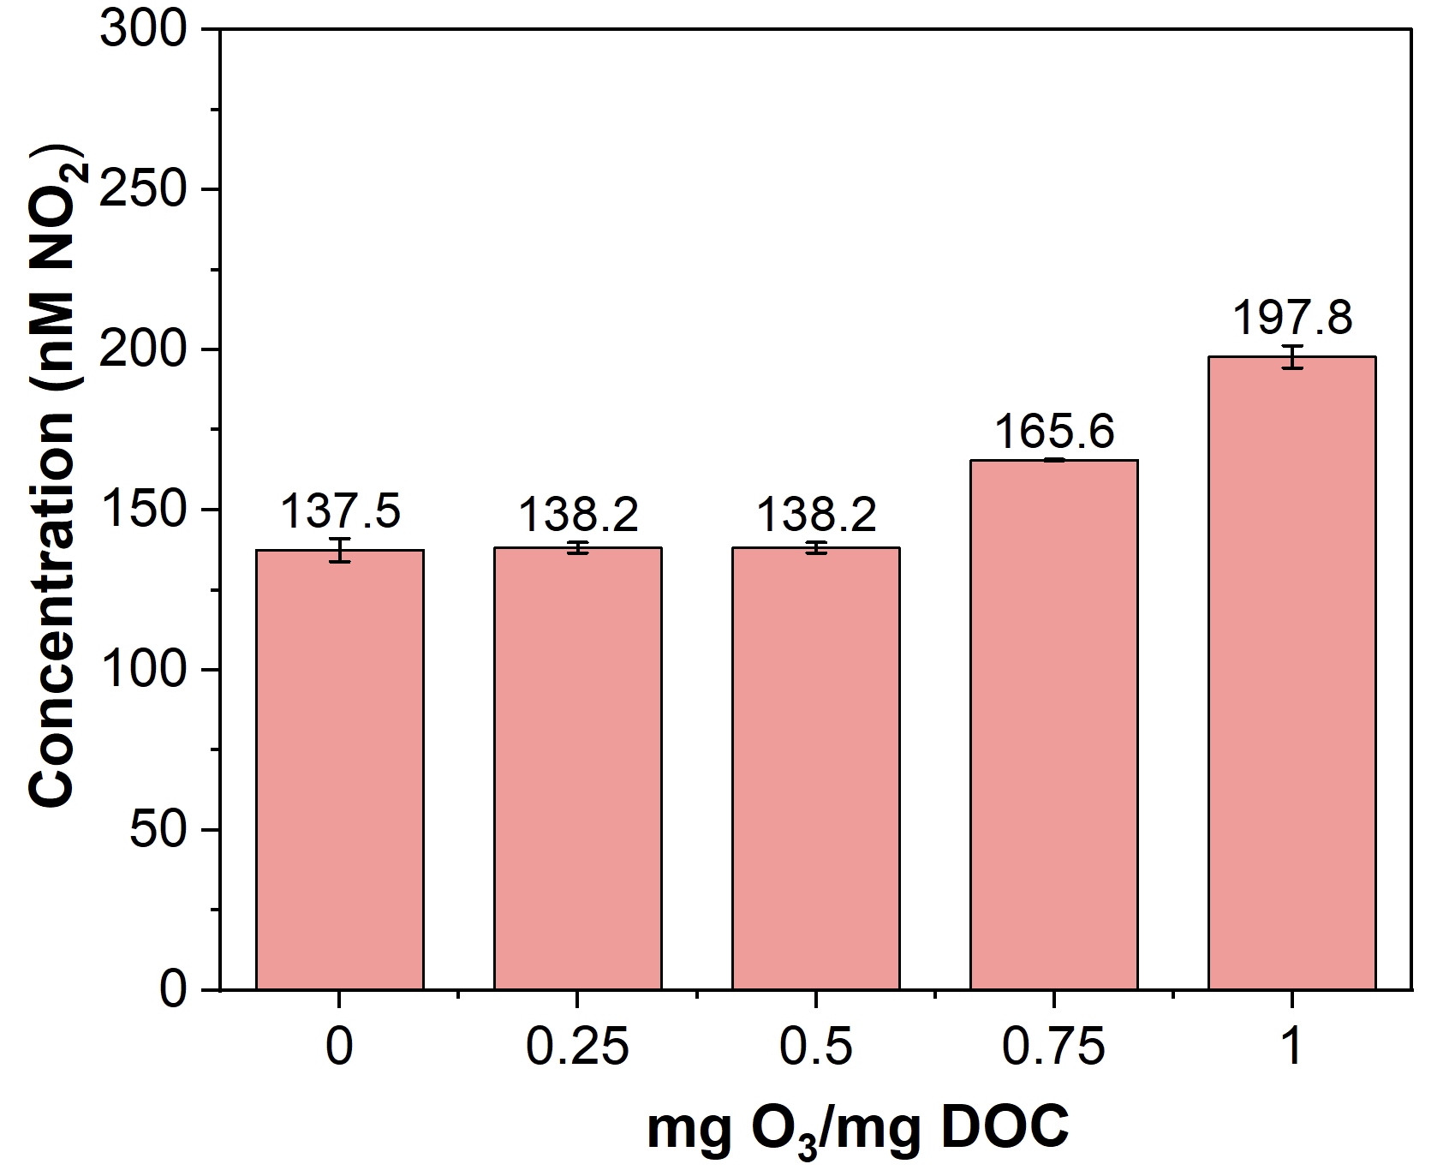
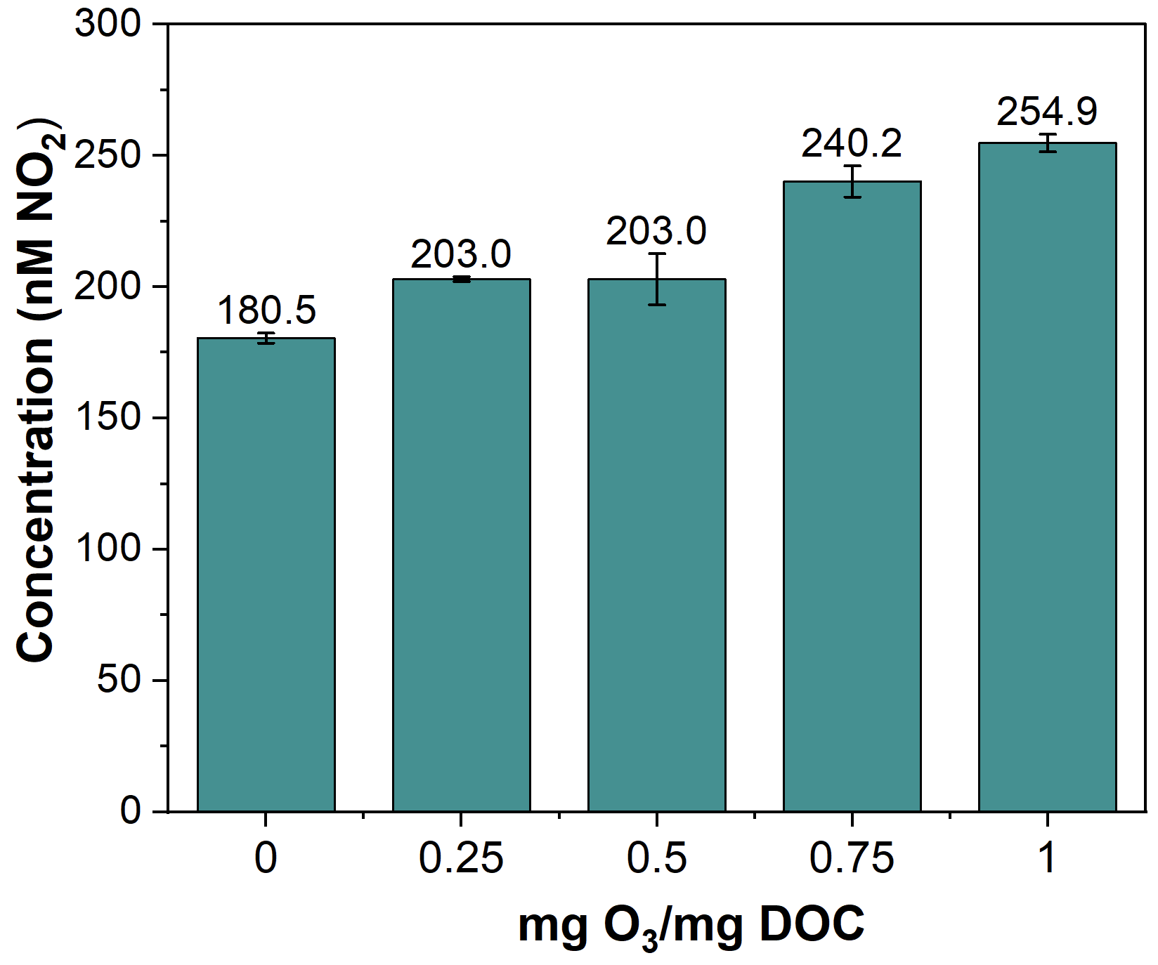
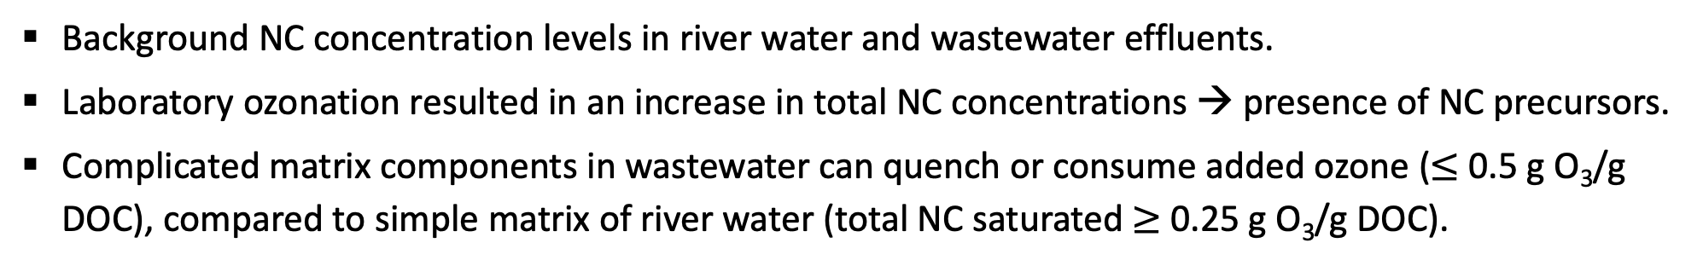
Occurance of total NCs in river water and wastewater effluents
River water
Wastewater-1
Wastewater-2
g O₃/g DOC
g O₃/g DOC
g O₃/g DOC
Total NC concentrations in laboratory ozonation of river water and wastewater effluents.
Background NC concentration levels in river water and wastewater effluents.
Laboratory ozonation resulted in an increase in total NC concentrations → presence of NC precursors.
Complicated matrix components in wastewater can quench or consume added ozone ($≤$ 0.5 g O₃/g DOC), compared to simple matrix of river water (total NC saturated $≥$ 0.25 g O₃/g DOC).

Slide 13
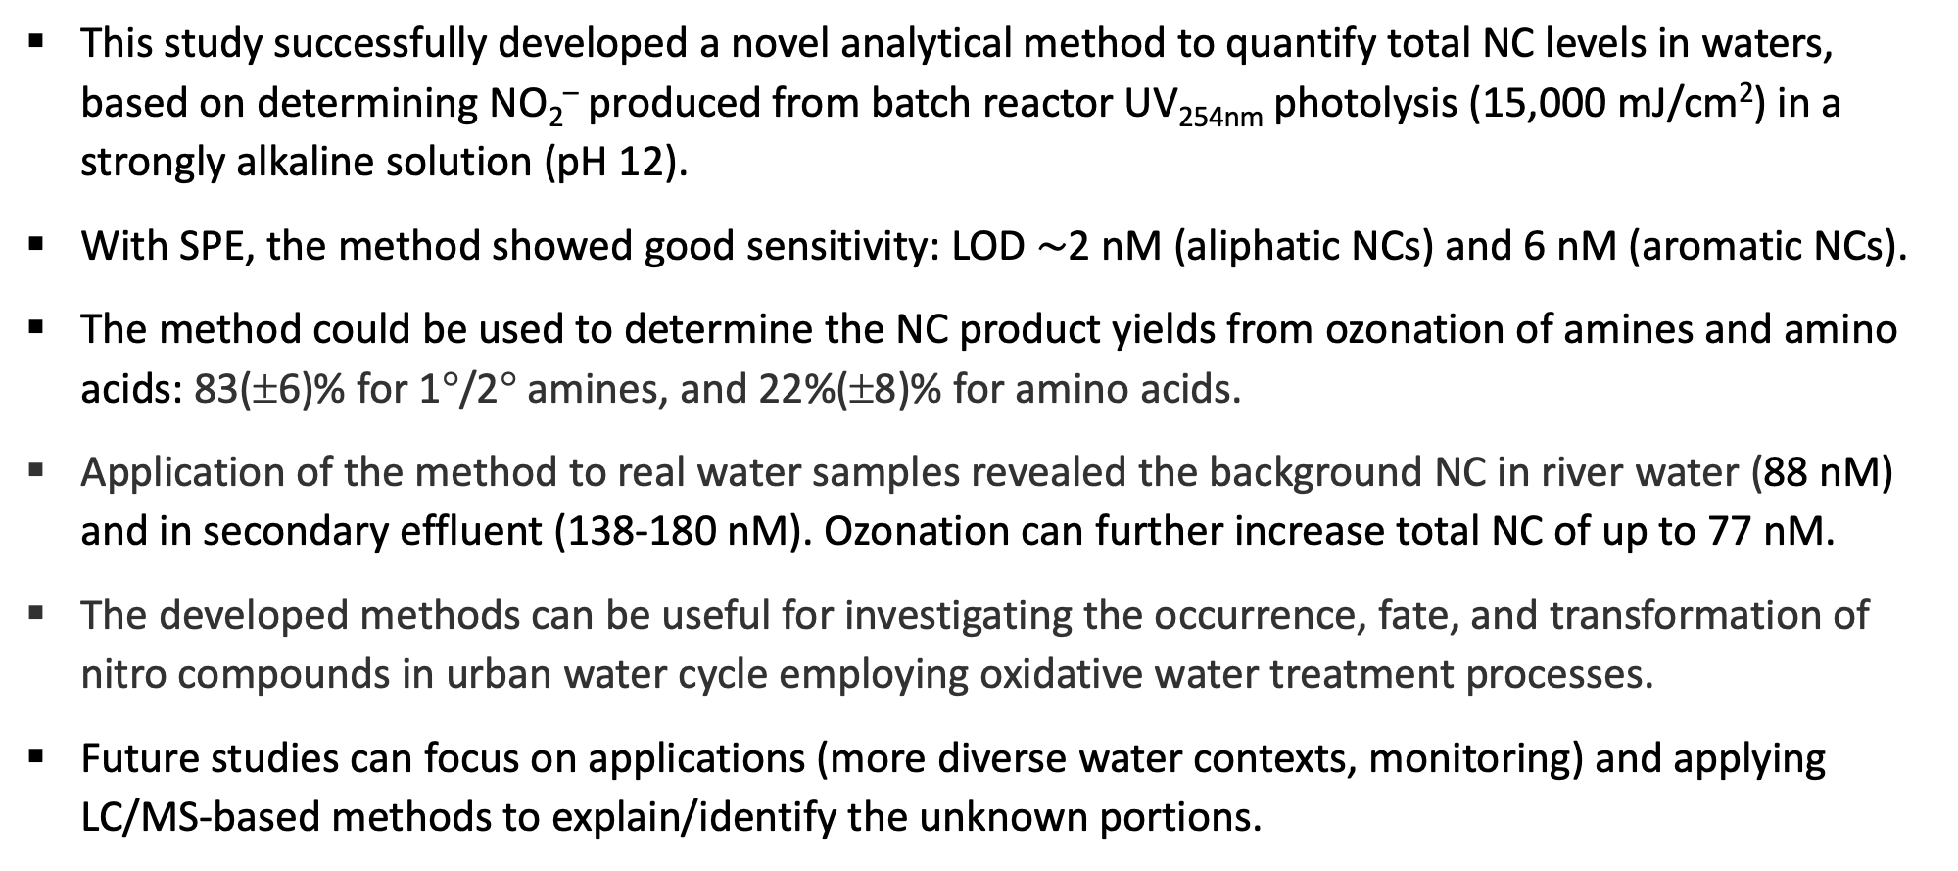
Conclusions
This study successfully developed a novel analytical method to quantify total NC levels in waters, based on determining NO₂– produced from batch reactor UV_{254nm} photolysis (15,000 mJ/cm²) in a strongly alkaline solution (pH 12).
With SPE, the method showed good sensitivity: LOD $\sim$2 nM (aliphatic NCs) and 6 nM (aromatic NCs).
The method could be used to determine the NC product yields from ozonation of amines and amino acids: 83(±6)% for 1°/2° amines, and 22%(±8)% for amino acids.
Application of the method to real water samples revealed the background NC in river water (88 nM) and in secondary effluent (138-180 nM). Ozonation can further increase total NC of up to 77 nM.
The developed methods can be useful for investigating the occurrence, fate, and transformation of nitro compounds in urban water cycle employing oxidative water treatment processes.
Future studies can focus on applications (more diverse water contexts, monitoring) and applying LC/MS-based methods to explain/identify the unknown portions.

Slide 14
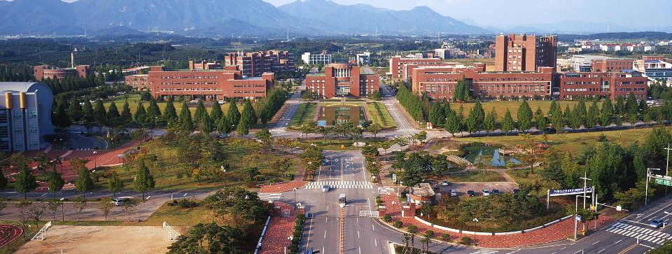
Thank you for your time and attention!
This study was supported by National Research Foundation of Korea (NRF, No. 2023R1A2C200616411).

Slide 15
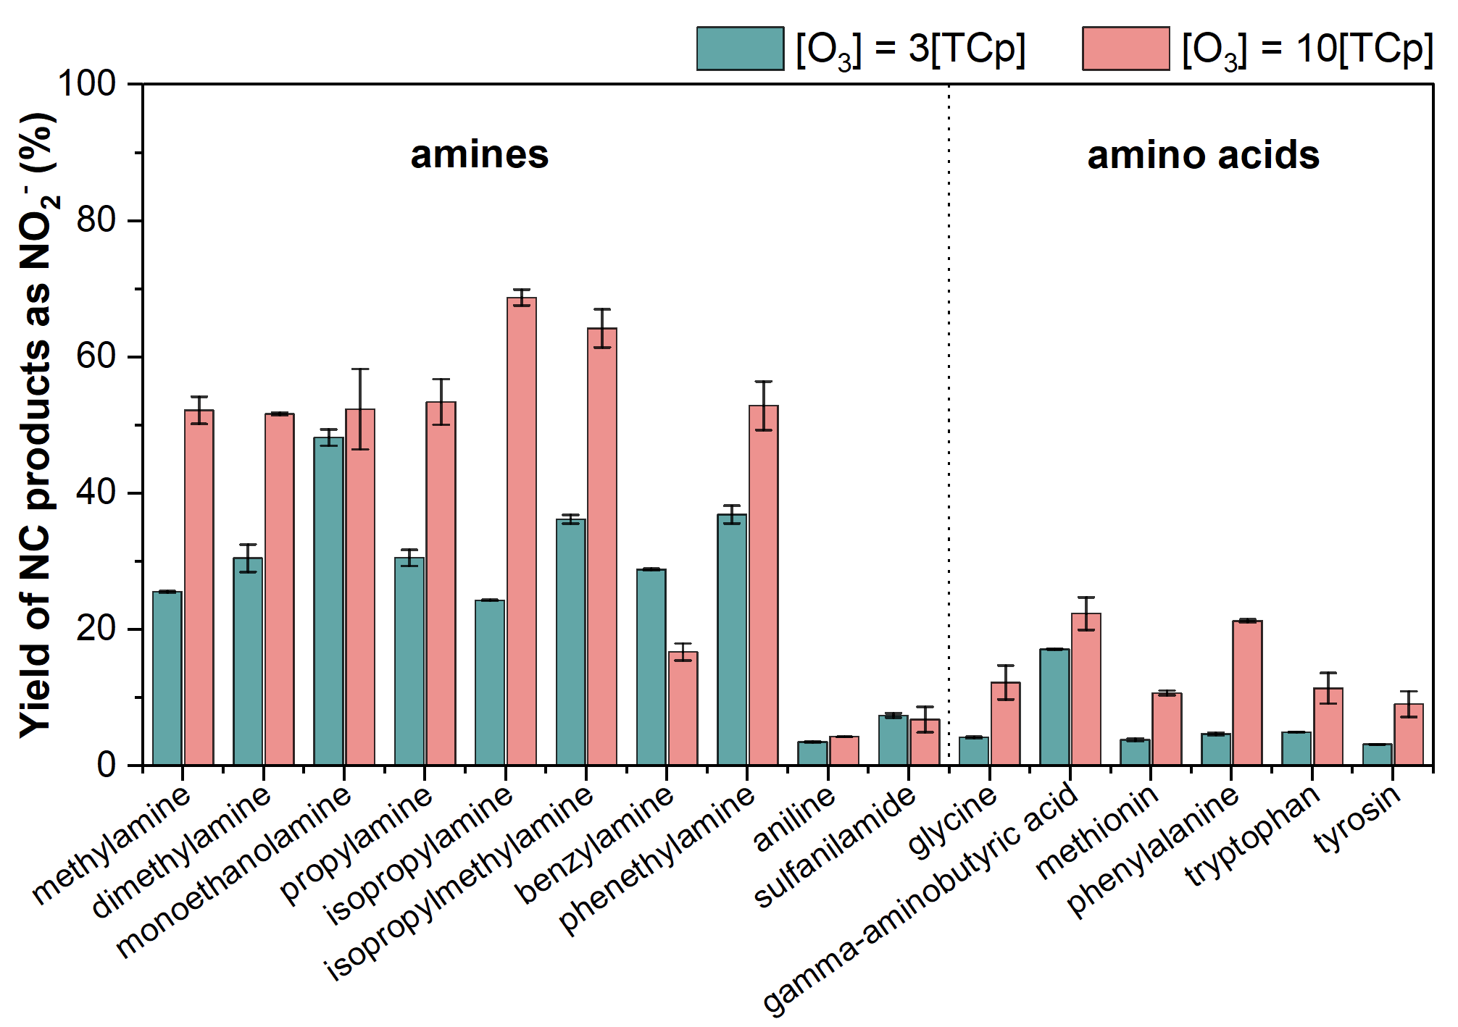
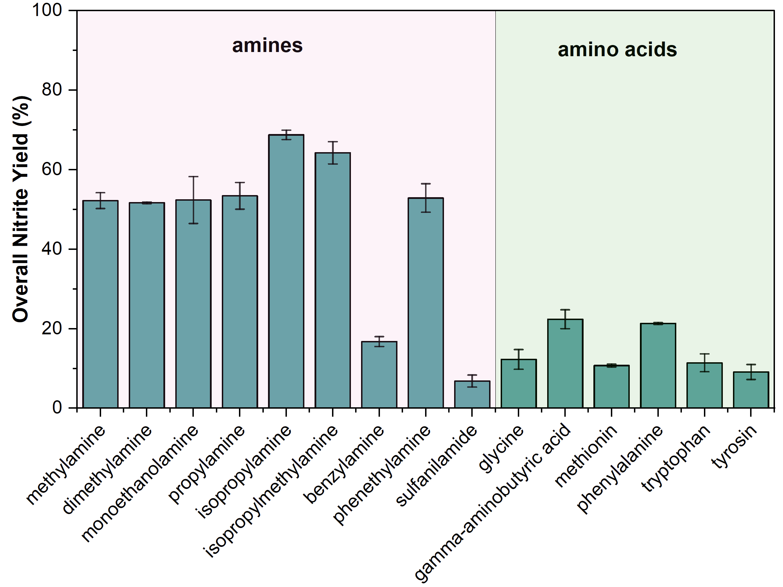

Yield of NC products from ozonation of amines and amino acids
TCp: target compound
1º/2º amines
NC products
nitrite
O₃
UV
NO₂–
NO₂– yield = X1
NO₂– yield = X2
NC product yield = X1/X2
NO₂– yield from the graph revealed the formation of NC products from ozonated amines and amino acids.
NC product formation depends on ozone doses.
[TCp]₀ = 10 μM, [O₃]₀ = 30 and 100 μM
[t-BuOH] = 10 mM, pH 7 (5 mM PBS)
Notes:
Amines/amino acids → Ozonation → NCs → total NC method to determine yields of NC products as NO₂– => reveal the formation potential of NCs from samples containing NC precursors.
Yields of NC products as NO₂–: aliphatic amines > amino acids > aromatic amines.
It is clear that NC formation depends on ozone doses.

