Slide 1

The 11th International Symposium on Flame Retardants (BFR 2024)
Quantification of Total Per- and Polyfluoroalkyl Substances (PFAS) in Water Using Persulfate Preoxidation Followed by Chemical Defluorination with Sodium Biphenyl or Ion-pair Formation with Methylene Blue
2024.04.10
Nguyen Cong-Hau¹, Sangki Choi², Heejong Son², Yunho Lee^{1,*}
¹School of Earth Sciences and Environmental Engineering, Gwangju Institute of Science and Technology, Gwangju, Rep. of Korea
²Busan Water Quality Institute, 691 Dongbuk-ro, Sangdong-myun, Kimhae-si, Gyeongsangnam-do, Rep. of Korea
(*) E-mail: yhlee42@gist.ac.kr

Slide 2


Main Findings in this Study
01
Sodium Biphenyl (SBP) Assay
Defluorination Efficiency
TOP Assay to Improve the Selectivity
02
MB Assay: A Semi-Quantification
03
Overall Analytical Method Performance
Contents
04
Application to Simulated Water Samples
05
Application to Real PFAS-Containing Water

Slide 3
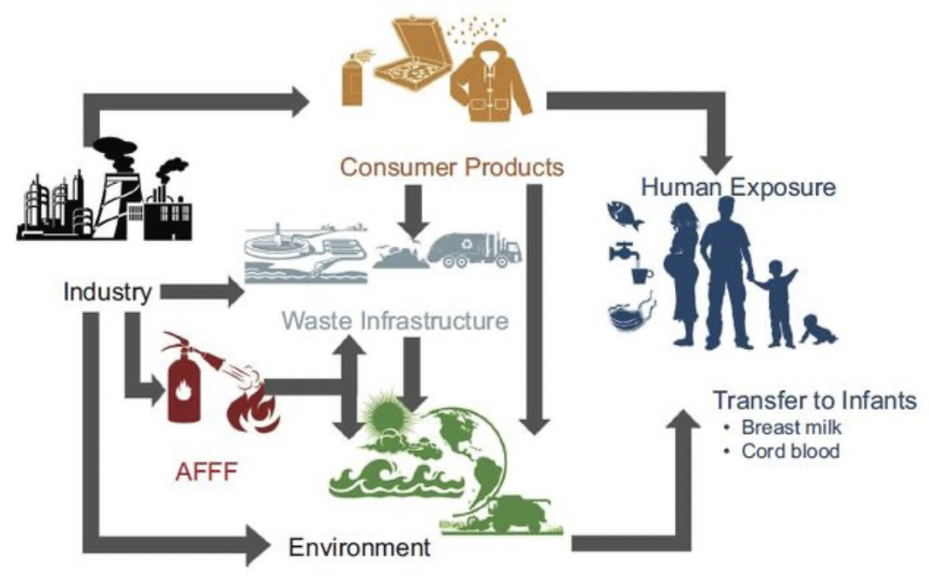
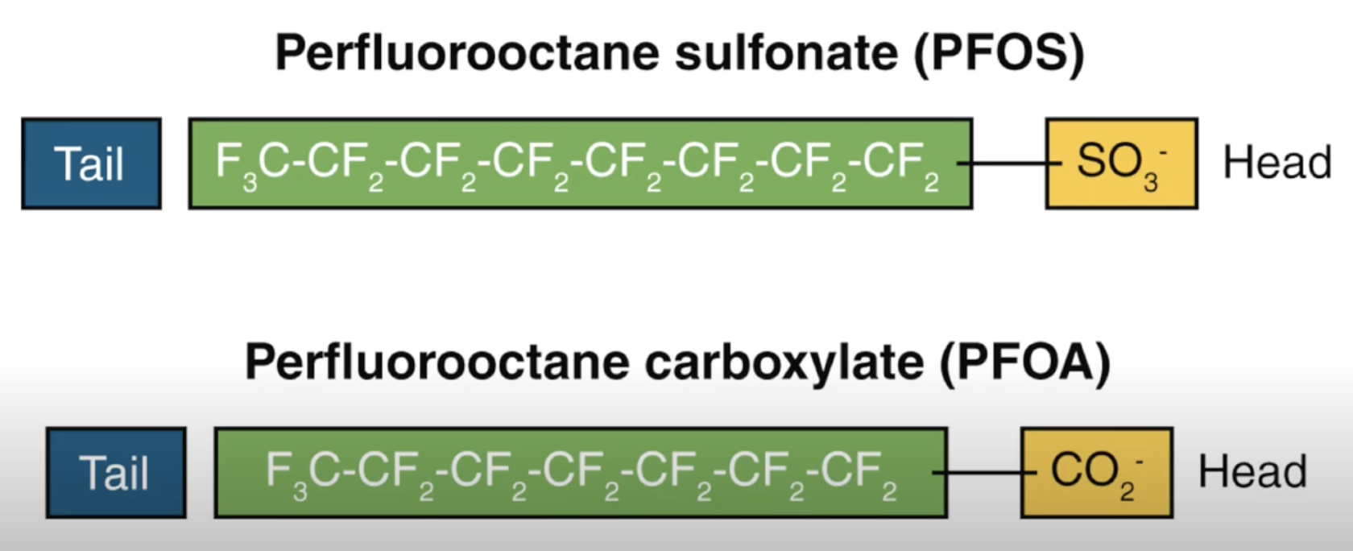
PFAS as Contaminants of Emerging Concern
Kwiatkowski, C. F. et al. Environ. Sci. Technol. Lett. 2020, 7 (8), 532–543.
Per- and polyfluoroalkyl substances (PFAS, C_{n}F_{2n+1}−R)
Over 12,000 PFAS have been identified.
H⁺
hydrophobic
hydrophilic
H⁺
Potential Major Exposure Pathways of PFAS to Humans.
Effects on the degradation in the environment.
Considered as “anionic surfactants”
Mobile in water and environment
https://www.researchgate.net/publication/342976600_Fate_of_per-and_polyfluoroalkyl_substances_PFASs_modelling_source_identification_and_assessment_of_bioaccumulation_and_biodegradation
https://pfas-1.itrcweb.org
Notes:
PFASs stand for with thousands of compounds have been discovered so far in many fields. Humans can be exposed to PFASs at different concentrations, indicating some threat.
if you look at the chemical structure, we can see the surfactant structure with hydrophobic tail, and hydrophobic head groups, making them mobile in water and env.
One feature is the fluorinated C chain length, highly resistence to oxidation/reduction.

Slide 4
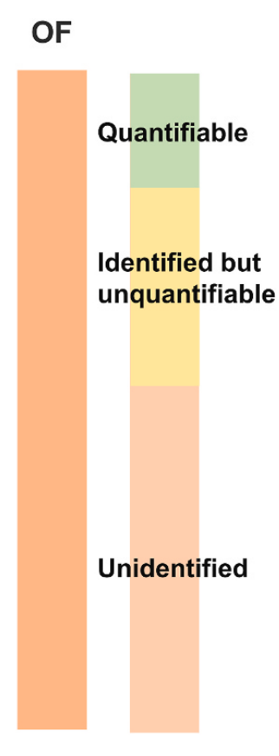
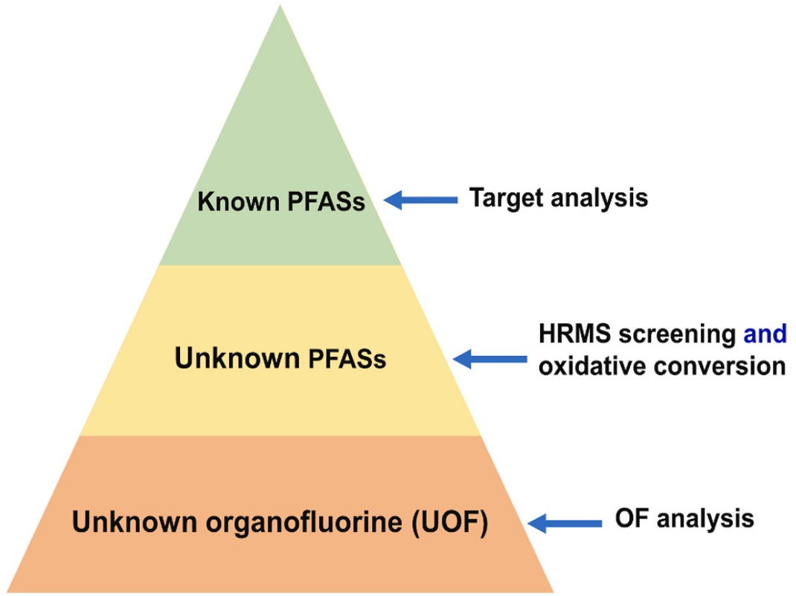
Needs to Develop Analytical Methods for Total PFAS
Adsorbable Organic Fluorine (AOF) Combustion-Ion Chromatography (CIC)
as a Standard Method for Unknown Organic F.
→ PFAS adsorbed by activated carbon;
→ Defluorination by combustion;
→ Liberated fluoride is detected by IC.
HPLC-(MS/)MS
TOP Assay
Sophisticated instruments
Limitation in selectivity for PFAS since CIC can include non-PFAS organofluorine.
Overview of Different Analytical Approaches for PFASs and a Certain Concern of Unknown Portion.
Wang, Q. et al. (2023). TrAC Trends in Analytical Chemistry, 117351.
Notes:
Literally, many analytical approaches are available. Simply speaking, we can divide into targeted and total analysis. Mostly people use the LC-MS/MS or combustion IC (for total Fluorine).
Additionally, TOP assay with oxidation can be applied to capture more PFAS precursors, discussed later.
generally, we can see that these methods somehow require sophisticated instruments and high expetise.
Another important thing is limitation in the selectivity for PFAS. For example, these methods can include the other non-PFAS portions, like fluoro organics, and anionic surfactants.

Slide 5
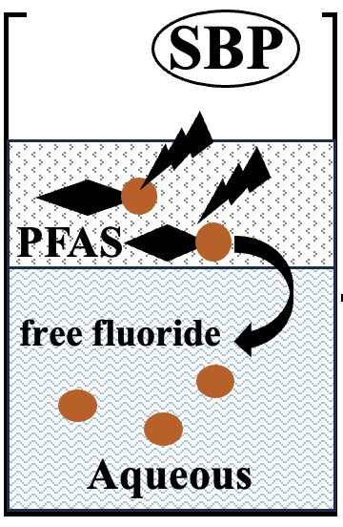
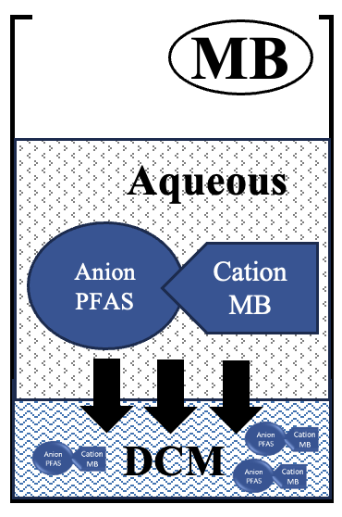
Needs to Develop Analytical Methods for Total PFAS
Jones, B. C. et al. J. Pharm. Sci. 1971, 60 (7), 1036–1039.
Jurado, E. et al. Chemosphere 2006, 65 (2), 278–285.
Chemical defluorination (compared to combustion defluorination in CIC);
Precolumn derivatization LC/UV for measuring the liberated F–.
Ion-pair reaction → extract to DCM;
UV/vis of DCM at 655 nm;
Analytical Method Principle of Sodium Biphenyl (SBP) and Methylene Blue (MB) Assays.
The SBP assay
was used in batch or flow injection analysis for some specific PFASª;
includes non-PFAS organofluorine.
The MB assay
was adapted for smartphone-based methods for certain PFAS^{b};
includes non-PFAS anionic surfactants;
cannot capture the non-anionic PFAS precursors.
Both methods still demonstrate a limitation in selectivity and sensitivity for PFAS.
ªMusijowski, J. et al. Anal. Chim. Acta 2007, 600 (1-2 SPEC. ISS.), 147–154.
^{b}Al Amin, M et al. Environ. Technol. Innov. 2020, 18, 100778.

Slide 6
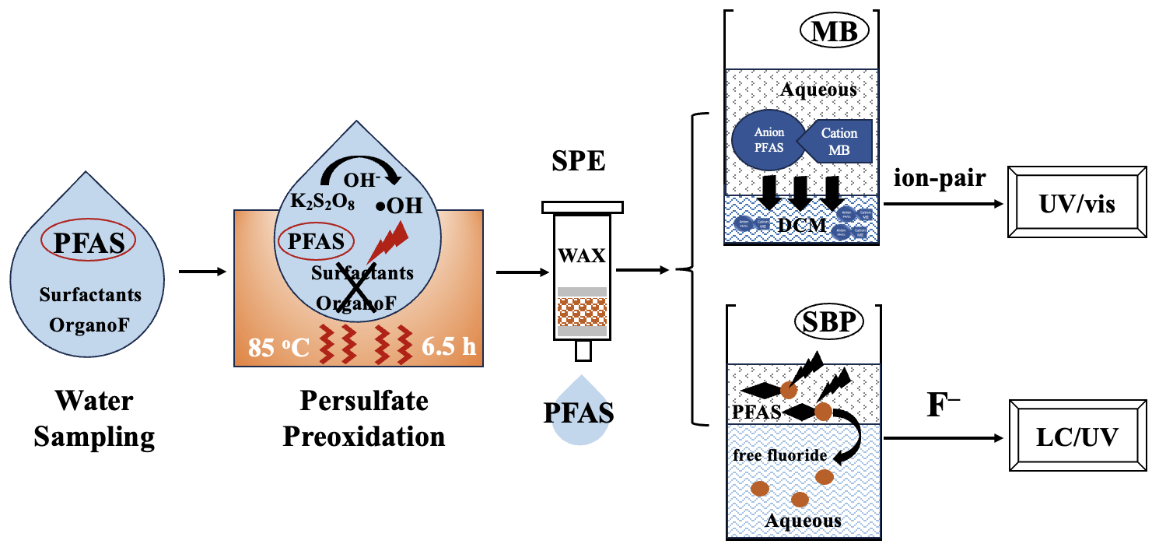
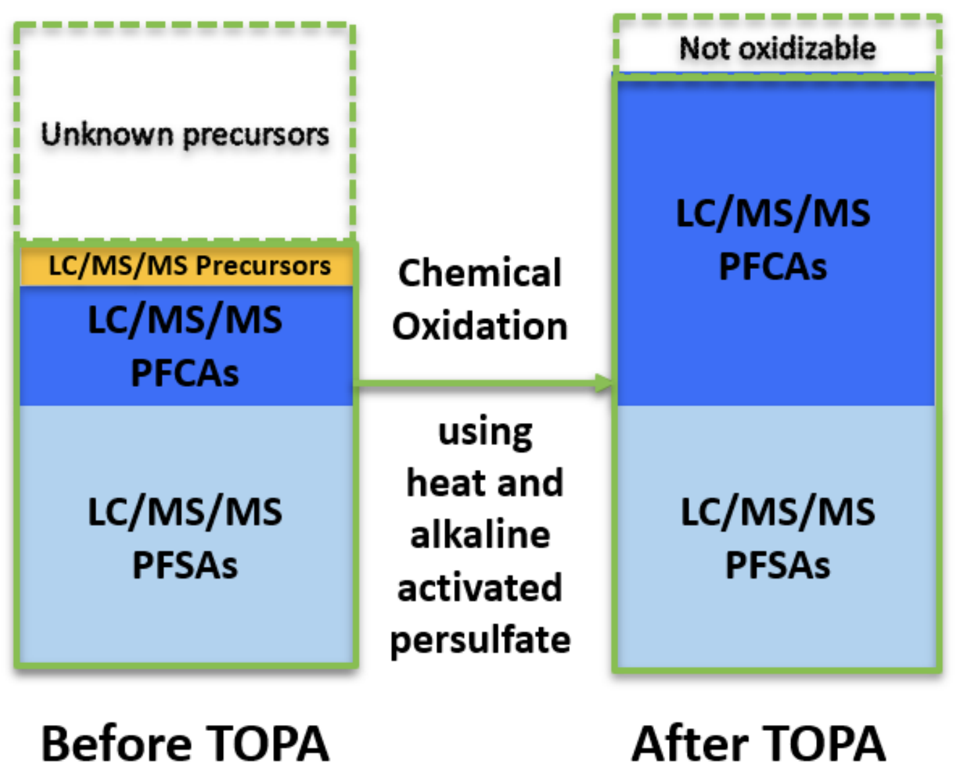
Persulfate Preoxidation (TOP Assay) to Improve the Selectivity
Dora Chiang (2019)
Conventional Role of TOP Assay:
Convert PFAS Precursors to Terminals to Estimate Precursor Contents by LC/MS.
The Entire Workflow for Quantifying Total PFAS in Water Using the Persulfate Preoxidation (TOP Assay) Followed by SBP or MB Assays.
TOP ASSAY IN THIS STUDY IS EXPECTED TO
decompose/oxidize the anionic surfactants (e.g., sodim dodecyl sulfate);
mineralize organofluorine into F– → washed out by the later SPE;
convert the non-anionic PFAS precursors to the anionic terminals → increase the inclusivity for MB assay.
Notes:
sửa lại thành hình overall
doi thu tu assay cho nhau

Slide 7
Research Objectives
This study developed an analytical methods for total PFAS based on persulfate preoxidation followed by chemical defluorination with SBP or ion-pair formation with MB.
The conditions of SBP and MB assays were optimized and tested for their responses with a range of PFAS structures, including PFAS terminals and precursors.
The effects of persulfate preoxidation and SPE on the selectivity and sensitivity of the methods were investigated using simulated samples spiked with various PFAS terminals and precursors, as well as other interferences such as organofluorine compounds, anionic surfactant, and F–.
The developed methods were applied to quantify total PFAS in industrial wastewater.
Reference methods: LC/MS (33 specific PFAS compounds*) and the CIC method to determine adsorbable organic fluorine (AOF).
This study used the ion-pair reaction with MB (UV-Vis) and chemical defluorination by SBP (HPLC-UV) for quantifying total PFASs in water samples.
TOP assay was applied to improve the method selectivity:
convert PFAS precursors to anionic terminals (MB assay);
remove the non-PFAS anionic surfactants (MB assay);
remove the non-PFAS organo fluorine (SBP assay).
Analytical methods were optimized and validated.
Applications to simulated waters (DIW, tap water, drinking water influent, and domestic wastewater effluent spiked selected model PFASs).
Applications to real PFAS-containing industrial wastewater effluent and comparison to AOF Combustion IC and HPLC-MS/MS (33 PFAS species).
*33 PFAS species: PFMOAA, PMPA, PFMOPrA, PFMOBA, PEPA, PFPrOPrA/HFPO-DA (“GenX”), ADONA, 9Cl-PF3ONS, 11Cl-PF3ONS, 4:2 FTS, 6:2 FTS, 8:2 FTS, PFBSA, PFHxSA, N-MeFOSAA, N-EtFOSAA, 6:2 diPAP, PFBA, PFPeA, PFHxA, PFHpA, PFOA, PFNA, PFDA, PFDoA, PFUdA, PFBS, PFPeS, PFHxS, PFHpS, PFOS, PFDS, and PFNS.

Slide 8
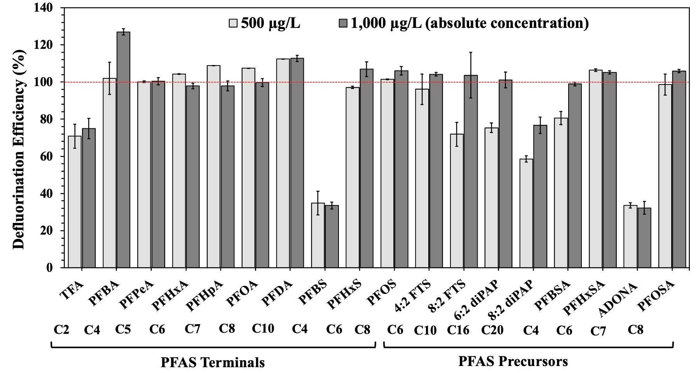
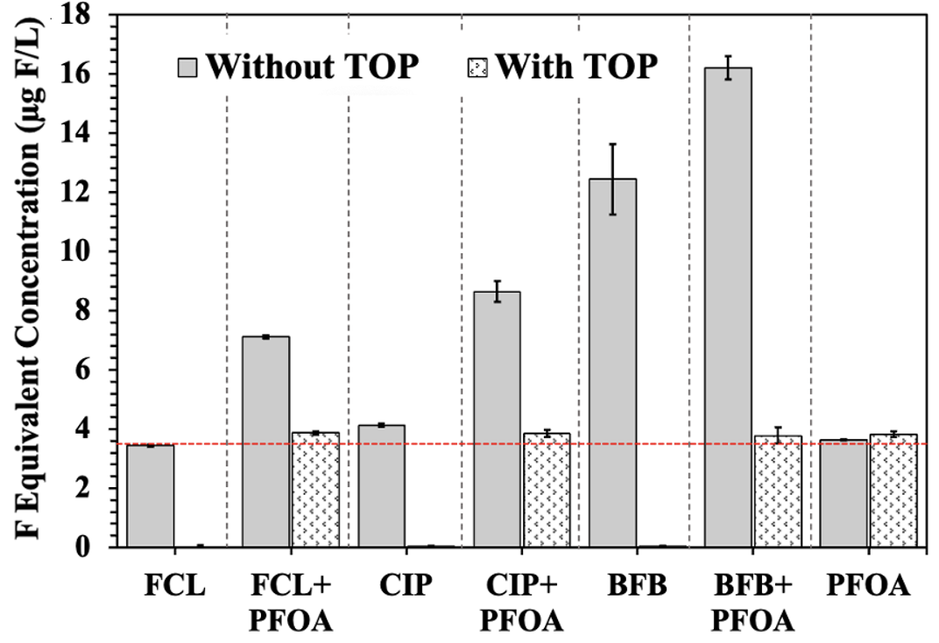
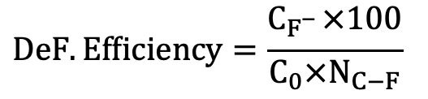
1
Optimization of the SBP Assay for Total PFAS Analysis
(a)
(b)
$$DeF. Efficiency=\frac{C_{F_{}^{−}}×100}{C_{0}×N_{C−F}}$$
C_{F-}: molar concentration of F– (SBP assay);
C₀: initial molar concentration of PFAS;
N_{C-F}: number of C-F bonds.
C₂₄H₃₀F₂O₆ 8.4% F
C₁₇H₁₈FN₃O₃ 5.7% F
C₆H₄BrF 10.9% F
The SBP Defluronation Efficiencies of Different PFAS Structures. Defluorinaiton efficiency (%) was calculated as C_{F-}/(C₀ × N_{C-F}) × 100%, C_{F-} is the molar concentration of F– released in the SBP assay, C₀ is the initial molar concentration of each PFAS, and N_{C-F} is the number of C-F bonds in the PFAS molecule.
Effects of TOP Assay on SBP Assay Responses of PFOA, Organofluorine and their Mixtures. fluocinolone acetonide-FCL, ciprofloxacin-CIP, 1-bromo-4-fluorobenzene-BFB.
Notes:
PFOA (3.4 μgF/L), FCL (3.6 μgF/L), CIP (5.7 μgF/L), BFP (10.9 μgF/L), and their mixtures, or the PFAS precursor (6.2 μgF/L PFHxSA, 6.5 μgF/L PFOSA, 6.3 μgF/L 6:2 diPAP, and 6.5 μgF/L 8:2 diPAP)

Slide 9
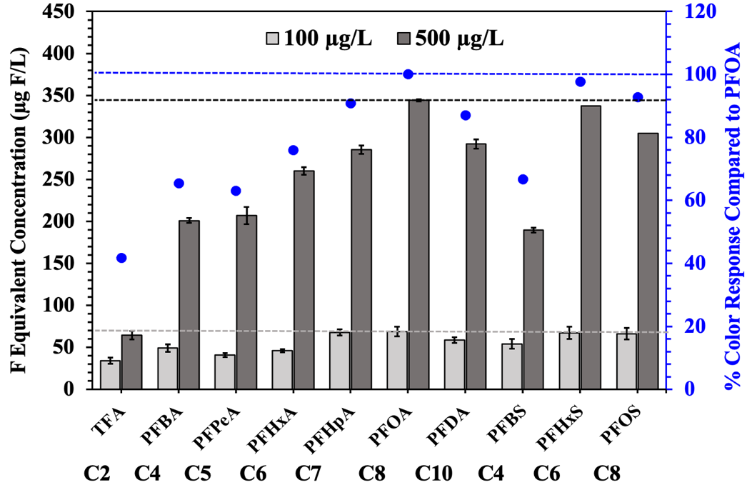
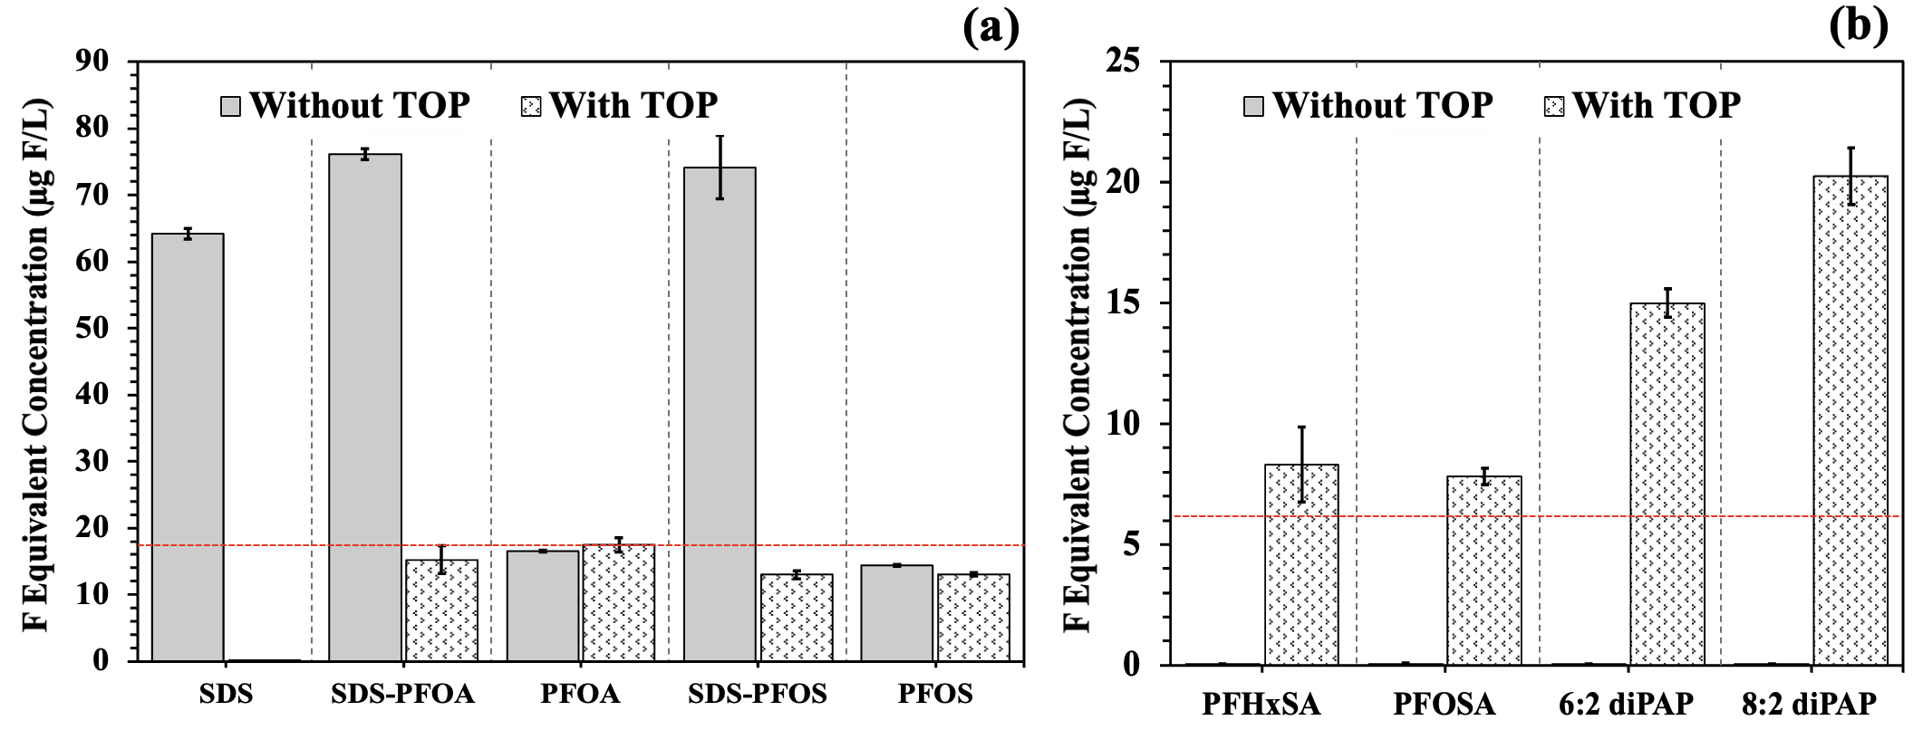
2
Optimization of the MB Assay: A Semi-Quantification
SDS (sodium dodecyl sulfate)
6:2 diPAP
Different color response → different ion-pair level formation between PFAS and MB.
Only PFOA was used as a standard for calibration.
Color Response of PFAS towards MB.
non-anionic PFAS precursors
Persulfate Preoxidation (a) to Eliminate the Non-PFAS Surfactants and (b) to Convert PFAS Precursors into Anionic Terminals. 25 µg/L PFOA/PFOS and 80 µg/L SDS for (b) and 10 µg/L of each PFAS precursor for (a).
only PFOA used as a standard chemical
different color response among PFAS
different ion-pair formation levels between MB and anionic PFAS
MB: semi-quantification for total PFAS
SDS was effectively removed by persulfate preoxidation.
Non-anionic PFAS precursors originally showed negligible color response → persulfate preoxidation could convert them to anionic terminals → improve the inclusivity for the MB assay.

Slide 10
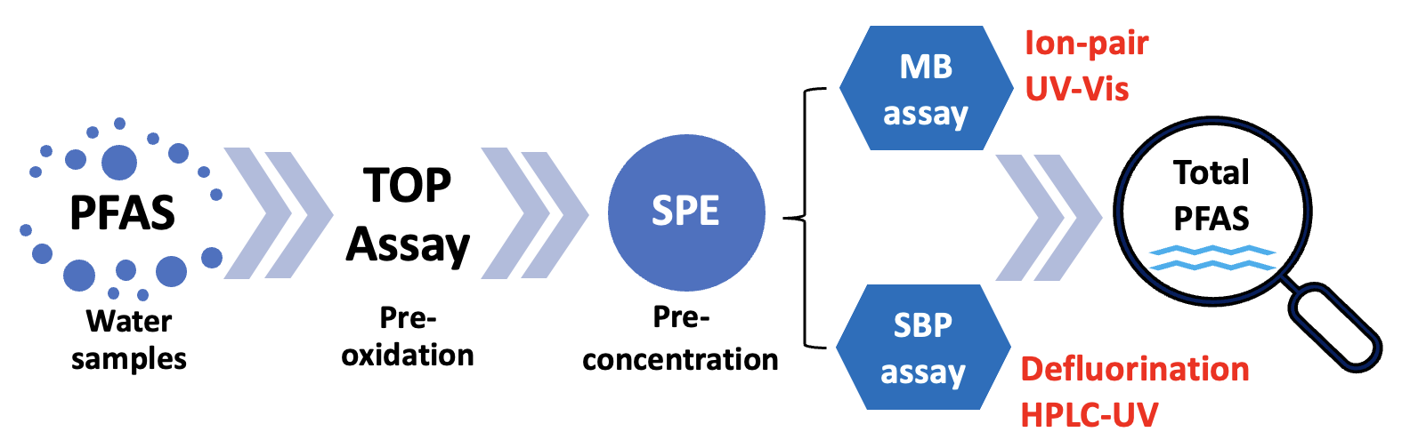
3
Overall Analytical Method Performance
Analytical Performance for the Persulfate Preoxidation Followed by the SBP or MB Assays.
 | Sodium Biphenyl (SBP) | Methylene Blue (MB)
Limit of Detection | 0.016 µg F/L | 0.20 µg F/L
Precision Intra-day (RSD_{r}) Inter-day (RSD_{R}) | 1.8% 4.3% | 1.1% 4.5%
Recoveries | 85-100% | 101-133%
Notes:
NaF and PFOA (68.8% F) were used as authentic standards for MB and SBP. LOD = $\overline{x}$ + 3SD, in which $\overline{x}$ and SD are the estimated concentration and standard deviation from simultaneously analyzing 10 blanks.
The precision (intra- and inter-day) is evaluated through the relative standard deviation for six replicates within one day (RSD_{r}) and three separate days (RSD_{R}) (significance level of 0.05).

Slide 11
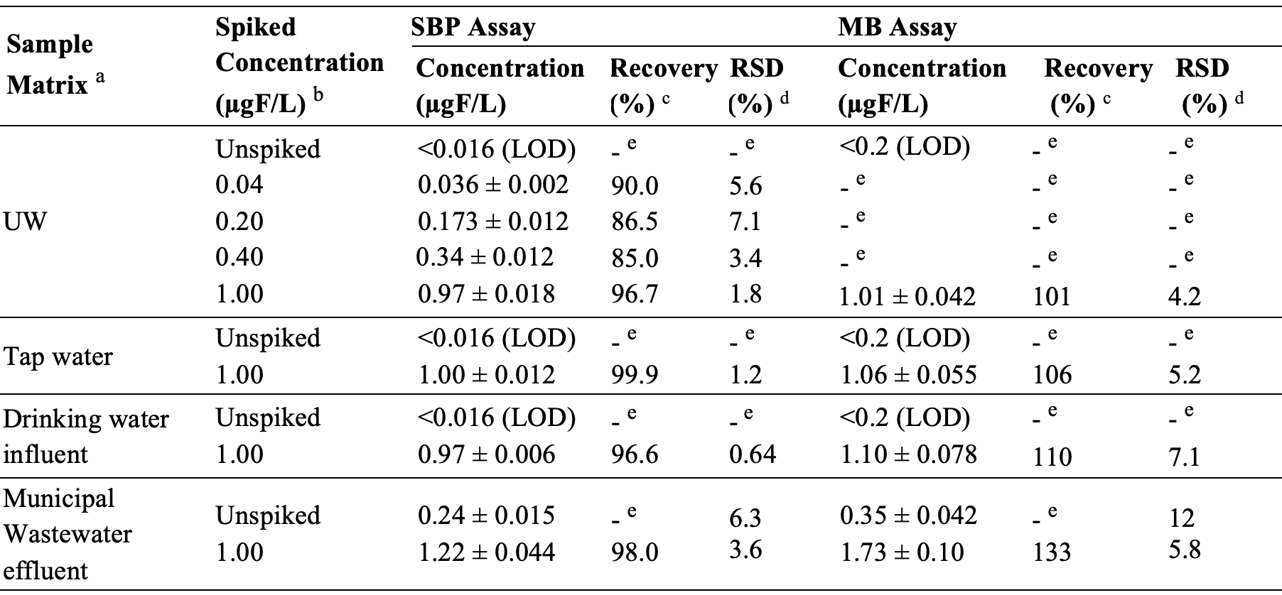
4
Application to Simulated Water Samples
Total PFAS Concentrations (Expressed in µgF/L) of Simulated Water Samples, Presented as the Average Value ± Standard Deviation for Triplicate Experiments.
Selected PFAS were spiked to the sample matrix, i.e., PFPeA, PFHxA, PFHpA, PFOA, PFDA, PFHxS, and PFOS.

Slide 12
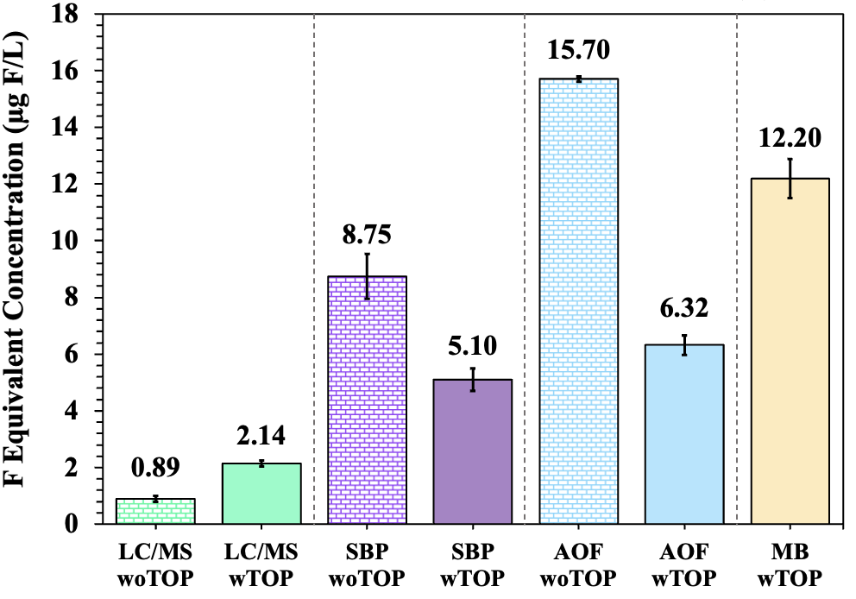
5
Application to Real PFAS-Containing Water Sample
targeted analysis
total quantification assays
Total PFAS methods: higher results than target PFAS wTOP → indicating the presence of significant portions of unknown PFAS.
SBP and CIC woTOP: higher results than those wTOP → presence of organofluorine compounds (or adsorbable organic fluorine-AOF) other than PFAS.
SBP and CIC wTOP: comparable results → robustness of SBP assay.
MB assay wTOP: higher results than SBP & AOF wTOP → a breakdown of a single PFAS precursor into multiple anionic terminals (e.g., diPAP) → semi-quantification method.
Total PFAS Concentrations from Different Determination Procedures in Industrial Wastewater Effluent.
33 PFAS species: PFMOAA, PMPA, PFMOPrA, PFMOBA, PEPA, PFPrOPrA/HFPO-DA (“GenX”), ADONA, 9Cl-PF3ONS, 11Cl-PF3ONS, 4:2 FTS, 6:2 FTS, 8:2 FTS, PFBSA, PFHxSA, N-MeFOSAA, N-EtFOSAA, 6:2 diPAP, PFBA, PFPeA, PFHxA, PFHpA, PFOA, PFNA, PFDA, PFDoA, PFUdA, PFBS, PFPeS, PFHxS, PFHpS, PFOS, PFDS, and PFNS.
Notes:
33 PFAS species: PFMOAA, PMPA, PFMOPrA, PFMOBA, PEPA, PFPrOPrA/HFPO-DA (“GenX”), ADONA, 9Cl-PF3ONS, 11Cl-PF3ONS, 4:2 FTS, 6:2 FTS, 8:2 FTS, PFBSA, PFHxSA, N-MeFOSAA, N-EtFOSAA, 6:2 diPAP, PFBA, PFPeA, PFHxA, PFHpA, PFOA, PFNA, PFDA, PFDoA, PFUdA, PFBS, PFPeS, PFHxS, PFHpS, PFOS, PFDS, and PFNS.

Slide 13
Conclusions
This study successfully developed a cost-effective analytical method for total PFAS quantification in waters using persulfate preoxidation (TOP assay) followed by SBP assay or MB assay.
The persulfate preoxidation strategy is integrated in the sample preparation to improve the method selectivity for PFAS, i.e., remove the anionic surfactants and organofluorine. The subsequent SPE can selectively preconcentrate PFAS & minimize/remove the impurities (sulphate, F–).
The SBP assay and reference CIC (wTOP) give comparable results, given that CIC is considered a more established method, indicating the robustness of the developed SBP assay.
The MB assay demonstrates its inherent limitation to give out higher concentrations, compared to the SBP assay as well as CIC (wTOP). However, with its simplicity, it is suggested to combine both of the SBP and MB assays, in which MB assay is used for initial screening purposes.
The developed assays should be applied to a wider range of different water scenarios. Besides the total PFAS concentration results, further advanced technique (e.g., high resolution mass spectrometry or HRMS) could be applied to identify unknown PFAS species.

Slide 14
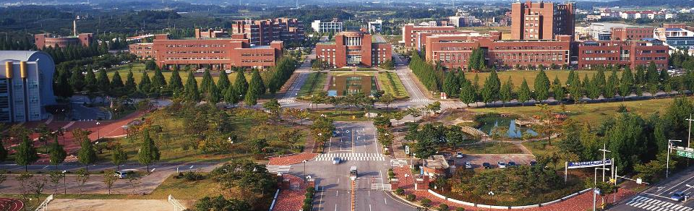
Thank you for your time and attention!
This study was supported by National Research Foundation of Korea funded by the Ministry of Science, ICT and Future Planning (NRF-2023R1A2C200616411).
The authors thank Seongbeom Jeon, Sujin Shin, Nguyen Pham Thai Ha, Eunji Lee, and Chaeyeong Park for the experimental support.

